Slide 1
Importance-Weighted Offline Learning Done Right
Authors: Germano Gabbianelli, Gergely Neu, Matteo Papini
Presenter: Tuan Nguyen

Slide 2
Outline
(Online) Contextual Bandits
Offline Contextual Bandits
Importance Weighting (IW) Estimator
Pessimistic Importance Weighting (PIW) Estimator
This paper: Implicit eXploration (IX) and PIW-IX Estimator
Conclusion
Notes:
Review
Introduce offline version
Talk about two solutions from prior work
Then, the proposed solution in this paper.
Conclusion

Slide 3
Online Contextual Bandits
Example: single-round medical treatment
Protocol: For time step $t=1,...,T:$
Receives context $X_{t}\sim ν$
Takes an action $A_{t}∊ 𝒜$
Receives reward $R_{t}= r\left(X_{t},A_{t}\right)+ε_{t}$
Goal:
Online policy $\hat{π}$ that minimizes the
expected cumulative regret
compared against the optimal policy $π^{∗}$
$$X_{t}$$
$$A_{t}$$
$$R_{t}$$
Patient
Agent
Notes:
how much difference in performance of the online poicy pi hat compared to pi star

Slide 4
Contextual Bandits Schematic
Context x
Feedback r
Click
Action a

Slide 5
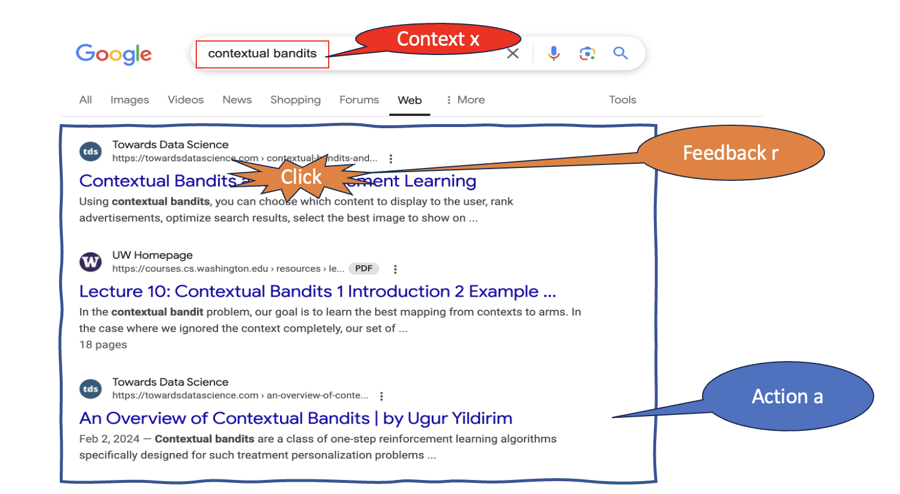
Search Engine
Context x:
Query
Action y:
(Ranking) Articles
Feedback r:
Click or no-click

Slide 6
News Recommendation
Context x:
User profile
Action y:
List of articles
Feedback r:
Reading time in minutes

Slide 7
Online Exploration is Challenging in Practice
News/Products: recommending wrong products are costly, i.e., annoying customers
Healthcare/Medical Treatments: wrong medicine/treatments are harmful to patient, not allowed to do online exploration
Solution?
=> Offline learning with available dataset.

Slide 8
Logging Feedback is More Accessible
Notes:
Logging feedback is more accessible. For example, for recommendation system, we can deploy a current recommendation policy on a system, collect and store all interactions from the system for a week. Then we use the logged feedback to improve the current policy. Repeat that process.

Slide 9
Offline Contextual Bandits
Given a dataset of interactions $𝒟$ $={\left(X_{t}, A_{t}, R_{t}\right)}_{t=1}^{n}$
Given a fixed logging policy 𝜇$\left(a | x\right)= 𝒳→ Δ$(𝒜)
The logging policy can be computed from the given dataset

Slide 10
Offline Contextual Bandits
Assumptions
Contextual distribution and reward function are unknown
All rewards are bounded in [0,1] (e.g., click rates)
All actions are taken by a fixed and known logging policy 𝜇
The set of all possible policies 𝛱 is finite
Notes:
There are several assumptions that we need to take into account.

Slide 11
Offline Contextual Bandit
Offline protocol:
Receives context $X\sim ν$
Takes an action $A∊ 𝒜$
Receives reward $A= r\left(X,A\right)+ε$
Goal:
Target policy ${\hat{π}}_{n}$ that minimizes the expected simple regret
where expected reward of a policy
Notes:
Can anyone make a guess why do we use simple regret instead of cumulative regret?
For online setting, the policy is not updated overtime.

Slide 12
Importance Weighting (IW) Estimator
Goal: find a target policy $π^{∗}$ with largest value $v(π$)
Importance Weighting (IW) estimator for $v(π$)
importance weight
Notes:
cumulative reward weighted by the importance weight,
Importance weight is the ratio between pi and mu

Slide 13
Importance Weighting (IW) Estimator
Derivation: change of policy (distribution)
Importance Weighting (IW) estimator of $v(π$)
Target policy
Logging policy
Importance weight
Notes:
We start with the expected reward weighted by the target policy,

Slide 14
Importance Weighting (IW) Estimator
Importance Weighting (IW) estimator of $v(π$)
From the derivation, IW estimator is unbiased
However, the estimator has high variance and uncertainty
Specifically, it is heavy-tailed – with significant probability, estimated value may be very far from the true value

Slide 15
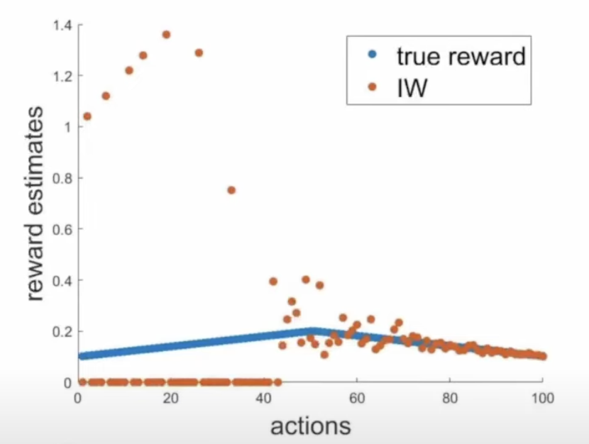
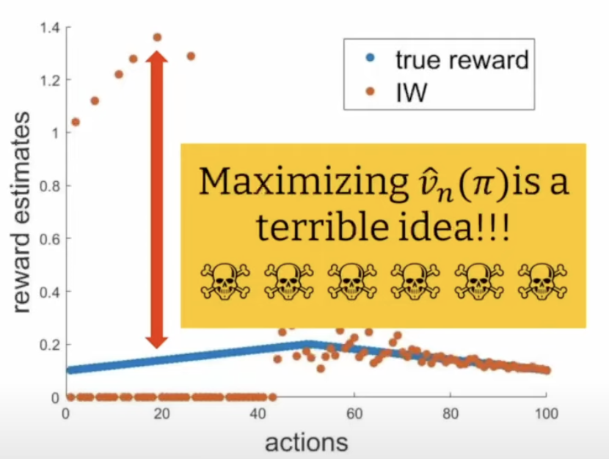
IW Estimator is Heavy-tailed
Experiment
MAB setup: no contexts, A = 100 actions
Logging policy
Low action indexes with low prob, high indexes with high prob.
Reward policy
Low rewards for small and high indexes, and high rewards for middle indexes
Figures from Gergely et al., 2023
Notes:
Blue dots are the true rewards. The red dots are the importance weighted estimator
The actions with low indexes are sampled with low probability. So they are often not sampled and their associated estimates are 0. But when they are sampled the associated estimates get super large.
Based on the setup. Can anyone make a guess what is the optimal policy here?
Can anyone make a guess why this happen?
This does not look a good way to guide offline policy learning.

Slide 16
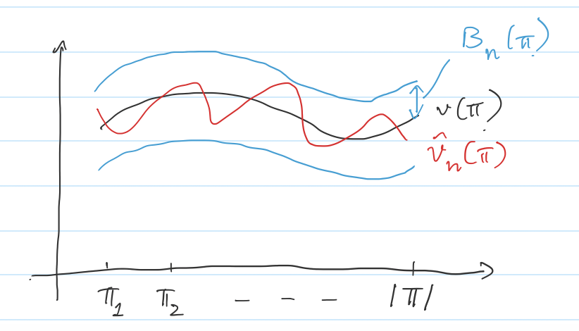
A Remedy: Pessimistic Adjustments
How do we deal these sampling artifacts from the heavy-tail?
We select a policy pessimistically:
where $B_{n}(π$) is a confidence width such that, with high probability
for all 𝜋 ∈ 𝛱,
Notes:
As we can see the estimated value can be very large, so we can not trust if it has high uncertainty.
We should choose a policy more conservatively or pessimistically
The estimator is bounded above and below.

Slide 17
Pessimistic Importance Weighted (PIW) Estimator
Notes:
Simple regret is bounded by the 2 times confidence width

Slide 18
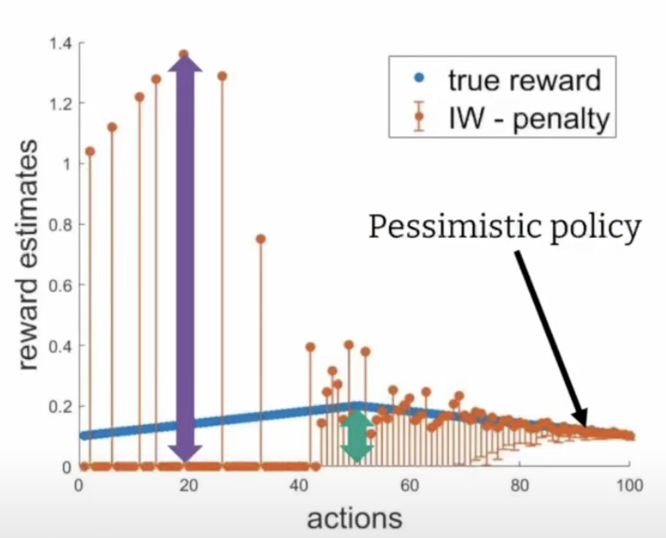
PIW Estimator
Regret bound IW estimator
Regret bound PIW estimator
Figure from Gergely et al., 2023

Slide 19
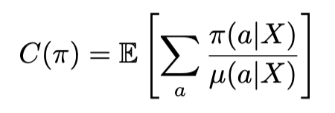
PIW Estimator: Policy Coverage Ratio
Important quantity: the policy coverage ratio
Summation of ratio between 𝜋 and 𝜇 for all actions
Measures the mismatch between 𝜋 and 𝜇
If for one action, 𝜋 want to sample (high probability mass) but 𝜇 rarely sample (low probability mass), then this coverage ratio is high

Slide 20
PIW Estimator: Confidence Width

Slide 21
PIW Estimator: Theorem
Important issue: the second term may blow up to $+∞$ when 𝛼 is very small, $μ(a|x)$ rarely sample an action $a$ for a context $x$.

Slide 22
How to improve?
Asymmetry: upper tail >> lower tail!
Solution: control both tails with two different tools!
Figure from Gergely et al., 2023

Slide 23
Implicit eXploration (IX) Estimator
Idea: use Implicit eXploration (IX) estimator (Neu et al., 2015)
Intuition:
adding 𝛾 help controlling the upper tail.
the estimator is always bounded by some value even $μ\left(a | x\right)=0$, i.e., logging policy does not sample $(a,x)$at all.

Slide 24
Implicit eXploration (IX) Estimator
Important quantity: the smoothed policy coverage ratio
key differences: adding 𝛾 and $r\left(X,a\right)$
Pessimistic bias
Variance is controlled
Notes:
Two nice properties

Slide 25
PIW-IX Estimator: Upper Tail

Slide 26
PIW-IX Estimator: Lower Tail
Notes:

Slide 27
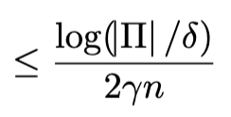
PIW-IX Estimator: Theorem

Slide 28
PIW-IX vs PIW
IW estimator largely overestimate $v\left(π\right)$
PIW estimator largely underestimate $v\left(π\right)$
PIW-IX estimator reasonably underestimate $v\left(π\right)$

Slide 29
Summary
To solve offline contextual bandits, we want to have good estimator
We first use IW estimator
IW estimator is heavy-tail and largely over estimate
We then adjust with pessimistic policy PIWO
PIWO estimator uses one tool for both upper and lower tail – not desirable since the estimator is asymetric
Finally, we use IX estimator who nicely controls both upper and lower tail.

Slide 30
Thank you for listening!
Q & A

