Slide 1
A DISTRIBUTIONAL PERSPECTIVE ON REINFORCEMENT LEARNING
↙
Marc G Bellemare, Will Dabney, and Rémi Munos.
PRESENTED BY: Rethvick Sriram Yugendra Babu

Slide 2
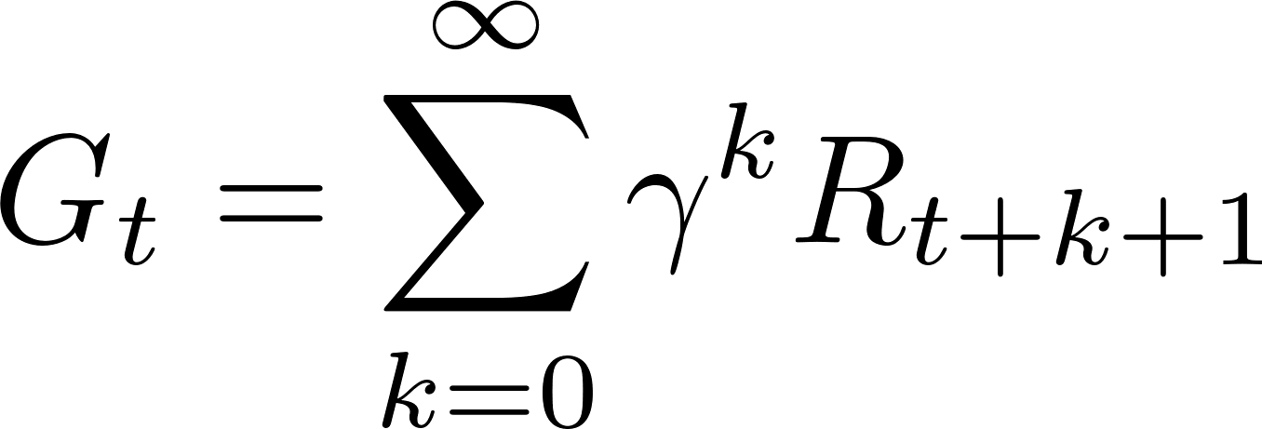
Traditional RL Focus
Expected Returns:
Traditional RL methods focus on the expected return,
V(s) = 𝔼[Gₜ | Sₜ = s]
where Gₜ is the return is the cumulative sum of future rewards
Limitation:
Ignores the variability and risk associated with different outcomes.
May not capture important aspects of the return distribution that affect decision-making.

Slide 3
Return (Gₜ)
Definition:
Gₜ, called the return, represents the total cumulative reward an agent receives starting from time t.
γ: Discount factor (0≤γ<1), controlling how future rewards are valued relative to immediate rewards.
: Reward receives k+1 steps into the future.

Slide 4
Let’s See An Example
Traditional RL

Slide 5
Problem Setup
The Core Problem:
How can we improve RL algorithms to account for the variability and risk in returns?
Key Question:
Can modeling the full distribution of returns provide better insights and lead to more robust learning?
Traditional RL focuses on expected returns, but this ignores variability. How can we address this gap?
Objective:
Develop methods to learn and utilize the entire return distribution in the decision-making process.

Slide 6
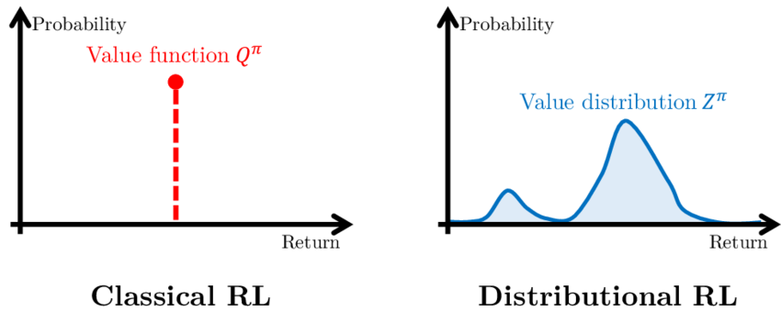
Goal of the Paper
Main Objective:
Model returns as probability distributions instead of single expected values.
Expected Outcome:
Enable more risk-aware decisions and improve learning speed and stability.
Improve learning performance and stability.
Unlike traditional RL, this approach provides richer information about variability.

Slide 7
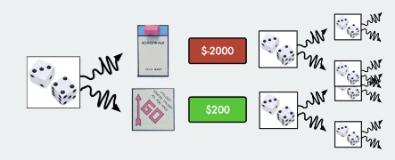
Let’s See An Example
Distributional RL

Slide 8
Motivation
Why Do We Care?
Risk-Awareness: Understanding the variability of returns is crucial in many applications (e.g., finance, healthcare, autonomous vehicles).
Better Exploration: Exploring actions with uncertain but potentially high rewards (like new strategies in games).
Improved Learning Dynamics: Modeling the distribution can lead to more stable and efficient learning processes.

Slide 9
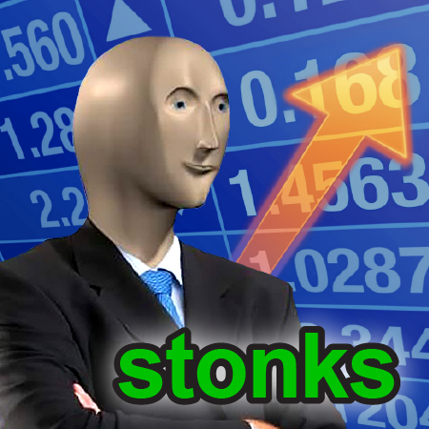
Real-World Example
Stock Trading Agent:
Expected Return Focus: May select strategies with high average returns but also high risk of significant losses.
Distributional Focus: Can identify strategies that offer favorable returns with acceptable levels of risk.
Implication:
While expected return focuses on average outcomes, distributional focus considers both the magnitude and probability of returns.
Modeling the full distribution allows for better risk management and decision-making in volatile markets.

Slide 10
Practical Applications
Finance:
Portfolio optimization by modeling the distribution of returns and risks.
Healthcare:
Personalized treatment planning by considering variability in patient responses.
Autonomous Vehicles:
Improved decision-making by accounting for uncertainties in sensor data.
Robotics:
Enhanced control policies considering the distribution of possible outcomes.

Slide 11
Related Work – Distributional Reinforcement Learning Foundations
Objective: Introduced distributional Bellman equations for policy evaluation.
Mechanism: Developed parametric and nonparametric methods to estimate return distributions.
Limitations: Computational challenges in high-dimensional spaces and sparse rewards.
Morimura, Takuya, Masashi Sugiyama, Hisashi Kashima, Hirotaka Hachiya, and Takeshi Tanaka. "Nonparametric Return Distribution Approximation for Reinforcement Learning." In Proceedings of the 27th International Conference on Machine Learning (ICML-10), pp. 799-806. 2010.

Slide 12
Related Work – Variance-Aware Reinforcement Learning
Objective: Proposed risk-sensitive RL to account for variability in returns.
Mechanism: Incorporated variance into policy optimization, enhancing decision-making under uncertainty.
Limitations: Limited scalability to large-scale environments due to computational overhead.
Tamar, Aviv, Yonatan Glassner, and Shie Mannor. "Policy Gradients with Variance Related Risk Criteria." In Proceedings of the 29th International Conference on Machine Learning (ICML-12), pp. 1651-1658. 2012.

Slide 13
Discounted Markov Decision Process (MDP)
Definition: A Markov Decision Process (MDP) is a framework for modeling decision-making in environments with uncertainty and sequential actions. The discounted version emphasizes immediate rewards more than future rewards.
States (S): Set of all possible states of the environment.
Actions (A): Set of all possible actions an agent can take.
Discount Factor (𝛾): A factor (0≤𝛾<1) that balances the importance of immediate versus future rewards.

Slide 14
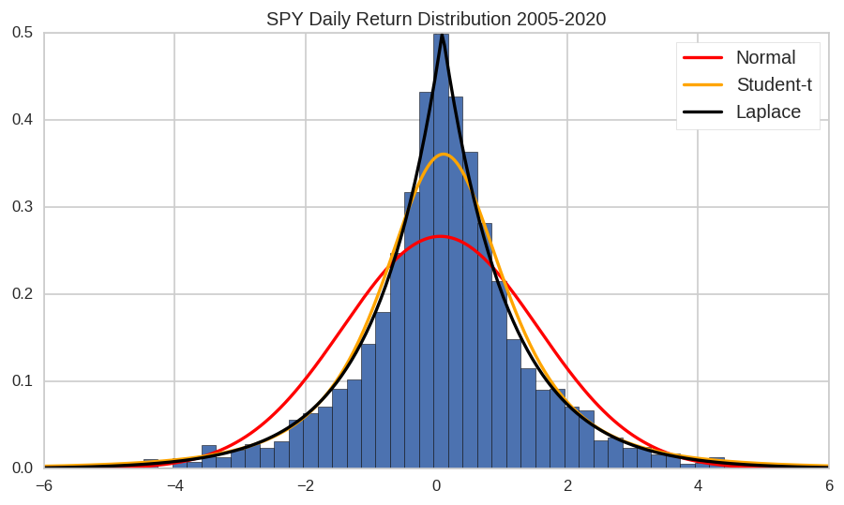
Proposed Approach
Distributional Reinforcement Learning:
Model the return Z (s, a) as a random variable with its own distribution.
The return distribution captures all possible future rewards from a state-action pair.
Traditional RL models expected returns, but this approach provides a richer understanding by considering the entire distribution.
Key Concept:
Learn the distribution over returns for each state-action pair rather than just the expected value.
The approach leverages a distributional Bellman operator to update the return distribution iteratively.

Slide 15
Mathematical Foundation
Here’s the mathematical underpinning of the proposed approach:
Return Distribution Equation:
Z(s, a) ⩵ᵈ R(s, a) + γZ(S', A’)
Z(s, a): Represents the full return distribution, which includes the immediate reward
R(s, a): Represents the immediate reward received after taking action a in state s.
γ: Discount factor, 0 ≤ γ < 1.
S', A': Next state and action, possibly random variables due to stochastic transitions and policies.
⩵ᵈ: Denotes equality in distribution.

Slide 16
The Bellman Equation
Definition: The Bellman equation is a fundamental concept in Reinforcement Learning that describes the relationship between the value of a state and the values of subsequent states.
Value Function:
V(s) = 𝔼[R(s, a) + γV(s’)]
V(s): Value of the current state s.
R(s, a): Immediate reward received by taking action a in state s.
s': Next state resulting from taking action a in state s.
γ: Discount factor (how much future rewards are valued relative to immediate rewards).
Action-Value Function (Q-Function):
Q(s, a) = 𝔼[R(s, a) + γ maxₐ' Q(s', a’)]
Q(s, a): Expected return when taking action a in state s, and then following the optimal policy.

Slide 17
The Bellman Equation
Why is the Bellman Equation Important?
Recursive Relationship:
Breaks down complex problems into simpler sub-problems (dynamic programming).
Policy Optimization:
Provides a foundation for algorithms like Q-learning, Deep Q Networks (DQN), and others.
Transition to Distributional RL:
Traditional Bellman focuses on expected returns, while Distributional Bellman models the entire distribution of returns.

Slide 18
The Distributional Bellman Operator
This operator forms the backbone of the distributional RL approach, enabling the agent to model and update return distributions effectively.
Definition:
𝒯Z(s, a) ⩵ᵈ R(s, a) + γZ(S', A’)
𝒯Z(s, a): Operator applied to the return distribution function.
⩵ᵈ: Represents equality in distribution.
R(s, a): Immediate reward for state-action pair.
γ: Discount factor for future rewards.
Z(S', A'): Return distribution for the next state-action pair.
Properties:
Nonlinear: Unlike the traditional Bellman operator, T operates on distributions.
Contraction Mapping: Under certain conditions, T is a contraction in a suitable metric space.

Slide 19
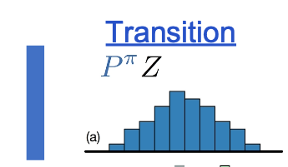
Distributional Bellman Operator With A Deterministic
Reward Function
Next state distribution under policy π
This step represents the transition of the agent to a new state based on the current state and action. The shape of the histogram reflects the probabilities of possible returns (future rewards) from this next state.

Slide 20
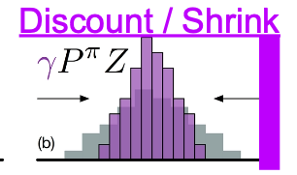
Distributional Bellman Operator With A Deterministic
Reward Function
Discounting shrinks the distribution towards 0
The operator shrinks the distribution towards 0 by multiplying it with the discount factor 𝛾 (where 0≤𝛾≤1). This reduces the magnitude of future rewards, emphasizing the importance of immediate rewards.

Slide 21
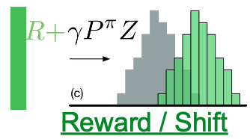
Distributional Bellman Operator With A Deterministic
Reward Function
The reward shifts
The immediate reward R is added to the discounted distribution γP^πZ, shifting the entire distribution to the right. This step incorporates the immediate benefit into the overall return distribution.

Slide 22
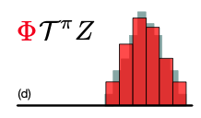
Distributional Bellman Operator With A Deterministic
Reward Function
Projection step
The resulting distribution is projected onto the fixed set of support points used to represent the distribution. This step ensures that the representation remains computationally feasible while retaining the core information of the distribution.

Slide 23
Control in Distributional RL
Learning Optimal Actions:
Control involves refining the distributional value function $Z_{θ}\left(s,a\right)$ guide the agent toward actions that maximize the cumulative rewards. This is achieved by iteratively applying the Distributional Bellman Update.
Improved Stability:
By operating on the entire distribution of returns rather than just expected values, control ensures smoother and more stable learning, especially in environments with high variability or uncertainty.
Better Decision-Making:
Control helps the agent evaluate actions more effectively by considering both the mean return and the variability (e.g., potential high-risk or high-reward scenarios).

Slide 24
Challenges with Distributions
Non-Uniqueness of Distributions:
Different distributions can have the same expected value.
The space of distributions is larger and more complex than the space of expected values.
Measuring Differences:
Need a metric to quantify the distance between distributions.
Solution:
Use probability metrics like the Wasserstein distance to measure differences meaningfully.

Slide 25
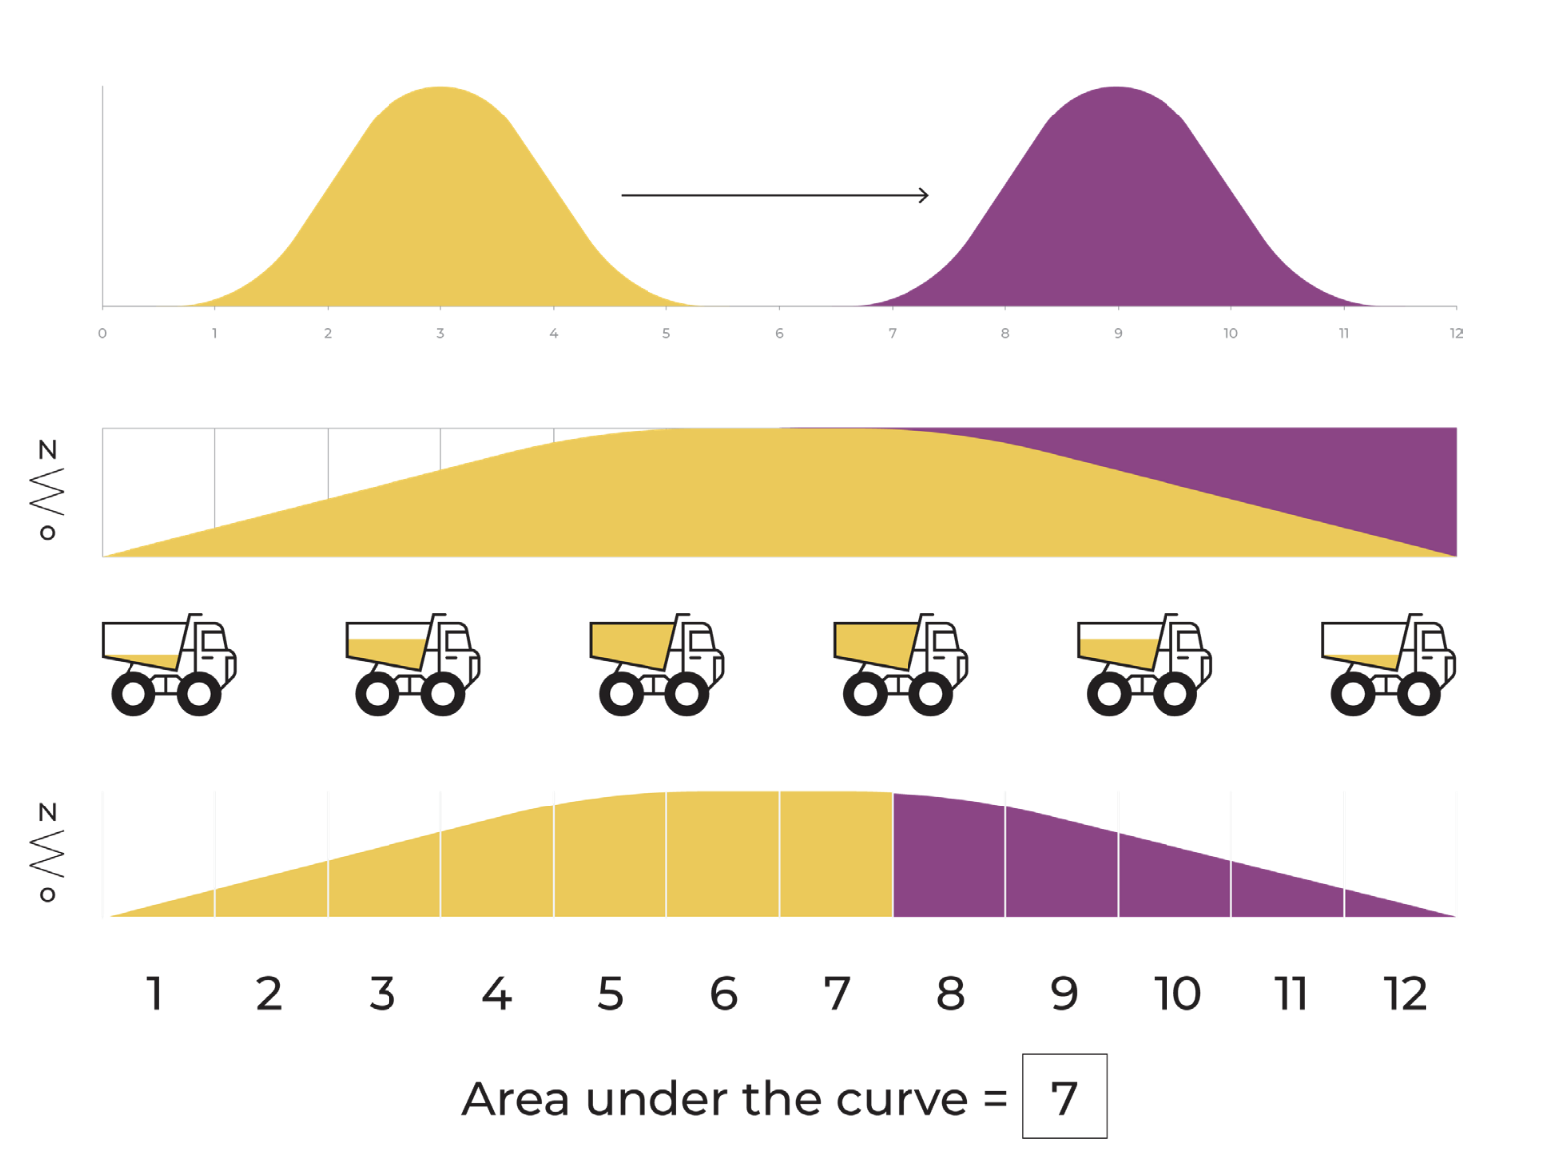
Wasserstein Distance
Definition:
where Γ(μ, ν) is the set of all joint distributions with marginals μ and ν.
It measures the distance between two probability distributions while preserving their structure (e.g., ordering of rewards).
It works well even when the distributions don't overlap, unlike KL-divergence.
It ensures stability in learning by treating the Bellman operator as a contraction, helping the distributions converge efficiently.

Slide 26
Learning with the Wasserstein Metric
Objective:
Minimize the Wasserstein distance between the predicted return distribution $Z_{θ}\left(s,a\right)$ and the target distribution 𝒯$Z_{θ}\left(s,a\right)$.
Learning Update:
Adjust the parameters θ to reduce (reduce the gap between the model's predictions and the desired outcomes.)
Benefits:
Leads to stable and convergent learning algorithms.
Captures the shape and spread of the distribution

Slide 27
Policy in Distributional RL
Action Selection:
The policy is derived from the learned value distribution $Z_{θ}\left(s,a\right)$by choosing the action 𝑎 that aligns with the desired strategy, such as maximizing the expected return or considering risk-aware metrics.
Risk Sensitivity:
Distributional RL allows for balancing risk and reward:
Risk-averse: Prioritize actions with lower variability.
Risk-seeking: Favor actions with higher potential gains despite higher risk.

Slide 28
Policy in Distributional RL
Policy Extraction:
Once the value distributions are updated, the policy is computed using:
This ensures the agent can:
Optimize actions based on a tradeoff between expected return and variability.
Choose strategies that suit the application, whether focused on safety or high performance.

Slide 29
Algorithm Overview
Step 1: Initialization
Initialize the parameters θ of the distributional value function $Z_{θ}\left(s,a\right).$
Step 2: Experience Sampling
Collect transitions (s, a, r , s′) by interacting with the environment or using a replay buffer.
Step 3: Distributional Bellman Update
Compute the target distribution ${\text{𝒯}Z}_{θ}\left(s,a\right)$using the observed reward and next state.
Step 4: Minimization
Update θ by minimizing (reduce the gap between the model's predictions and the desired outcomes.)
Step 5: Policy
The policy is derived by selecting actions that maximize the expected return from the distributional value function $Z_{θ}\left(s,a\right)$.

Slide 30
Categorical Distributional RL (C51)
Approach:
Approximate the return distribution using a fixed categorical distribution with a discrete set of N atoms.
Why ”C51”?
The algorithm uses N = 51 atoms to represent the distribution.
Projection Step:
The target distribution is projected onto the fixed support using a projection operator Φ.
Advantage:
Models return distributions efficiently with minimal computation, enabling scalability to complex environments.
Loss Function:
Minimizes the cross-entropy loss between predicted and target distributions.

Slide 31
Advantages of Distributional RL
Captures Uncertainty:
Provides a complete picture of possible future rewards, including variability and risk.
Improved Performance:
Empirically shown to achieve higher performance in various tasks, particularly in stochastic environments.
Risk-Sensitive Policies:
Enables agents to make decisions aligned with specific risk preferences or constraints.
Enhanced Exploration:
Understanding the distribution can lead to better exploration strategies, avoiding local optima.

Slide 32
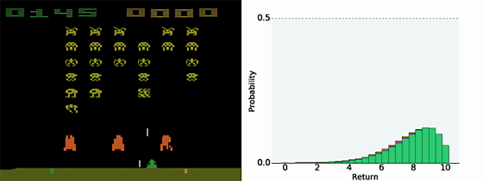
Experimental Setup
Environment:
Atari 2600 Games: A suite of challenging games from the Arcade Learning Environment.
Baseline Comparison:
Compared against traditional DQN and other state-of-the-art methods.
Metrics:
Mean and Median Scores: Evaluated over multiple games to summarize performance across the suite.
Learning Curve: Tracks cumulative rewards to assess learning speed and stability over time.

Slide 33
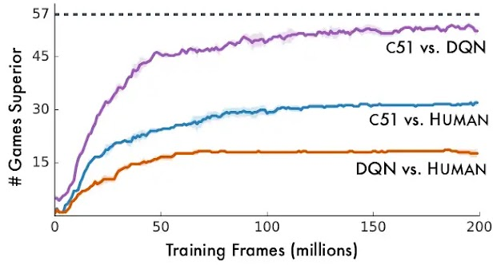
Results – Performance Improvement
Observations:
Distributional RL methods like C51 significantly outperformed DQN on many games.
Notable improvements in games with high reward variability.
C51 showed improvements in almost 85% of games compared to DQN.
Quantitative Results:
Average Score Increases: Some games showed over 100% improvement.
Learning Speed: Faster convergence and more stable learning curves.

Slide 34
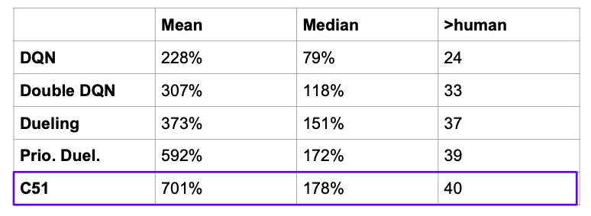
Results – 57 games Atari 2600

Slide 35
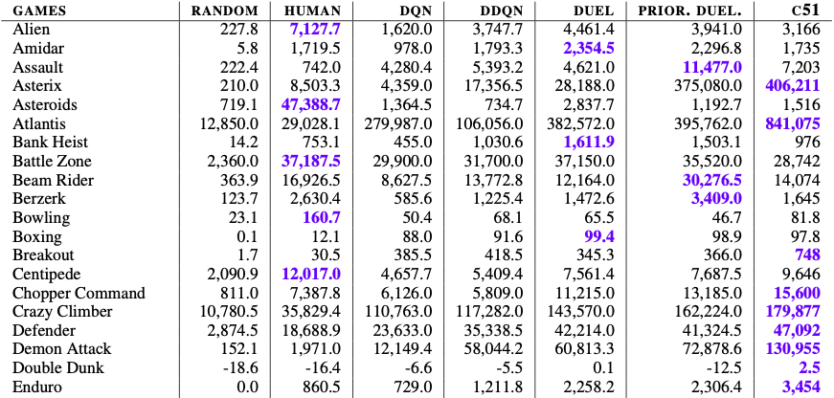
Raw Scores Across All Games, Starting With 30 NO-OP Actions

Slide 36
Limitations of the Paper
Computational Complexity:
Increased computational requirements due to modeling distributions.
Longer training times and higher memory usage.
Approximation Errors:
Discretization in methods like C51 can introduce inaccuracies.
Scalability:
Challenges in scaling to environments with continuous action spaces.

Slide 37
Future Work
Extending to Continuous Actions:
Developing algorithms suitable for environments with continuous action spaces.
Risk-Aware Policies:
Investigating how distributional RL can be used to optimize for risk-sensitive objectives.
Multi-Agent Systems:
Exploring the application of distributional RL in multi-agent environments.
Theoretical Analysis:
Further study of the mathematical properties of distributional operators.

Slide 38
THANK YOU
ANY QUESTIONS?

