Slide 1
A Minimaximalist Approach to Reinforcement Learning from Human Feedback
Gokul Swamy, Christoph Dann, Rahul Kidambi, Zhiwei Steven Wu, Alekh Agarwal
Presented by Chi-Heng Yang
November 1, 2024

Slide 2
Agenda
Introduction
Literature Review
Proposed Method
Experimental Evaluations
Conclusion
Limitations and Future Works

Slide 3
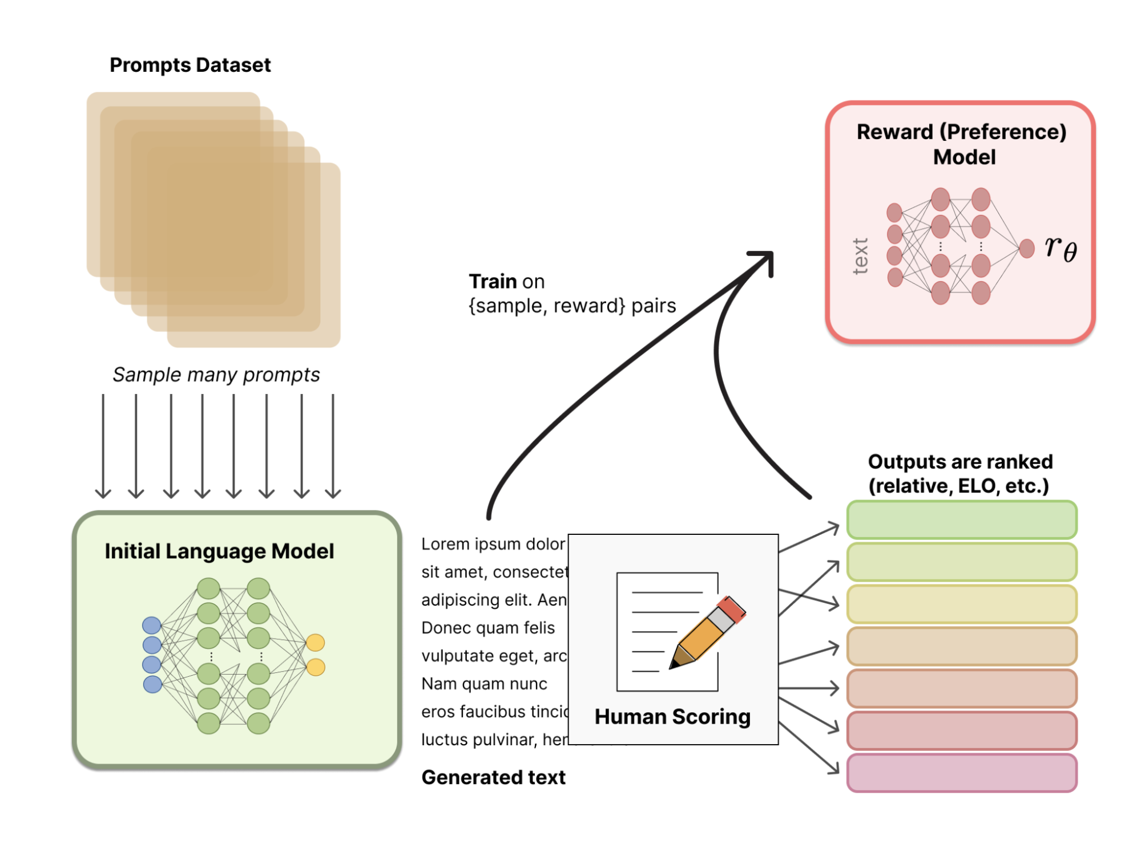
Introduction – Reinforcement Learning from Human Feedback
Reinforcement Learning from Human Feedback (RLHF) optimizes agent behavior based on human feedback rather than predefined reward functions.
Example: ChatGPT fine-tuning
State space: Chat history
Action space: Generated text
Reward: Reward model trained from human scoring
State Transition: Include the newly generated text into chat history
Notes:
Process:
Human raters provide comparative preferences (e.g., preferring one trajectory or outcome over another).
These preferences are aggregated to train a reward model representing human goals.
The reward model is then used to train the RL policy.

Slide 4
Introduction – RLHF Challenges
Several challenges exist in RLHF:
Error Propagation: Reward model errors can accumulate over time.
Preference Noise and Intransitivity: Human feedback can be cyclic or stochastic.
Non-Markovian Feedback: Human feedback can depend on entire trajectory contexts
$$≻$$
A
B
B
$$≻$$
C
C
$$≻$$
A
I want to go somewhere relaxing in Italy.
Italy has many cities, like Rome and Milan.
I meant somewhere quieter, maybe with nature or beaches.
Got it! For a relaxing, nature-focused trip, consider the Amalfi Coast for beautiful beaches or Lake Como for a peaceful lakeside retreat

Slide 5
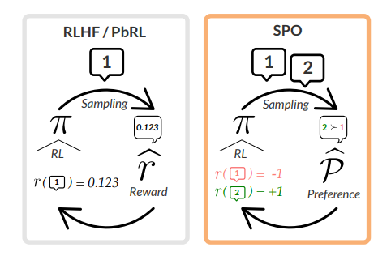
Introduction
This paper propose Self-Play Preference Optimization (SPO)
Use preference instead of reward model ➔ No error propagation
Converge on intransitive preference and non markovian feedback
Tradditional RLHF
Proposed SPO
Preferences
Reward model

Slide 6
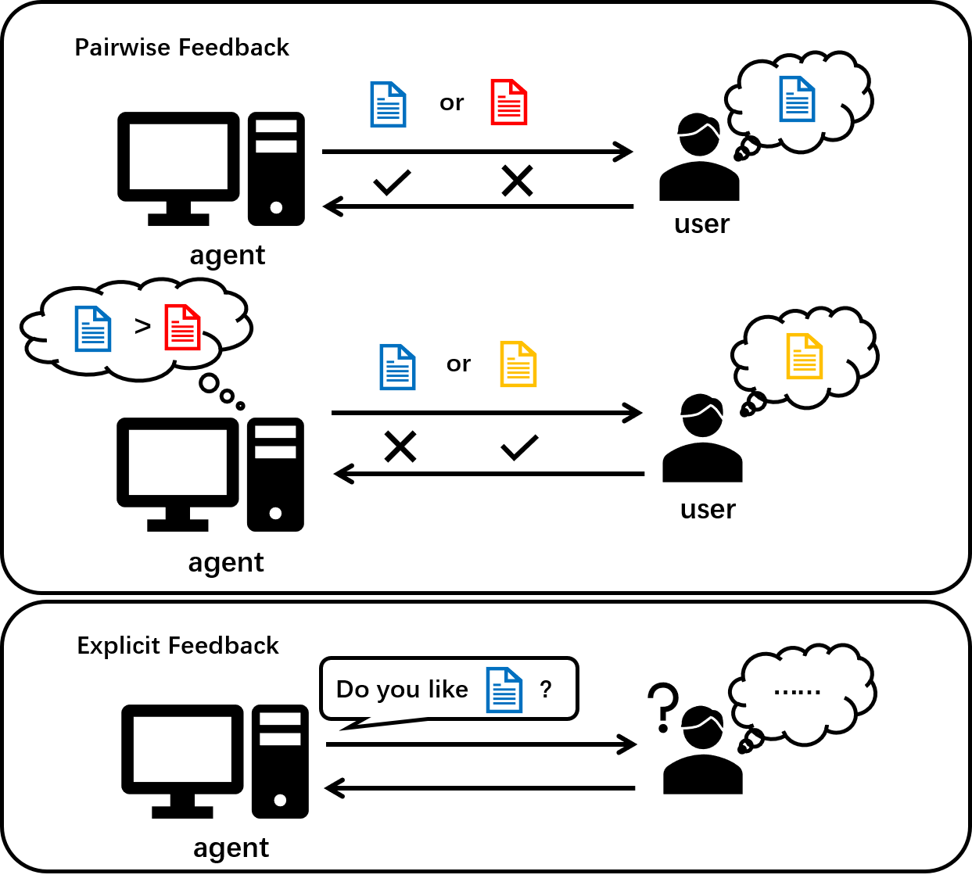
Literature Review – Dueling Bandits and RL
Dueling Bandits: Optimizes based on pairwise comparisons, used in simpler decision-making tasks
Dueling RL: Expands dueling bandits to RL settings, pairing policies to determine preferred actions over long horizons.
Limitations:
Scalability: Effective for simple tasks but challenging to extend to complex RL settings.
Data Inefficiency: Requires extensive feedback to converge on an optimal policy

Slide 7
Literature Review - RLHF without Reward Models

Slide 8
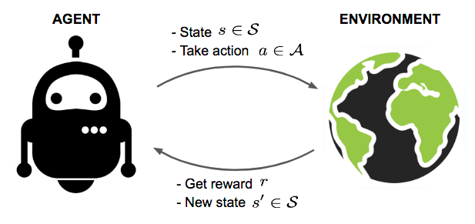
Proposed Method – Problem Setup
Markov Decision Process (MDP) $⟨S,A,T,H⟩$ with finite horizon and reward-free:
$S$: State space
$A$: Action space
$T: S× A→Δ(S)$ : Transition function
$H$: Horizon (number of steps per episode)
Trajectory Space: $Ξ≜{\left(S× A\right)}^{H}$
History Space: $Φ_{h}≜ {\left(S × A\right)}^{h−1} × S$
$h$: the length of history

Slide 9
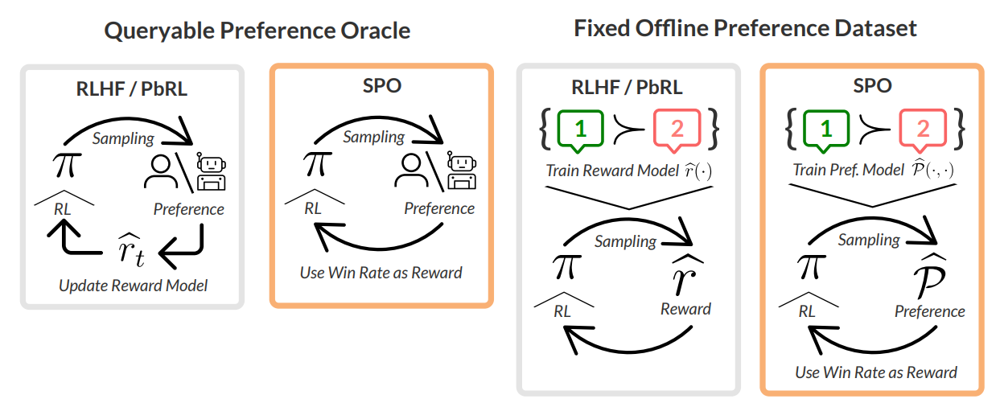
Proposed Method – Problem Setup
Preference Oracle Function
$$P:Ξ×Ξ→ [−1, 1]$$
For trajectories, $ξ_{1}$​, $ξ_{2}∈Ξ×Ξ$​
$$P\left(ξ_{1}, ξ_{2}\right)= 2P(ξ_{1}≻ξ_{2}) −1$$
Anti-symmetric:
$$∀ξ_{1}, ξ_{2} ∈ Ξ×Ξ, P(ξ_{1}, ξ_{2})=−P(ξ_{2} ξ_{1})$$
Work in both online and offline settings
Notes:
Online: SPO no need for going through a reward model
Offline: preference model

Slide 10
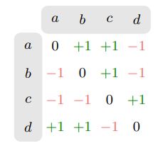
Proposed Method – Social Choice Theory
Who is the winner in a, b, c, and, d?
Intuition: Pick the one that beats the most.
Copeland Winner technique (CW):
where
Winners are often not unique
Item | Beat | # beats
a | b, c | 2
b | c | 1
c | d | 1
d | a, b | 2

Slide 11
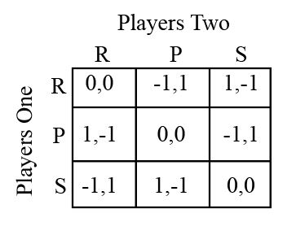
Proposed Method – Social Choice Theory
No model can satisfy
$$r\left(a\right)> r\left(c\right), r\left(c\right)> r\left(d\right), r(d) > r(a)$$
Solution: randomly choose between the two
Equivalent to computing the nash equilibrium of the two-player zero-sum game (2p0s) with payoffs given by the preference function
One player’s gain is exactly the other player’s loss

Slide 12
Proposed Method – Social Choice Theory
Minimax winner:
Properties:
Reward model-free
MW is a strict generalization of the CW
Worst case for $p$(player 1)
Worst case for $q$ (player 2)
Notes:
in the case where there actually does exist an underlying reward function that explains the observed preferences, the MW coincides with the optimal policy for that reward

Slide 13
Proposed Method – One Player is All You Need
Traditional approach of 2p0s: run two no-regret algorithms (adversarial training)
Challenges:
large memory consumption
unstable behavior
This paper argues that they only need a single player due to the anti-symmetry of preference function
Round 1:
Player 1: [0.333, 0.333, 0.333]
Player 2: [0.333, 0.333, 0.333]
Round 2:
Player 1: [0.320, 0.340, 0.340]
Player 2: [0.350, 0.325, 0.325]

Slide 14
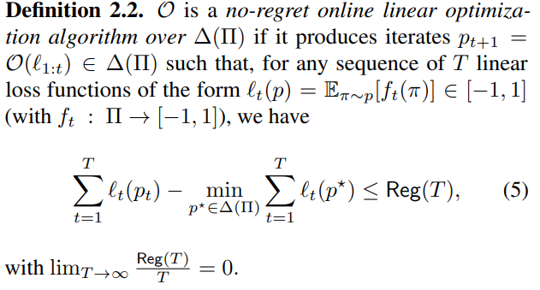
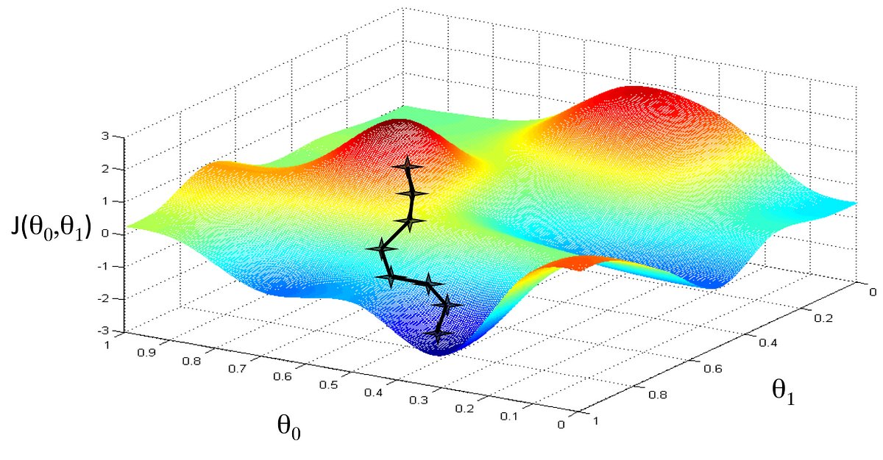
Proposed Method – One Player is All You Need
There always exists a symmetric MW
$$∃\left(\hat{p}, \hat{q}\right)∈ MW\left(P\right)s.t.\hat{p}=\hat{q}$$
We can compute a symmetric MW by running a single no-regret algorithm against its own iterates
Example: Gradient Descent
$Reg\left(T\right)≤O(√T)$

Slide 15
Proposed Method – One Player is All You Need
Consider a single copy of an algorithm $O$,
Initialize $p_{1}∈∆(Π)$and set $p_{t+1} = O(ℓ_{1:t}^{SPO})$
Then, $(p_{1} + . . . + p_{T} )/T$is a $\frac{2Reg\left(T\right)}{T}$-approximate Minimax Winner
Intuition:
Consider a pair of strategies $p,q$
Average strategies $(p_{1} + . . . + p_{T} )/T$converge to a Nash equilibrium (Minimax Winner) at the rate of the underlying no-regret algorithm
If, at some time $τ$ , $p_{τ}$ and $q_{τ}$ have the same strategy and perform updates based on the same loss function, $p_{τ+1}=$ $q_{τ+1}$
If we run our single no regret algorithm for long enough, we can get arbitrarily close to an exact MW
Notes:
The reason this approach works is that a no-regret algorithm ensures that, on average, we don’t perform significantly worse than the best single strategy (in hindsight) over a large number of rounds. By averaging the strategies, we “smooth out” any suboptimal choices made along the way, resulting in a strategy that is robust and close to minimax optimal.
but with a small margin of error defined by 2 Reg(T)T\frac{2 \, \text{Reg}(T)}{T}T

Slide 16
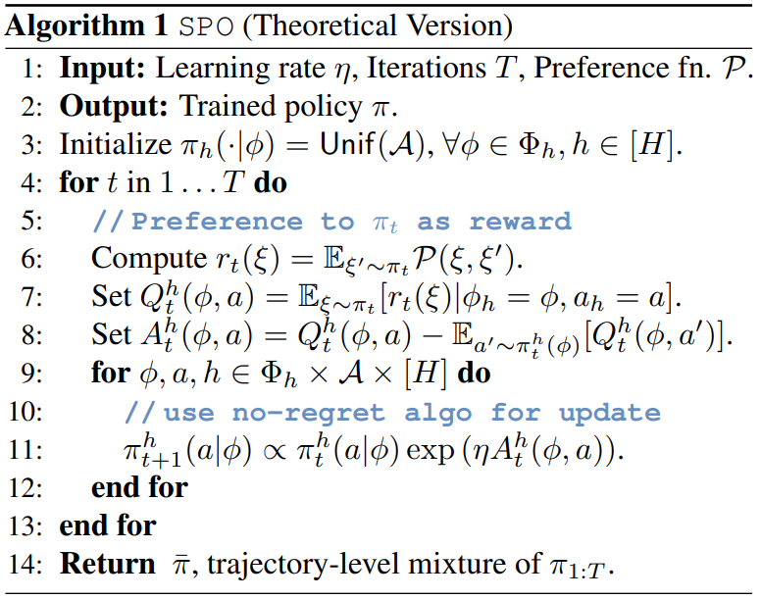
SPO: Self-Play Preference Optimization
What is the right no-regret algorithm to optimize the sequence of SPO losses?
Compute the reward for the trajectory $ξ$
Compute the Q value $Q_{t}^{h}(φ, a)$ under history $φ$ and action $a$
Compute the advantage $A_{t}^{h}(φ, a)$ of an action $a$ under history $φ$
Update the policy based on advantages

Slide 17
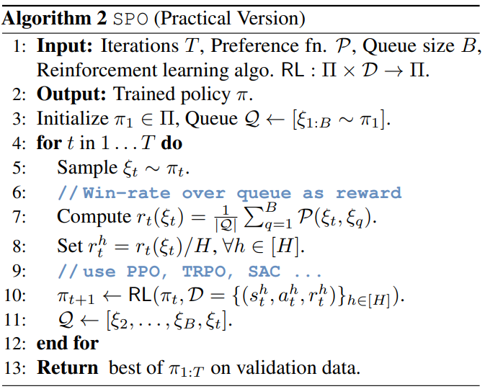
SPO: Self-Play Preference Optimization
In Practice:
Policies are often represented by a deep network rather than tabular format.
How to do credit assignment with trajectory-level feedback?
Solution: split the trajectory-level reward equally amongst all state-action pairs

Slide 18
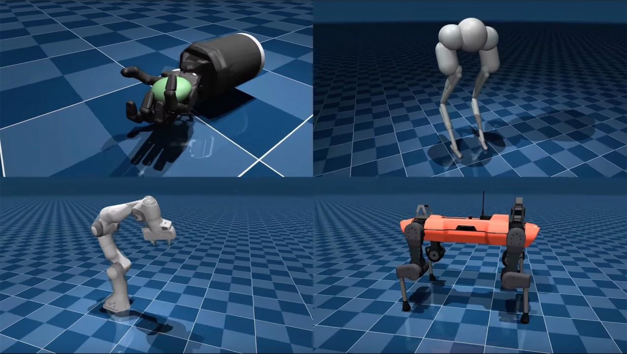
Experimental Evaluation – Overview
Run SPO against reward modeling (RM)
Allow both to query the preference function online
Task: Continuous control tasks from the MuJoCo environments
Evaluation metrics: Accumulated rewards

Slide 19
Experimental Evaluation
Question: Can SPO compute MWs when faced with intransitive preferences?
Setup:
Consider 3 populations, each of which has internally transitive preference over a discrete set of 3 options, but intransitive when combined
Result:
SPO almost exactly computes the MW across a range of sub-population weightings
RM forces a total order over the actions, and the policy typically converges to a corner far from the MW

Slide 20
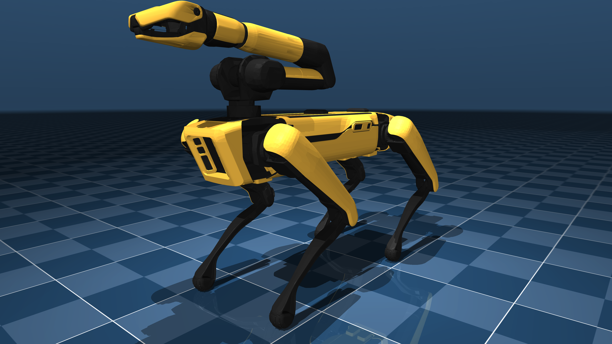
Experimental Evaluation – Environment
Quadruped: four-legged robot (quadruped) learns to perform locomotion tasks, such as walking, running, or balancing
State: quadruped's joint angles, velocities, body orientation, and position.
Action: movement applied to each joint to control limb movement.
Reward: Based on forward velocity and stability, with penalties for instability.
Transition: MuJoCo’s physics engine, simulating realistic physical interactions.

Slide 21
Experimental Evaluation
Question: How sample efficient is SPO on problems with unique Copeland Winners / optimal policies (favors RM)?
Setting: consider tasks where the preferences are determined according to comparisons based on the underlying ground truth reward function
Result: SPO converges fast
Notes:
tasks imply that the agent has learned to run faster or more effectively

Slide 22
Experimental Evaluation
Question: How robust is SPO to stochastic preferences?
Setting: Flip the maximum reward preference $P1(·)$according to i.i.d Bernoulli noise $k$
$$P2(ξ, ξ′ ) = (1 − k)P1(ξ, ξ′ ) + k · P1(ξ ′ , ξ)$$
Result: SPO performs equally or worse than RM

Slide 23
Experimental Evaluation
Question: Can SPO handle Non-Markovian preferences?
Settings: Agent’s total reward in the last quarter of a trajectory is below a threshold $r_{max}⁡$
Result: SPO is consistently able to cross the $4 r_{max}⁡$ threshold that corresponds to exhibiting qualitatively non-Markovian behavior

Slide 24
Conclusion
Propose the SPO that avoids reward modeling, compounding errors, and adversarial training
Use a reduction-based analysis to investigate the convergence properties of SPO
Demonstrate that on continuous control tasks with realistic preference functions, SPO is more performant than reward-model based approaches.

Slide 25
Limitations and Future work
Limitations:
The current SPO does not properly handle noisy preference
Depend on frequent oracle queries
Future work:
Develope an iterative preference model to capture and generalize noisy or stochastic preferences could improve SPO’s robustness
Develop batch query mechanism to reduce the frequency for orcle queries
Apply SPO to fine-tuning generative models with AI feedback from large models
Notes:
whether learning an iterative preference model helps close this gap
We do not explore the contextual setting in our experiments and leave a thorough study of approximations of the above update that scale to modern-day generative modeling applications to future work

Slide 26
Thank you for your attention
Questions and Discussions

