Slide 1
Reward Centering
Abhishek Naik, Yi Wan, Manan Tomar, Richard S. Sutton
In RLJ/RLC 2024
CSC 696H Presentation by Chenyi Wang

Slide 2
Outline
Introduction - Context
What is ‘Reward Centering’? Why ‘Reward Centering’ helps?
How to do ‘Reward Centering’? Two examples:
Temporal-Difference Learning
Q-Learning
Limitations

Slide 3
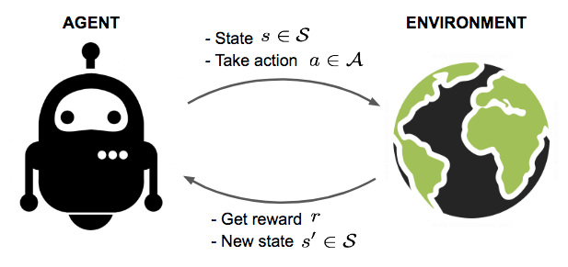
Setups
Continuing Reinforcement Learning (CRL):
An RL problem is an instance of CRL if the best agents never stop learning. - Abel et al. 2023 [2]
Q: Examples?

Slide 4
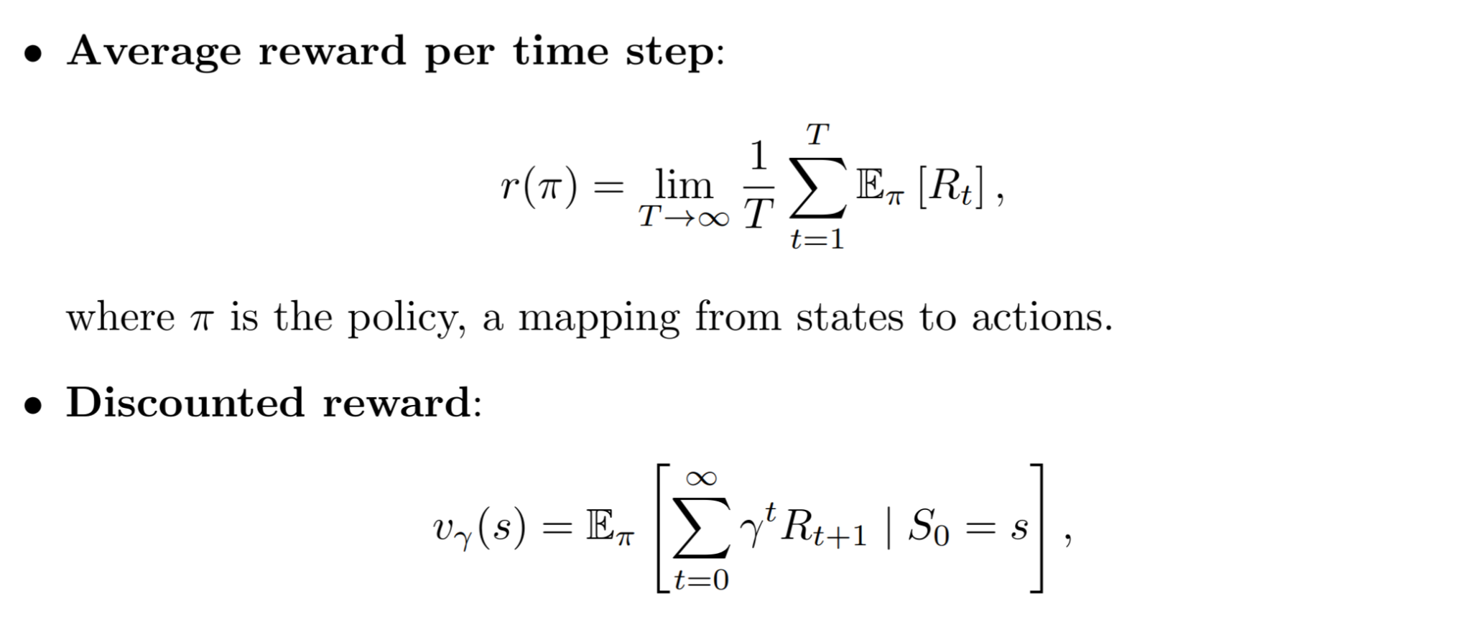
Setups
Q: What values should gamma take? How to interpret?
Notes:
Gamma is not part of the problem but an algorithm parameter

Slide 5
Goal
Maximize:
Laurent-series decomposition:
Average Reward
where
Q: Any insights?
Centered discounted value
Notes:
Gamma is not part of the problem but an algorithm parameter. Change t=0 to t=1 in the centered discounted value makes it the differential value

Slide 6
Proof of the decomposition

Slide 7
Motivation

Slide 8
So, what is ‘Reward Centering’?
The information within the discounted value function is captured through
(1) the constant average reward, and
(2) the centered discounted value function
Benefits? Stable and tractable.
What else?
What can be the potential hurdles?
Notes:
As gamma -> 1 the discounted values tend to explode but the centered discounted values remain small and stable. Change of discount factor becomes efficient.

Slide 9
How can we know the average reward?
First idea - maintain a running average of the rewards observed so far:
The estimate can be updated with a step-size parameter:
This ‘simple centering’ can be used with almost any RL algorithm. We will see an example now.

Slide 10
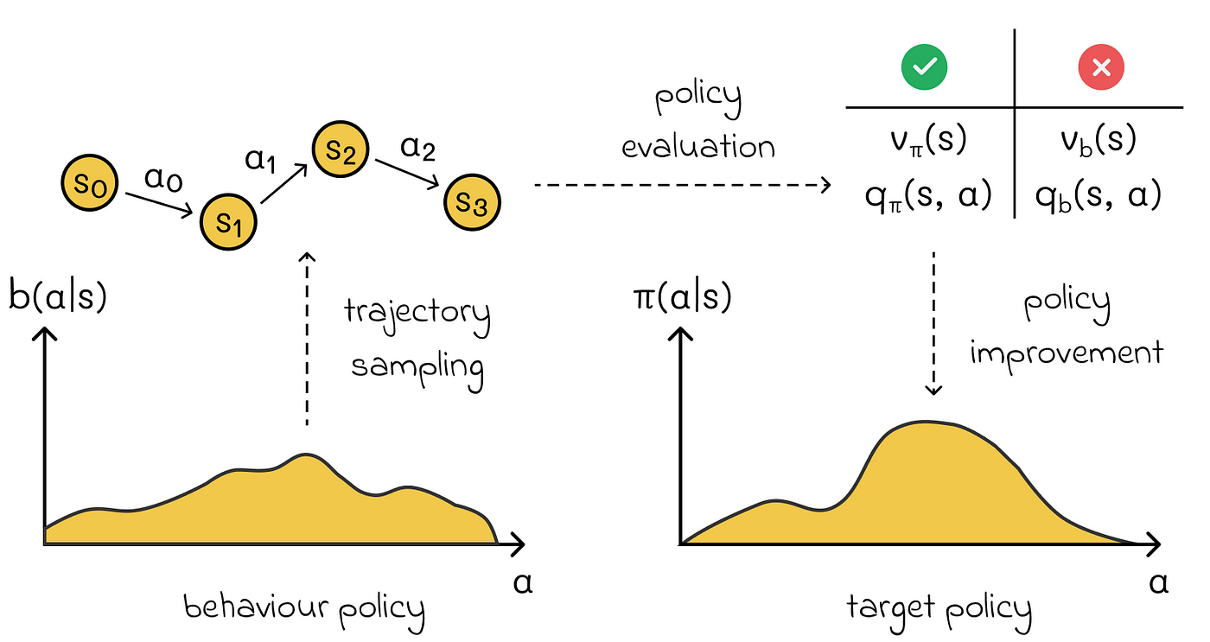
Background on TD Learning
What is Temporal Difference (TD) Learning?
Combines ideas from Monte Carlo methods and dynamic programming, for policy evaluation.
Used to estimate the state-value function , which represents the expected cumulative reward starting from a given state s, following a policy 𝜋.
Image credit: https://towardsdatascience.com/reinforcement-learning-part-3-monte-carlo-methods-7ce2828a1fdb
Notes:
Sample-efficient compared to Monte Carlo methods because it updates the value estimates after every time step.
Suitable for tasks where episodes are long or never-ending.
Does not require a complete model of the environment, unlike dynamic programming.

Slide 11
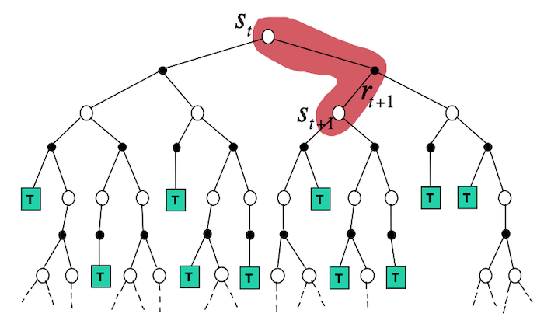
Background on TD Learning
Key Features of TD Learning:
Incremental update: updates the value of a state based on a one-step lookahead, making it more sample-efficient than Monte Carlo methods.
Uses the temporal-difference error:
Update incrementally:
On-Policy (by default): Typically evaluates a specific policy 𝜋, meaning it updates based on the actions taken by the same policy.
Bootstrapping: Combines observed rewards and the value estimate of the next state, which allows updates without waiting for the end of an episode.
Notes:
Sample-efficient compared to Monte Carlo methods because it updates the value estimates after every time step.
Suitable for tasks where episodes are long or never-ending.
Does not require a complete model of the environment, unlike dynamic programming.

Slide 12
Background on Q-Learning
Learns the action-value function Q(s,a), which estimates the expected cumulative reward for taking action a in state s and then following the optimal policy thereafter.
Bellman Equation for Q-Learning
Off-policy method, meaning it learns the optimal policy independent of the behavior policy used during training.
Key Features of Q-Learning:
Update rule for Q-Learning:
where d is the greedy estimate for the next state’s value .
Q: What is the advantage of Q-Learning?
Notes:
Can learn the optimal policy without requiring a model of the environment.
Robust to exploration strategies since it separates the policy used for learning from the policy being optimized.

Slide 13
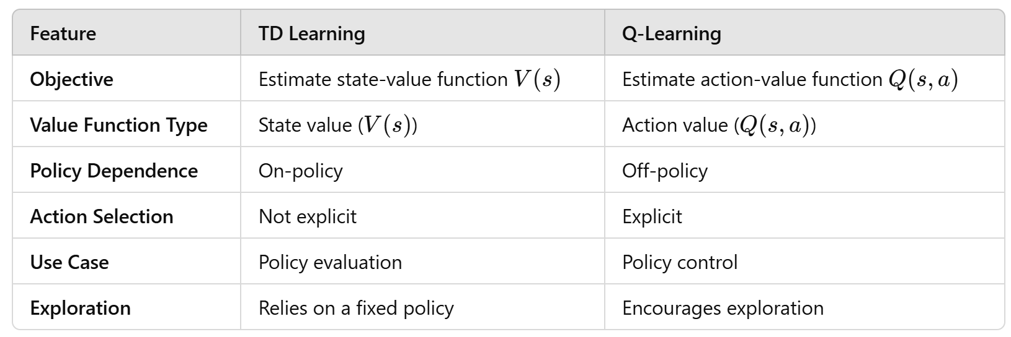
Comparison between TD-Learning and Q-Learning
Notes:
In essence, TD learning focuses on evaluating a policy (what is the value of being in a state), while Q-learning focuses on finding an optimal policy (what is the value of taking an action in a state).

Slide 14
Example 1: Temporal-Difference (TD) Learning
Recall the idea of TD-Learning:
Apply reward centering upon transition from t to t+1:
Notes:
https://www.lancaster.ac.uk/stor-i-student-sites/jordan-j-hood/2021/04/12/reinforcement-learning-temporal-difference-td-learning/

Slide 15
Example 1: Temporal-Difference (TD) Learning
Four methods for estimating the mean reward:
No reward centering
Oracle centering
Simple centering (running average)
Value-based reward centering (to be introduced later).
Notes:
https://www.lancaster.ac.uk/stor-i-student-sites/jordan-j-hood/2021/04/12/reinforcement-learning-temporal-difference-td-learning/
One algorithm used R¯ t = 0, ∀t, and thus involves no reward centering. The second algorithm used the best possible estimate of the average reward: R¯ t = r(π), ∀t; we call this oracle centering. The third algorithm used simple reward centering as in (4). The fourth algorithm used a more sophisticated kind of reward centering which we discuss in the next section.

Slide 16
TD-Learning Experiment Setup: A Simple MDP
Experiment Configuration:
Each parameter (step size) setting was tested over 50,000 time steps.
Experiments were repeated 50 times for statistical reliability.
Performance Metric:
The Root-Mean-Squared Value Error (RMSVE) was used to measure performance at time t.
For centered algorithms, RMSVE was calculated between (estimated value) and (true value).
For algorithms without centering, RMSVE compared with .
Training Period:
No separate training and testing phases; performance was measured continuously during learning.

Slide 17
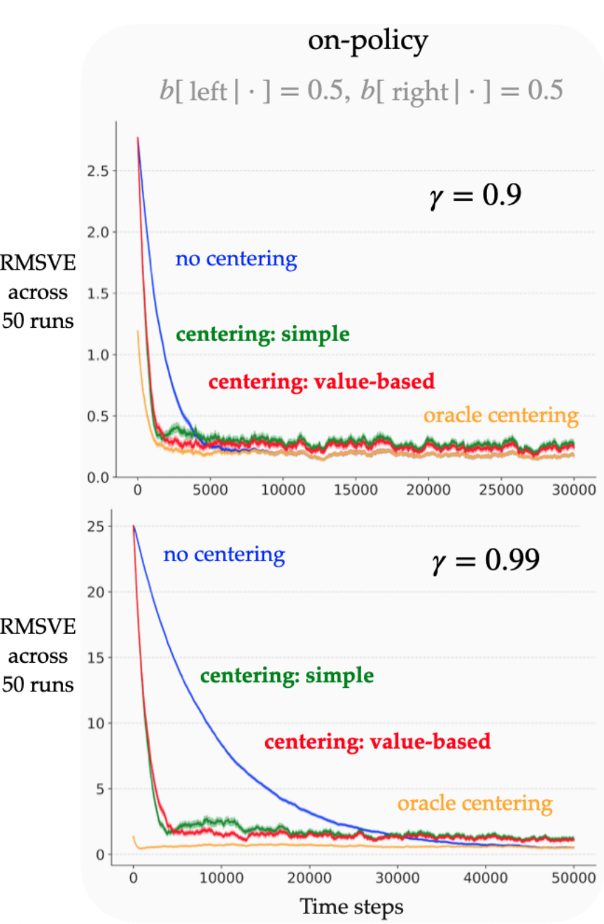
Results
Notes:
First note that the learning curves start much lower when the rewards are centered by an oracle; for the other algorithms, the first error is of the order r(π)/(1 − γ). TD-learning without centering (blue) eventually reached the same error rate as the oracle-centered algorithm (orange), as expected. Learning the average reward and subtracting it (green) indeed helps reduce the RMSVE much faster compared to when there is no centering. However, the eventual error rate is slightly higher, which is expected because the average-reward estimate is changing over time, leading to more variance in the updates compared to the uncentered or oracle-centered version. Similar trends hold for the larger discount factor (lower left), with the uncentered approach appearing much slower in comparison (note the difference in axes’ scales). In both cases, we verified that the average-reward estimate across the runs was around 0.25. These experiments show that the simple reward-centering technique can be quite effective in the on-policy setting, and the effect is more pronounced for larger discount factors.

Slide 18
TD-Learning in Off-Policy Setting

Slide 19
Limitations in the off-policy setting
converges to r(b) not r(𝜋). Adding the importance-sampling ratio to the update is not enough to
guarantee convergence to r(𝜋) - it only corrects the mismatch in action distributions, not the mismatch in the resulting state distributions.
Effect of inaccurate average reward estimates:
The family of solution can be written in
Problem with this?
Notes:
However, note that an inaccurate estimation of the average reward is not a deal-breaker: standard algorithms that do not center the rewards can be perceived as using a fixed inaccurate estimate of the average reward (zero), yet they are guaranteed to converge to the true values of the target policy in the tabular case. So the issue is less about convergence and more about the rate of learning. Estimating the average reward accurately may yield better sample-complexity bounds when using standard methods than simply estimating the uncentered values (e.g., the bounds for Q-learning involve powers of 1/(1 −

Slide 20
Value-based Reward Centering
Recall that a simple reward update
Instead of using the conventional error, use temporal difference (TD) error leads to an unbiased estimates of the reward rate in tabular off-policy setting (Wan et al 2021).
is the importance-sampling ratio.
Notes:
. Since this centering approach involves values in addition to the reward, we call it value-based centering. Unlike with simple centering, the convergence of the average-reward estimate and the value estimates is now interdependent.

Slide 21
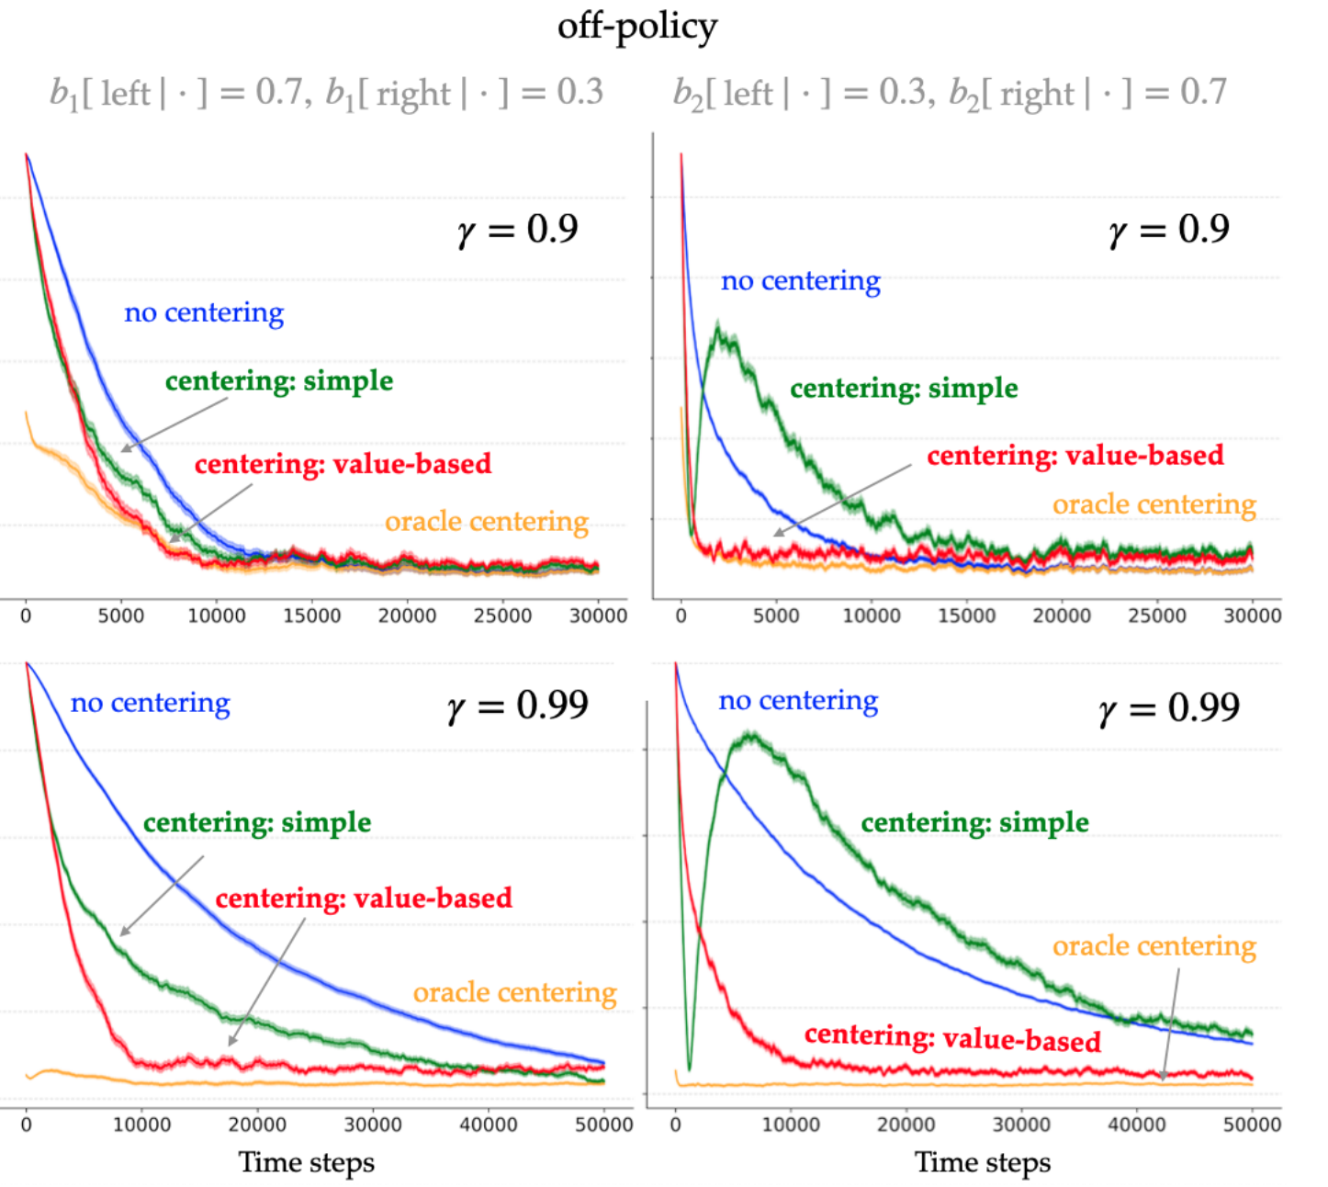
Results
Notes:
Corresponding to b1, we saw that value-based centering resulted in a lower RMSVE faster than simple centering for both values of γ, and the final error rate was roughly the same. As expected, the simple approach estimated the average reward incorrectly and hence the learned values were relatively larger than with value-based centering (but not as large as when there was no centering). The results with b2 were more interesting. The RMSVE reduced rapidly at first with simple centering, then rose sharply, and then reduced again. This is because the average-reward estimate was initialized to zero and it converged to around 0.5 (because b2 skews the agent’s state distribution towards the more-rewarding right side). When the estimate passed the true value of 0.25, the RMSVE was quite low, however, the estimate quickly climbed to 0.5, resulting in the peak in RMSVE. Eventually the value estimates settled to values corresponding to an average-reward estimate of around 0.5. In contrast, the average-reward estimate was much closer to the true value when using value-based centering, resulting in a smoother learning curve. The effects were amplified with the larger discount factor

Slide 22
Example 2: Q-Learning

Slide 23
Example 2: Q-Learning

Slide 24
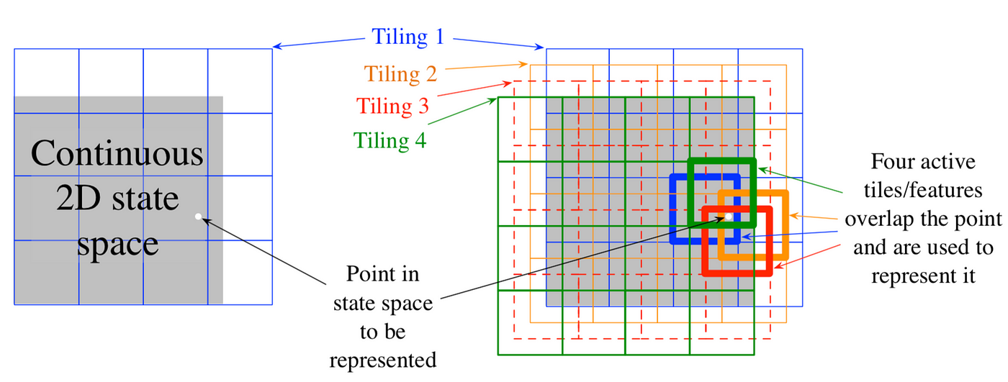
Tile-Coding

Slide 25
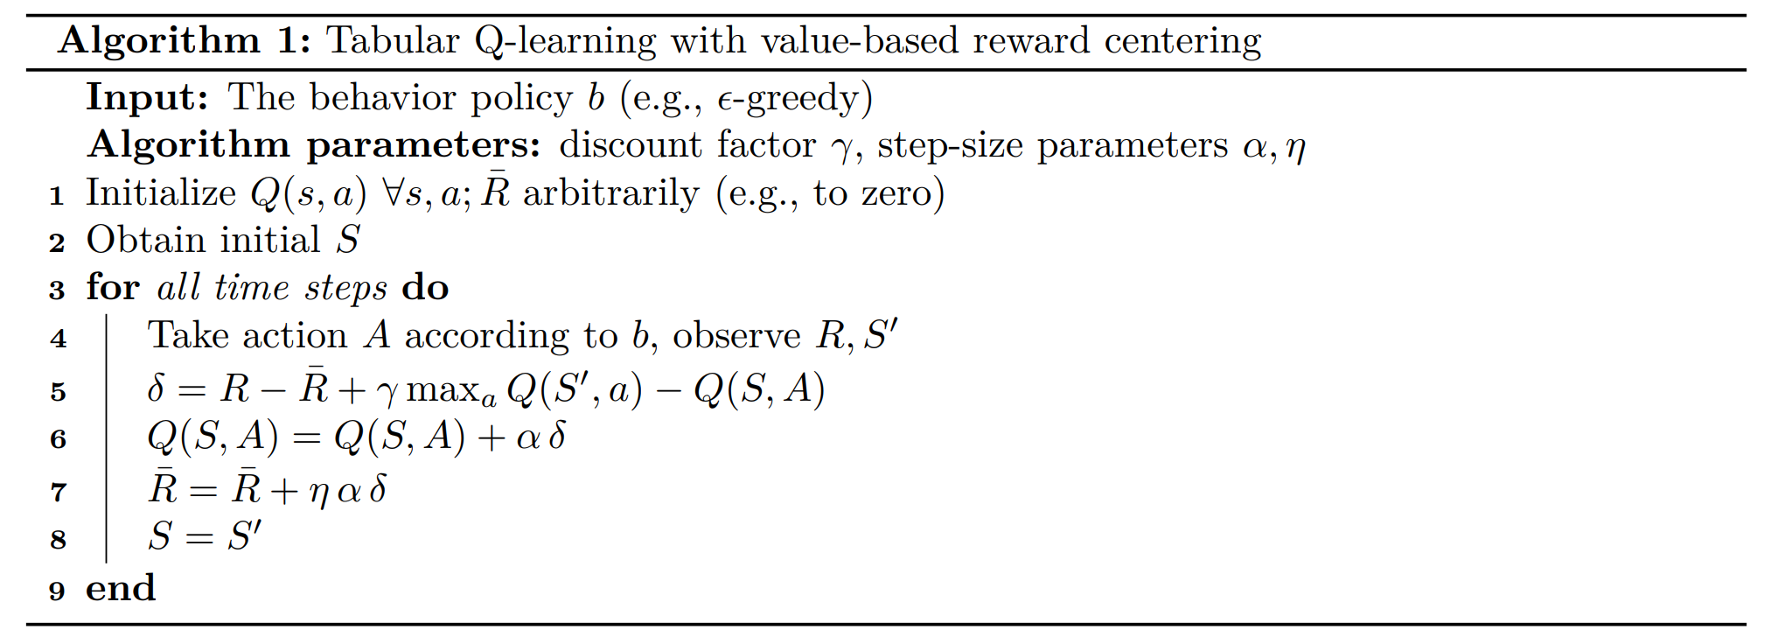
Example 2: Q-Learning

Slide 26
Example 2: Q-Learning
Recall Bellman Equation for Q-Learning

Slide 27
Setup
Problem Overview:
The agent manages the access of incoming jobs to a set of servers in a continuing task.
Jobs arrive at the front of the queue with one of four priorities: {1, 2, 4, 8}.
Each priority is equally likely, arriving with equal probability.
Agent's Decision:
Accept the job: The job is assigned to a free server; The agent receives a reward proportional to the job’s priority.
Reject the job: The job is removed from the queue, and the agent receives zero reward.
System Dynamics: Servers become free with a certain probability at each time step.
The agent can observe:
The number of free servers available.
The priority of the job at the front of the queue.
Objective:
Maximize the cumulative reward by effectively balancing job acceptance based on server availability and job priority.
8
2
4
4
Front of queue

Slide 28
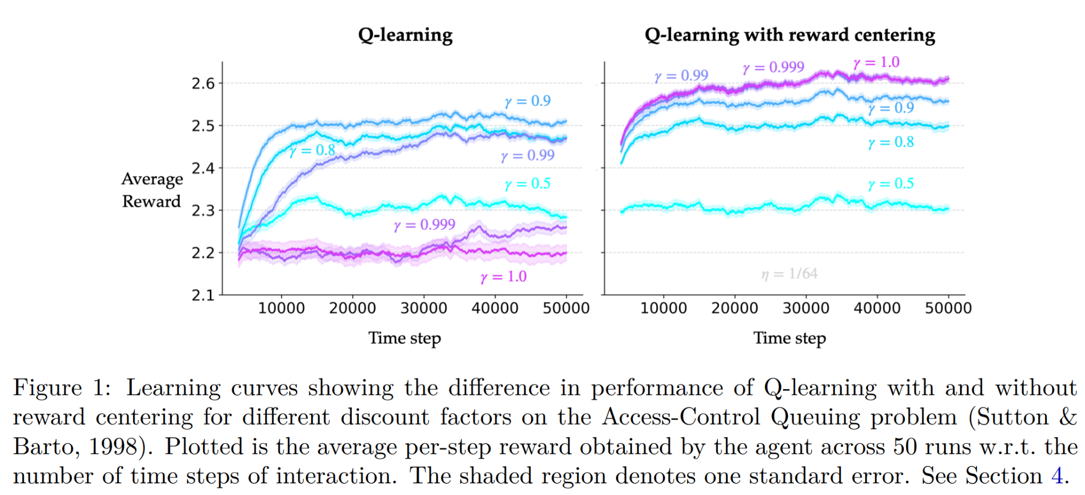
Results
Notes:
g. For Q-learning, the curves correspond to the step-size parameters that resulted in the fastest learning over the training period (quantified by the area under the learning curve). For Q-learning with centering, they correspond to the best step-size parameters for a fixed value of η (shown in grey in the figure); this does not always mean the best (α, η) pair but that is okay since the results were robust to the choice of η. Throughout this section we followed this same practice of picking hyperparameters to plot learning curves. The performance of Q-learning with centering did not degrade when the discount factor was close to one, unlike when there was no centering. For each discount factor, the performance with centering matched or exceeded that of the standard uncentered method. To verify if centering indeed helped remove the potentially large state-independent term, we checked the magnitude of the learned values.

Slide 29
Results
Notes:
g. For Q-learning, the curves correspond to the step-size parameters that resulted in the fastest learning over the training period (quantified by the area under the learning curve). For Q-learning with centering, they correspond to the best step-size parameters for a fixed value of η (shown in grey in the figure); this does not always mean the best (α, η) pair but that is okay since the results were robust to the choice of η. Throughout this section we followed this same practice of picking hyperparameters to plot learning curves. The performance of Q-learning with centering did not degrade when the discount factor was close to one, unlike when there was no centering. For each discount factor, the performance with centering matched or exceeded that of the standard uncentered method. To verify if centering indeed helped remove the potentially large state-independent term, we checked the magnitude of the learned values.

Slide 30
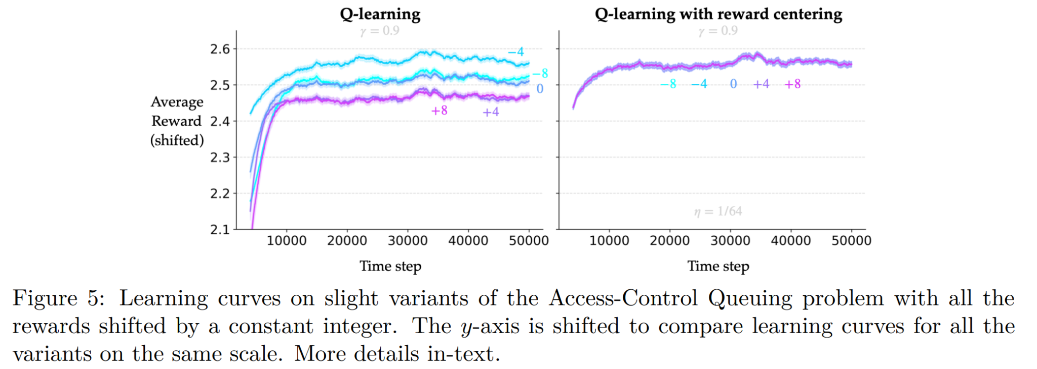
Results
Notes:
g. For Q-learning, the curves correspond to the step-size parameters that resulted in the fastest learning over the training period (quantified by the area under the learning curve). For Q-learning with centering, they correspond to the best step-size parameters for a fixed value of η (shown in grey in the figure); this does not always mean the best (α, η) pair but that is okay since the results were robust to the choice of η. Throughout this section we followed this same practice of picking hyperparameters to plot learning curves. The performance of Q-learning with centering did not degrade when the discount factor was close to one, unlike when there was no centering. For each discount factor, the performance with centering matched or exceeded that of the standard uncentered method. To verify if centering indeed helped remove the potentially large state-independent term, we checked the magnitude of the learned values.

Slide 31
References
[1] Abhishek Naik, Yi Wan, Manan Tomar, Richard S. Sutton. 2024. Reward Centering. (RLC ‘24)
[2] David Abel, André Barreto, Benjamin Van Roy, Doina Precup, Hado van Hasselt, and Satinder Singh. 2024. A definition of continual reinforcement learning. (NIPS '23)
[3] Yi Wan, Abhishek Naik, Richard S. Sutton. 2021. Learning and Planning in Average-Reward Markov Decision Processes. (ICML ‘21)

