Slide 1
Planning and acting in partially observable stochastic domains
Authors: Leslie Pack Kaelbling, Michael L. Littman
Anthony R. Cassandra
By Brandon Hall

Slide 2
Outline (The Plan)
Introduction
Basic MDPs
Partially Observable MDPs
Belief States
Computing belief states
The Agent and the Tiger (Example problem)
Policy Trees
Plan graphs
The Witness Algorithm (If time allows)

Slide 3
Introduction

Slide 4
Navigating Chaos: The Robot's Dilemma
Imagine a robot trying to navigate a busy office building. Its movements are unreliable… it might overshoot a turn or mistake a hallway for a dead end.
Challenges: Sometimes it can’t even trust what it sees! A simple corner could look like a hallway, a T-junction could feel like an L-junction. The robot never gets accurate information about its own state.
Big Question: How can a robot that makes mistakes like these still find its way, even with knowledge of the world?

Slide 5
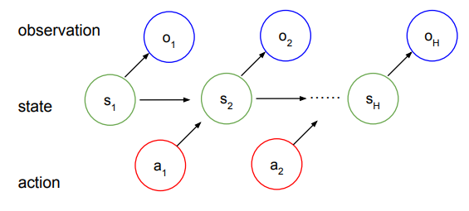
The Solution: Partially Observable MDPs
Our Approach: We model this problem using Partially Observable Markov Decision Processes (POMDPs).
The robot uses past actions and observations to estimate a belief about its location—even if it’s not sure.
It needs to think strategically, choosing between actions that help it gather information and those that move it toward its goal. In general, it will take actions that fulfill both purposes simultaneously.

Slide 6
Innovative Algorithms for Complex Decisions under Uncertainty
What This Paper Brings to the Table:
They extend the basic MDP to formulate a new POMDP Architecture to solve Problems where the agents state is unknown
They introduce a novel algorithm (The witness algorithm) to crack POMDPs and make decisions that adapt to changing environments.

Slide 7
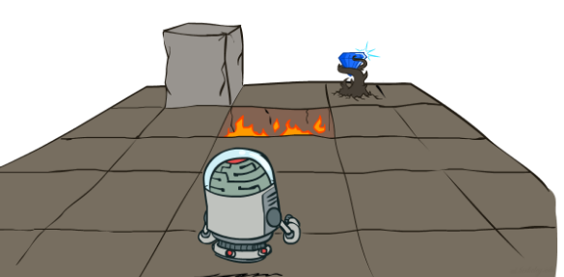
Basic MDPs

Slide 8
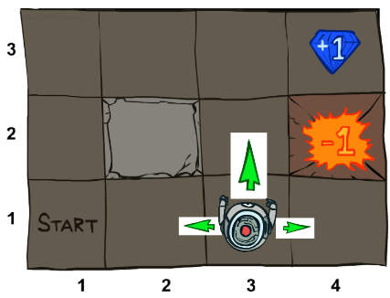
Markov Decision Processes
Although there may be a great deal of uncertainty about the effects of an agent’s actions, there is never any uncertainty about the agent’s current state.
The next state and the expected reward depend only on the previous state and the action taken.
Even if we were to condition on additional previous states, the transition probabilities and the expected rewards would remain the same.

Slide 9
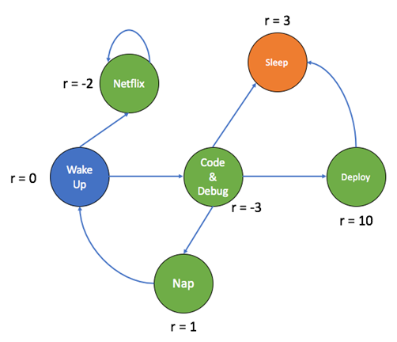
Introduction to Markov Decision Processes (MDPs)
Represented as a tuple <S,A,T,R>.
Components of MDPs:
States (S): A finite set representing different situations or configurations of the world.
Actions (A): A finite set of possible actions the agent can take.
Transition Function (T) [T :S × A → Π(S)]: Probability distribution that describes the likelihood of moving from one state to another given an action.
Reward Function (R) [S × A → R]: Describes the immediate reward gained by performing an action in a specific state.

Slide 10
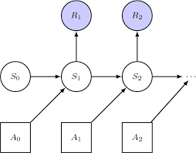
The Markov Property
The Markov Property ensures that:
The future state depends only on the
current state and action, not on the sequence of previous states.
This simplifies decision-making by reducing the amount of information required to predict the next state.
This implies that past actions will not be remembered

Slide 11
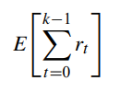
Acting Optimally in MDPs
The goal is to maximize cumulative
reward over time.
Two key models:
Finite-Horizon Model: Maximize rewards over a fixed number of steps.
Infinite-Horizon Discounted Model: Maximize rewards over an infinite lifetime, with future rewards discounted using a factor γ (0 < γ < 1).

Slide 12
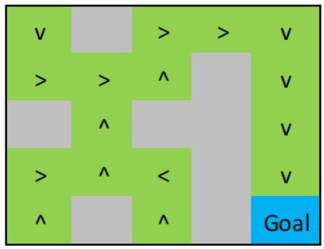
Policies
Policy: Description of the behavior of an agent
Types of policies:
Stationary policy: A state-action mapping specifying the action for each state, independent of the time step.
Non-stationary policy: A time-indexed sequence of state-action mappings.

Slide 13
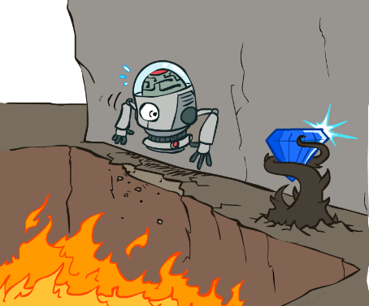
Values functions
Value Function (V_{π}): Measures the expected reward starting from a state and following a specific policy.
The Infinite-Horizon value of being in state s under nonstationary policy :
Immediate Reward: R(s,π(s))
Discounted Future Value: Involves all possible resulting states s′ and their likelihoods T(s,π(s),s′). This is discounted by γ.

Slide 14
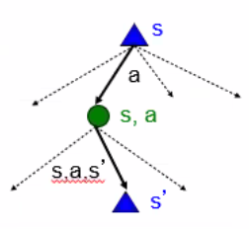
Optimal Policies
Optimal Value Function (V): Measures the expected reward starting from a state and acting optimally.
To derive a policy from V:
Choose the action that maximizes immediate reward plus the expected discounted value of the next state.

Slide 15
Partial observability

Slide 16
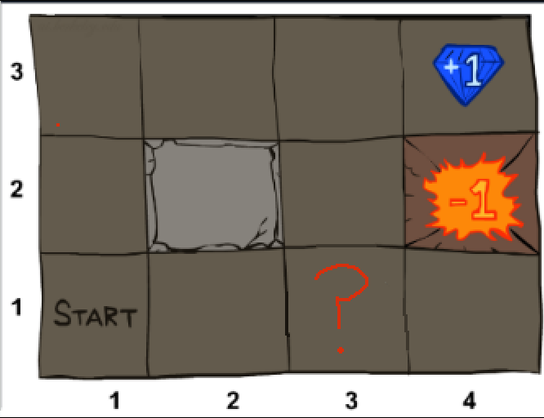
Partial observable Markov Decision Processes (POMDP)
There is still a great deal of uncertainty about the effects of an agent’s actions
There is also a great deal of uncertainty about the agents current state
The next state and the expected reward depend only on the current belief state, the observation, and the action taken.

Slide 17
Partial Observability and POMDPs
Naive Approach: Map the latest observation directly to an action without considering past information. This leads to repetitive actions in similar-looking locations.
Improved Approach: Introduce randomness, where the policy maps observations to a probability distribution over actions. This avoids deterministic loops but is still limited.
POMDP Solution: The agent must use memory of past actions and observations to effectively navigate uncertainty. The POMDP framework formalizes this approach.

Slide 18
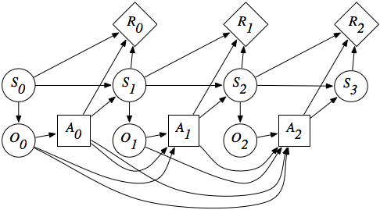
POMDP Framework
POMDPs expand basic MDPs because the decision maker has incomplete information about the true state of the agent or environment. A POMDP is defined by the tuple <S,A,T,R,Ω,O>:
S, A, T, and R: Same as with normal MDPs.
Observations (Ω): A finite set of observations the agent can experience of its world
Observation function (O) [S × A → Π(Ω)]: Gives, for each action and resulting state, a probability distribution over possible observations

Slide 19
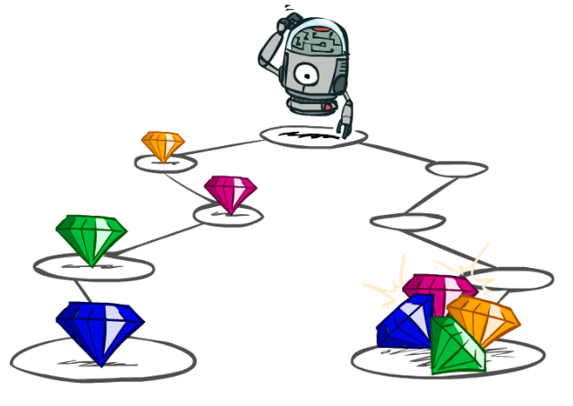
How to act optimally in a POMDP?

Slide 20
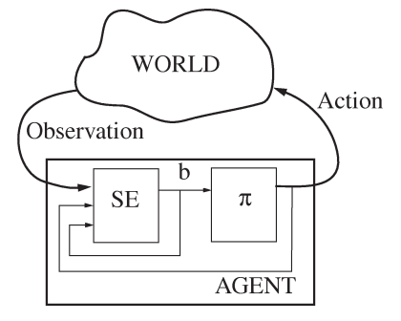
Belief States in POMDPs
POMDP Control: Divided into two components:
State Estimator (SE): Updates the belief state (b) based current observations, and previous belief.
Policy (π): Generates actions based on the belief state rather than the actual world state.
Belief State:
A probability distribution over possible world states, representing the agent's uncertainty.
Belief states summarize past actions and observations, acting as a sufficient statistic for decision-making. Once computed, no further history is required.

Slide 21
Calculating the Belief State in a POMDP
Belief State: A probability distribution b over states S where b(s) is the probability for state s:
Update Rule:
Key:
O(s′,a,o): observation function
T(s,a,s′): state transition function
b(s): Current belief sate
Pr(o∣a,b): Normalizing factor

Slide 22
The agent and the Tiger
(Example Problem)

Slide 23
The Tiger Problem 🐅
An agent is in front of two closed doors. One hides a fearsome tiger, and the other holds a reward waiting to be claimed. But beware! If you open the wrong door, you’ll face a penalty—and it’s not just losing your lunch (probably)!
Agents actions:
LEFT: Open the left door.
RIGHT: Open the right door.
LISTEN: Eavesdrop to gather clues about the tiger’s location (for a small fee).
Rewards & Costs:
🎉 Reward for choosing correctly: +10
🐅 Penalty for the tiger: -100
🥵 Listening cost: -1

Slide 24
World Settings
States:
sl: Tiger behind Door 1 (left).
sr: Tiger behind Door 2 (right).
Actions & Transitions:
LISTEN: No state change.
LEFT/RIGHT: Each has a 50% chance of revealing either state (resetting the scenario while handing out the carrot or the stick).
Observation Outcomes:
In state sl:
TL (hears tiger left): 85% probability.
TR (hears tiger right): 15% probability.
In state sr:
TL: 15% probability.
TR: 85% probability.

Slide 25
Optimal Policies at Time t=1 🐅
At step t=1 (The last action), the agent must make a choice!
How should the agent act?

Slide 26
Optimal Policies at Time t=1 🐅
At step t=1 (The last action), the agent must make a choice!
Key Insights:
High Probability of Tiger on the Left:
Best Action: Open the right door.
High Probability of Tiger on the Right:
Best Action: Open the left door.
If uncertain: The optimal strategy is to listen:
Why? Guessing wrong costs −100, while guessing right gives +10.
Expected reward from opening a door at random is very low:
Expected reward of random guess:

Slide 27
Policy Trees

Slide 28
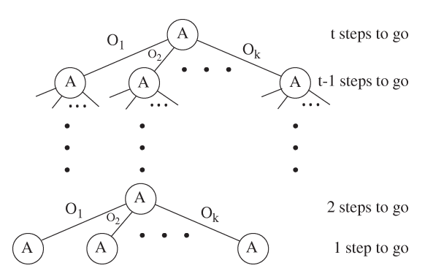
Introduction to Policy Trees
A policy tree represents a nonstationary t-step policy for decision-making in uncertain environments.
Structure:
A tree of depth t where each node is labeled with an action to be taken if reached.
The top node specifies the first action; subsequent actions depend on the observations from previous actions.

Slide 29
Close Up
Functionality:
With 1 step remaining: The agent takes a single action with no resulting observation.
With 2 steps remaining: The agent takes an action, makes an observation, and then takes another action based on that observation.

Slide 30
The Value of a Policy Tree (Mathematical Representation)
For a t-step policy tree p:
γ - Discount factor (Applied to ensure closer rewards are higher priority)
R(s,a(p)) - Reward function for taking action a from state s in policy tree p
This has nothing to do with the belief state built by traversing the policy tree

Slide 31
Expectation from Belief State
Because the agent will never know the exact state of the world, it must be able to determine the value of executing a policy tree p from some belief state b.

Slide 32
Expectation from Belief State
To determine the value from a belief state b:
Each state's value is multiplied by the probability b(s) of being in that state. This weighting reflects how likely it is for the agent to actually be in each state when evaluating the expected outcome of the policy.

Slide 33
Rewardard for Belief?
The agent seems to be rewarded simply for believing it is in favorable states.
However, since the state estimator is based on accurate observation and transition models of the world, the belief state reflects the true occupation probabilities for all states s.
Consequently, the reward function represents the agent’s true expected reward.

Slide 34
The agent and the Tiger
(Revisited)

Slide 35
Optimal Policies at Time t=2-3
When t=2 and t=3:
Action: ?
What action should we take to ensure the optimal policy?

Slide 36
Optimal Policies at Time t=2-3
When t=2 and t=3:
Action: Always LISTEN.
Reason: Opening a door resets belief to (0.5,0.5), leading to another listening action.
Structure: Multiple policy trees with the same root action, resulting in five linear regions of belief states.
Transition to t > 3:
Policies begin to incorporate open door actions for certain belief states.
This implies that you need at least 3 time steps to gain any reward

Slide 37
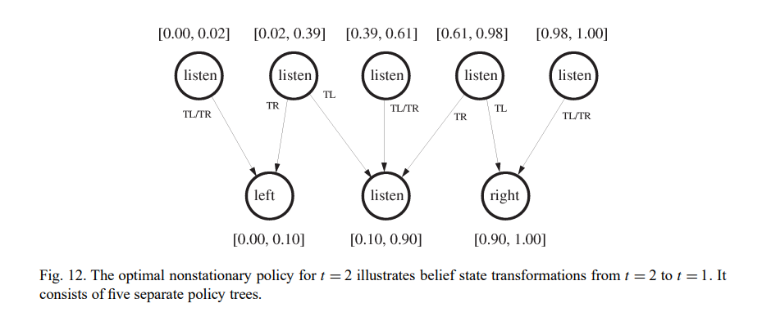
Last Two Steps of the Tiger Problem

Slide 38
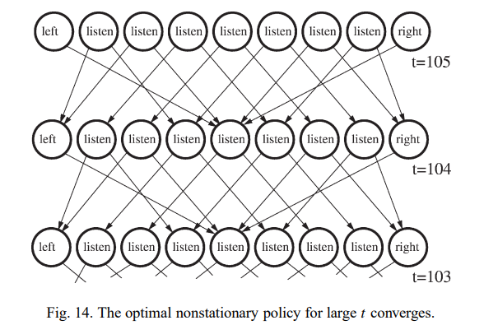
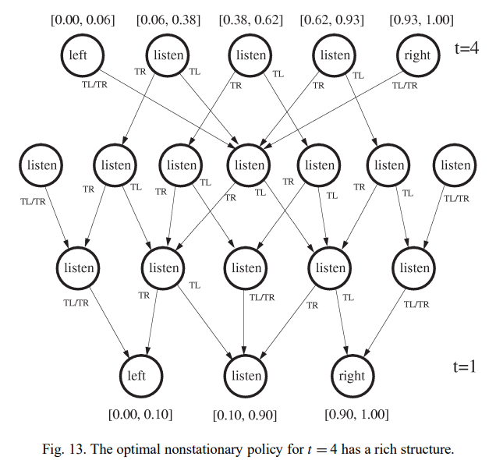
Discounted Finite-Horizon POMDPs
Impact of Discount Factor:
Reward Structure: Future rewards decrease in influence as horizon t increases.
Convergence: Value function converges; optimal situation-action mappings for large t resemble those for t−1.
Observations:
For large t, mappings show negligible differences.
Consistency appears at t=56.

Slide 39
Infinite-Horizon Properties
Optimal Value Function:
Finite Linear Segments: Infinite-horizon value functions can have finitely transient optimal policies.
Observations:
The structure of the graph is exactly the same from one time to the next
This implies that the value of t has little meaning after a certain threshold

Slide 40
Plan Graphs

Slide 41
Plan Graphs Overview 📊
Challenges of POMDPs:
Maintaining a belief state can be computationally expensive, especially with large state spaces.
Introduction to Plan Graphs:
Encode policies in a graph format, allowing action selection without explicit belief state representation.
Key Insight: Convert non-stationary policies into stationary ones by redrawing edges.
Simplified plan graph representation focuses on key actions until the agent gathers sufficient information.

Slide 42
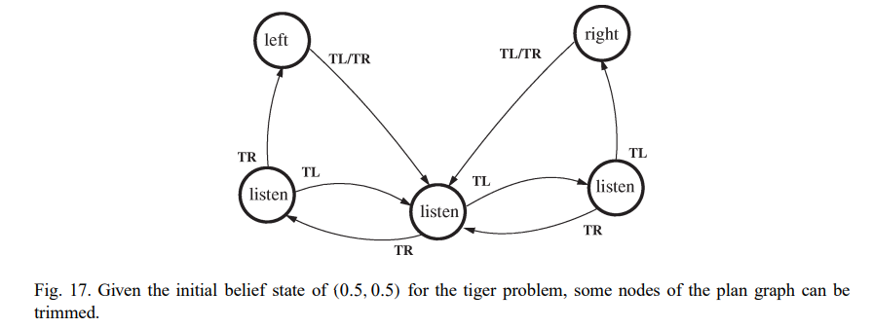
Plan graph of the tiger problem

Slide 43
What if the listen probability was 65% (Instead of 85%)

Slide 44
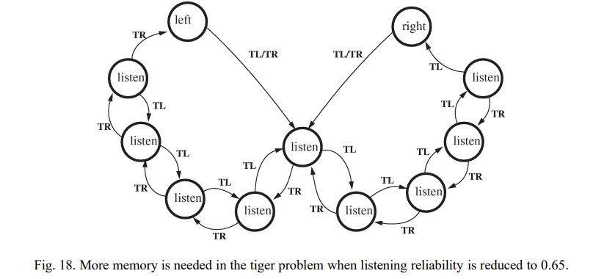
What if the listen probability was 65%

Slide 45
The Witness Algorithm

Slide 46
What is the Witness Algorithm?
The Witness Algorithm computes an optimal policy tree
The algorithm avoids the costly generation of the intermediate set V⁺ (A large superset of policy trees that is exponential in Ω)​ by focusing on the direct construction of V_{t} (The optimal policy tree)
Performs faster in practice over a wide range of problem sizes. (Paper from 1998)

Slide 47
The Witness Algorithm
The witness algorithm refines value functions in POMDPs by building an optimal set of policy trees iteratively.
The algorithm looks for a "witness point," a belief state where the current policy set underestimates the true value.
If a witness point is found, a new policy tree is constructed to better handle that state and is added to the candidate set.
This process repeats until no more witness points are found, signaling that the policy set accurately represents the value function.

Slide 48
How It Works (The Math Behind It)
We can express Qª_{t} (b) as:
(This is the value of taking action a in belief state b and continuing optimally for t − 1 steps)
Since V is the value of the best action, we also have
That is, the optimal t-step value of starting in belief state b is the value of executing the best policy tree in that belief state.

Slide 49
The witness theorem
The true Q-function, Qª_{t} , differs from the approximate Q-function, Qª_{t} , iif there is some p ∈ U_{a}, o ∈ Ω, p’ ∈ V_{t−1} and some b such that
If there is a belief state, b, for which p_{new} is an improvement over all the policy trees we have found so far, then b is a witness.
Conversely, if none of the trees can be improved by replacing a single subtree, there are no witness points.

Slide 50
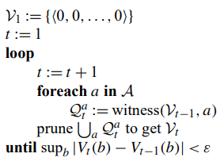
The Algorithm (code)
It computes a set Qª_{t} for each action a, showing the best value for taking that action
We would like to find a minimal set of policy trees for representing Qª_{t} for each a.
All these sets are merged together to get a representation of the optimal strategy.
The merged set is "pruned" to remove unnecessary policy trees, keeping only the best strategies

Slide 51
Witness inner loop
The inner loop aims to accurately estimate the value function for each action by refining a set of policy trees:
Start: Begin with one policy tree that works well for an initial belief state.
Check Accuracy: Look for a belief state, called a witness, where the current estimate of the value function is too low. This indicates the estimate needs improvement.
Update with New Information:
Create a new policy tree tailored to that witness state.
Add this new tree to improve the accuracy of the estimate.
Repeat until there are no more witness states, meaning the estimate is now accurate for all belief states.

Slide 52
The End (Finally!)
Questions?

