Slide 1
Learning Safety Constraints from Demonstrations with Unknown Rewards
Authors: David Lindner, Xin Chen, Sebastian Tschiatschek, Katja Hofmann, Andreas Krause Presenter: Baoying Feng

Slide 2
Problem

Slide 3
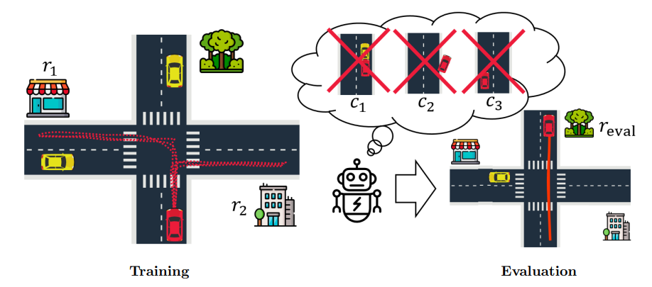
Convex Constraint Learning for Reinforcement Learning

Slide 4
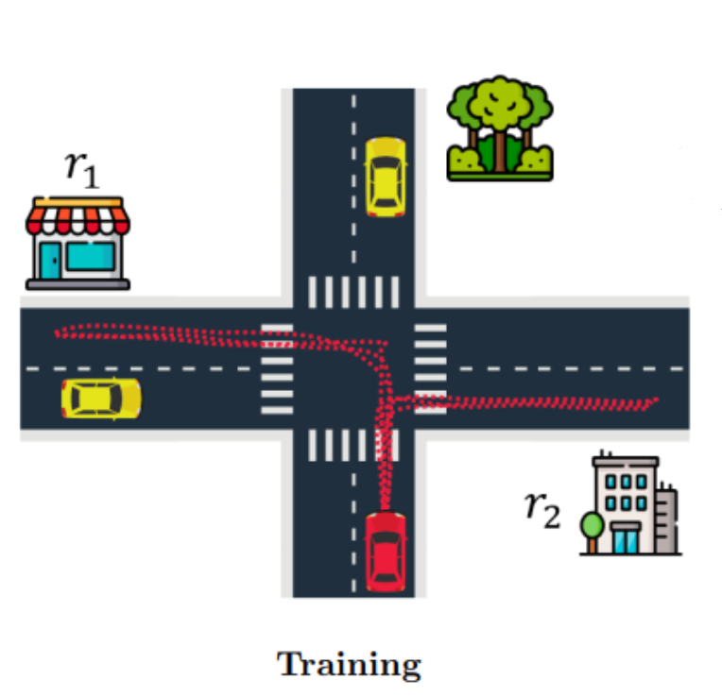
Convex Constraint Learning for Reinforcement Learning

Slide 5
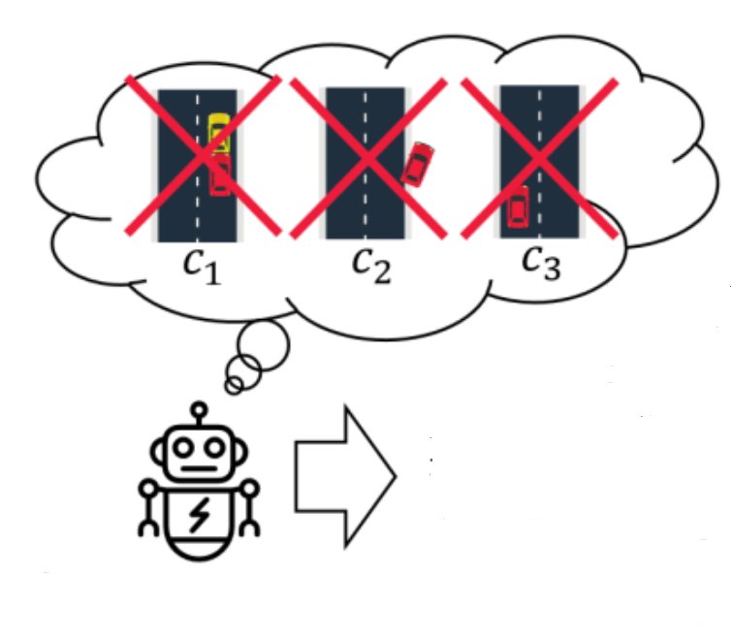
Convex Constraint Learning for Reinforcement Learning

Slide 6
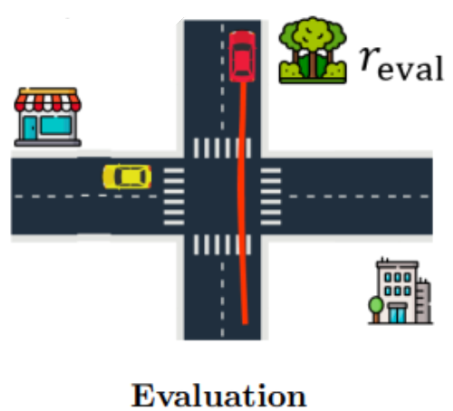
Convex Constraint Learning for Reinforcement Learning

Slide 7
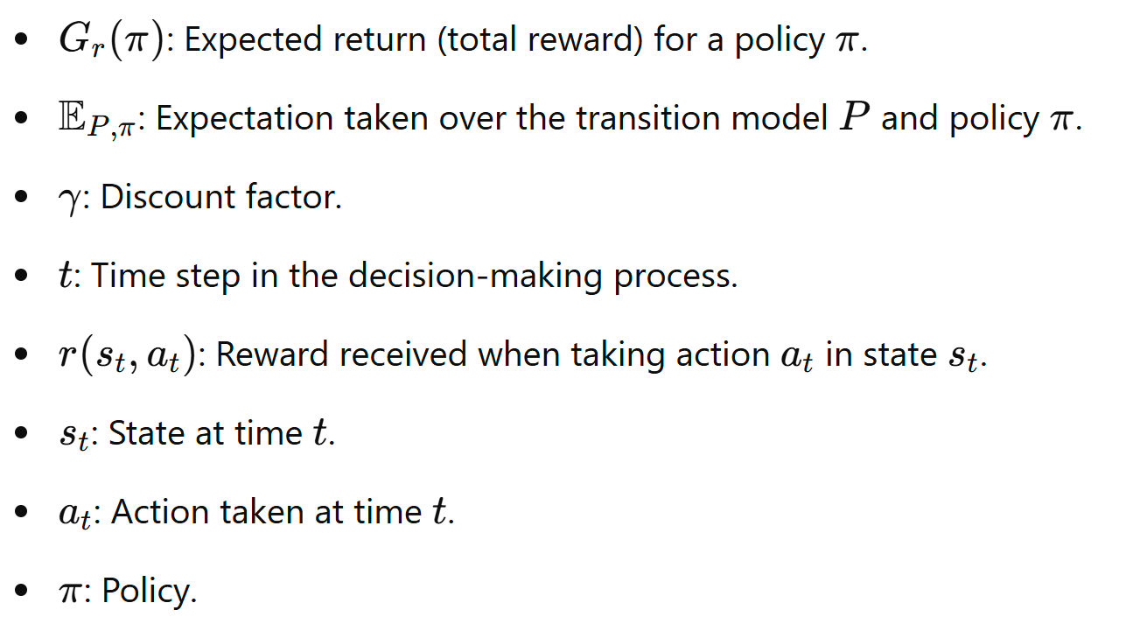
Markov Decision Processes(MDPs)

Slide 8
Constrained Markov Decision Processes(CMDPs)

Slide 9
Difference
MDP
The agent’s only goal is to maximize the expected reward over time
The agent is free to choose any policy that maximizes rewards, even if it sometimes involves risky or unsafe actions.
CMDP
The agent aims to maximize the reward while also satisfying a set of constraints on its behavior
The agent must choose a policy that maximizes rewards and keeps each cost function within its threshold

Slide 10
Problem Setup
CMDP with Unknown Rewards and Constraints
Infinite-horizon discounted CMDP
Access to Demonstrations
The agent has access to demonstrations from k different safe policies
Each demonstration is associated with an unknown reward function which might reflect different driving goals or driver preferences

Slide 11
Problem Setup
Shared Constraints Across Policies
All demonstrations share a common set of constraints defined by unknown cost functions and thresholds
Cost Functions in Feature Space
The cost functions are assumed to be linear in a d-dimensional feature space
The discounted feature expectations for a policy π

Slide 12
Problem Setup
Cost Functions in Feature Space
Each cost function is parameterized by a vector φ
Objective for Evaluation
The agent is given a new reward function representing a new task
The goal is to find an optimal policy for the CMDP where the constraints inferred from demonstrations must still hold

Slide 13
Problem Setup
Input:
Demonstrations
Convex Constraint Learning for Reinforcement Learning
(CoCoRL)
Output:
Policy

Slide 14
Convex Constraint Learning for Reinforcement Learning
Constructing a Convex Safe Set
Convergence for Optimal Demonstrations
Estimating Feature Expectations

Slide 15
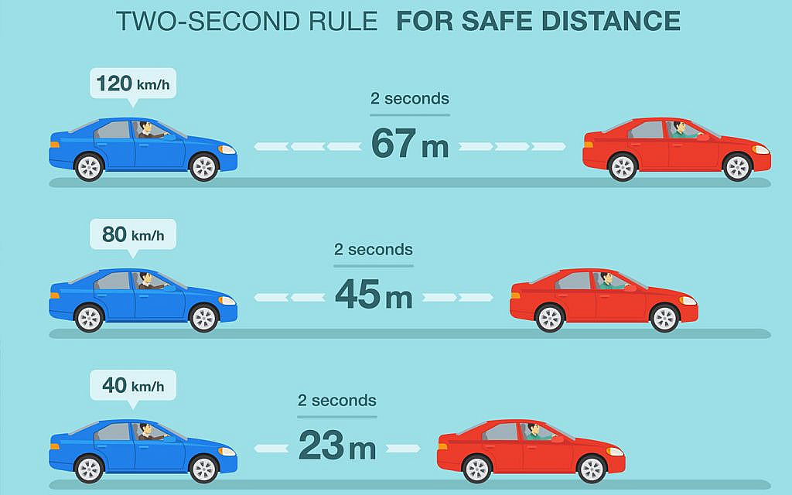
Step 1: Constructing a Convex Safe Set
Let the true safe set be the set of all policies that satisfy the constraints
CoCoRL is based on the key observation that the true safe set is convex.

Slide 16
Step 1: Constructing a Convex Safe Set
Convex Safe Set

Slide 17
Step 1: Constructing a Convex Safe Set
Theorem 1 - Estimated Safe Set
Any policy π within the convex safe set Ｓ is guaranteed to be safe, meaning it satisfies all constraints.
Theorem 2 - Inferred CMDP
There exist inferred cost functions and thresholds such that solving the inferred CMDP using these constraints is equivalent to finding an optimal policy in the true CMDP.
Corollary 1 - Ｓ is maximal
Ｓ is the largest safe set that can be constructed from the demonstrations.

Slide 18
Step 2: Convergence for Optimal Demonstrations
Policy Regret
The aim is to show that this regret tends to zero as the number of demonstrations k increases

Slide 19
Step 2: Convergence for Optimal Demonstrations
When the safe demonstrations are exactly optimal
When they are approximately optimal according to a Boltzmann model
In the Boltzmann model, actions or policies are chosen with probabilities that depend on their expected returns.
β - Temperature Parameter, controls the level of “rationality” or optimality

Slide 20
Boltzmann Model
It can learn from demonstrations that are close to optimal without assuming that the expert always acts with perfect precision.
The model allows CoCoRL to handle "soft" constraints on optimality, where experts mostly choose good actions but occasionally deviate, making the learning process more robust.

Slide 21
Step 2: Convergence for Optimal Demonstrations
Assumption 1 - Linear Rewards
The reward functions for both the demonstrations and the evaluation are linear in the feature space.
Assumption 2a - Exact Optimality
Each demonstrated policy is exactly optimal in its respective CMDP, meaning it fully maximizes the reward for the given constraints.
Assumption 2b - Boltzmann-Rationality
If exact optimality is unrealistic, demonstrations are assumed to follow a Boltzmann distribution with respect to the reward function.

Slide 22
Step 2: Convergence for Optimal Demonstrations
Theorem 3 - Convergence, Exact Optimality
Under Assumptions 1 (Linear Rewards) and 2a (Exact Optimality), as the number of demonstrations k increases, the policy regret converges to zero with high probability.
Theorem 4 - Convergence, Boltzmann-rationality
Under Assumptions 1 (Linear Rewards) and 2b (Boltzmann-Rationality for Approximate Optimality), as the number of demonstrations k increases, the policy regret converges to zero with high probability.

Slide 23
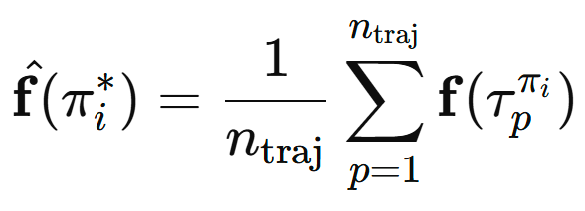
Step 3: Estimating Feature Expectations
Problem: Earlier sections assumed access to the true feature expectations of each demonstrated policy. However, in practice, this exact information might not be available.
Solution: Instead of using exact feature expectations, we can estimate them by observing sample trajectories of each policy in the environment.

Slide 24
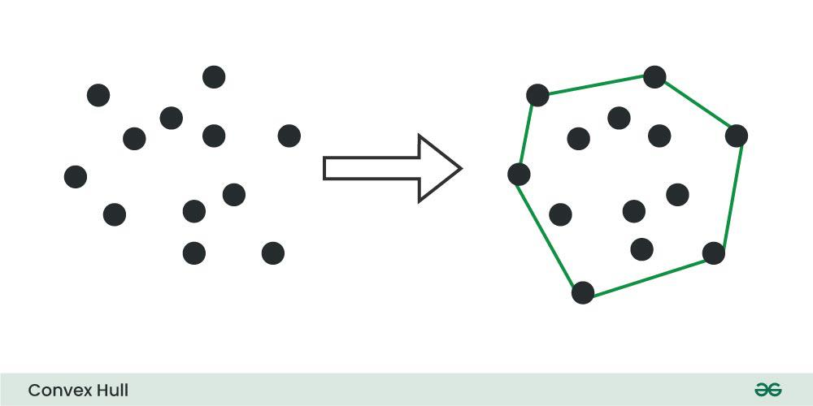
Practical Implementation
Compute or estimate the demonstrations’ feature expectations
Constructing the convex hull with Quickhull algorithm

Slide 25
Practical Implementation
Solving the inferred CMDP using Constrained Reinforcement Learning algorithm
Handling high dimensionality
Handling degenerate safe sets
Incrementally expanding the safe set

Slide 26
Inverse Reinforcement Learning(Andrew Y. (2000))
Observations of Behavior
Learning the Reward Function
Solving the Inverse Problem

Slide 27
Limitations of IRL in CMDPs
Cannot Guarantee Safety
Difficulty in Learning Transferable Constraints

Slide 28
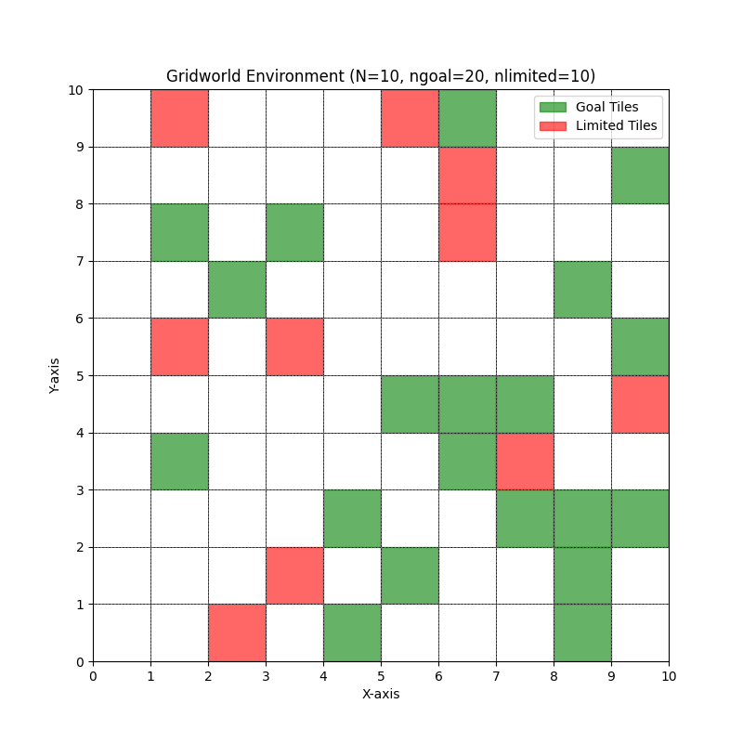
Experiments
Gridworld Environments
Evaluate CoCoRL’s performance in a controlled, tabular setting where optimal policies can be computed exactly.
Includes "goal" cells (to reach for rewards) and "limited" cells (that impose constraints).

Slide 29
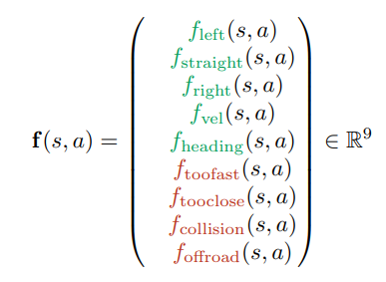
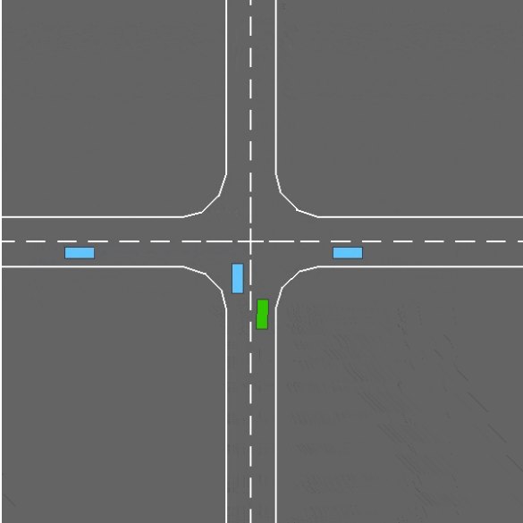
Experiments
Driving Simulation(Highway Environment)
Test the scalability and robustness of CoCoRL in a more complex, continuous environment.
The driving simulation involves a 2D four-way intersection where the agent can turn left, turn right, or go straight. Constraints include safe driving behaviors like keeping a safe distance and obeying speed limits.

Slide 30
Experiments - Gridworld Environments

Slide 31
Experiments - Driving Simulation(Highway Environment)

Slide 32
Related Work
Constraint Learning in Reinforcement Learning
All of the approaches assume full knowledge of the demonstrations’ reward functions
Scobee and Sastry (2020), Stocking et al. (2021), Malik et al. (2021)
Multi-task Inverse Reinforcement Learning
In general, IRL-based methods are challenging to adapt to CMDPs where safety is crucial
Dimitrakakis and Rothkopf (2012), Xu et al. (2019), Yu et al. (2019), Wang et al. (2021), Amin et al. (2017)
Learning Constraints for Driving Behavior
All the approaches assume fully known reward functions, which is often unrealistic beyond basic highway driving scenarios
Rezaee and Yadmellat (2022), Scobee and Sastry (2020), Liu et al. (2023), Gaurav et al. (2023)
Bandits & Learning Theory
None of these methods directly apply to the structure of the problem
Lindner et al., (2022), Camilleri et al. (2022), Khan and Madden (2014), Baddeley et al. (2007), Gottlieb et al. (2018)

Slide 33
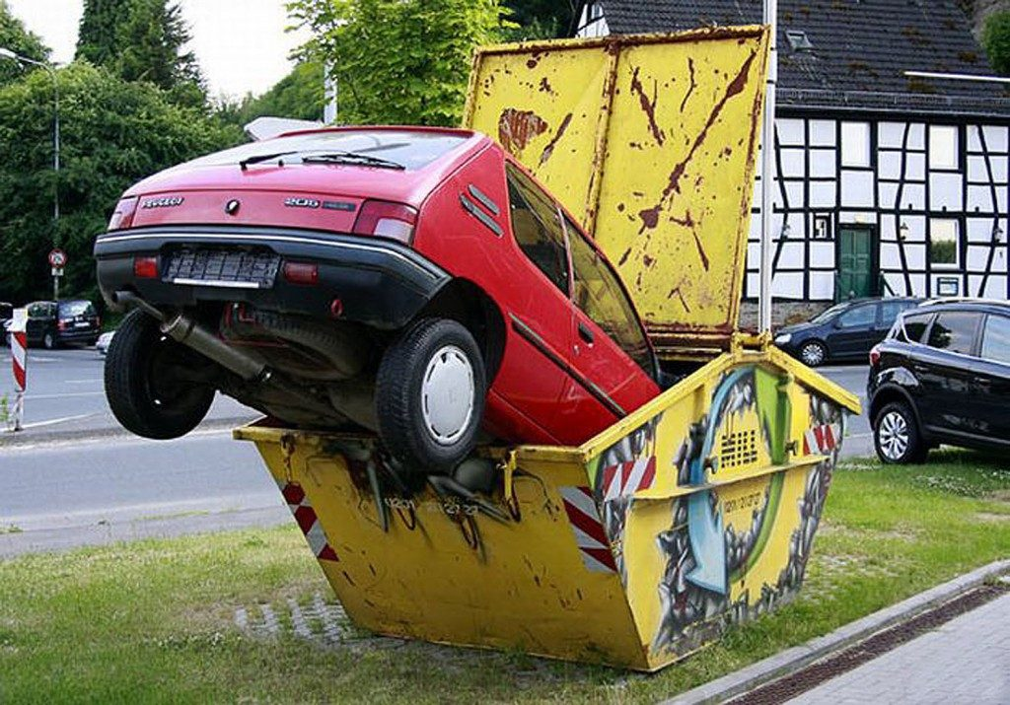
Limitation
Assuming safe demonstrations and access to a feature representation in non-tabular environments.
Learning from potentially unsafe demonstrations and learning features to represent constraints

Slide 34
Conclusion
Infer shared constraints from demonstrations with unknown rewards
Guarantees safety and achieves strong performance
Make learning constraints more practical in a range of applications

Slide 35
Q&A

