Slide 1
Almost Optimal Model-Free Reinforcement Learning via Reference-Advantage Decomposition
By Zihan Zhang, Yuan Zhou and Xiangyang Ji
A review by Aryan Pathare

Slide 2
Background

Slide 3
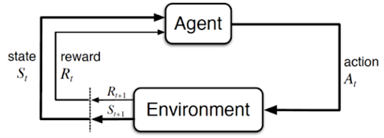
Markov Decision Process [MDP] model
The MDP model is formally defined as the tuple <S,A,p,r>
S = State space
A = Action Space
p = Transition probability function
R = Reward function
Notes:
A Markov Decision Process (MDP) model contains:
A set of possible world states S.
A set of possible actions A.
P = probability of taking action a in state s and transitioning to state s’
R = reward of taking action a in the state s.
A real-valued reward function R(s,a).
A policy is a solution to Markov Decision Process.

Slide 4
Notation -
K = number of episodes
H = length of a single episode
T = time step; calculated based on on the number of episodes and episode length as T = KH
V(s) = value of state s
For video game agent, S is all possible game states, A is all possible actions the player can take, K is the number of complete games the agent plays, H is the turns in an individual game
Notes:
The value function gives the expected sum of remaining rewards received from current step onwards under policy π until end of episode
Game states = player position, health, enemy position, etc
Actions = move left/right/up/down, shoot, etc

Slide 5
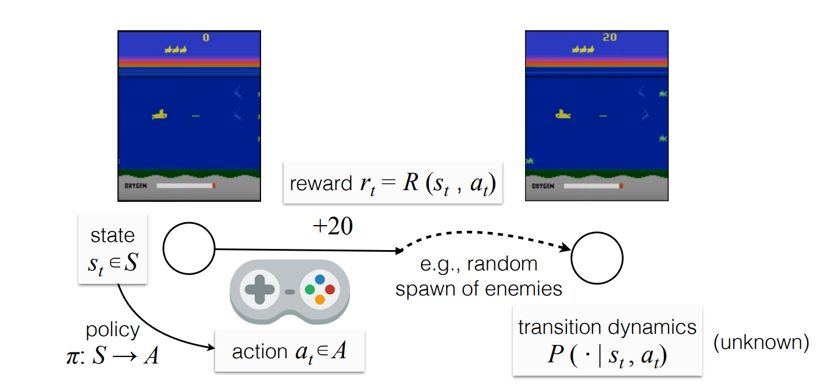
Video game playing agent -
Notes:
S = 2^9, A = 9, K = selectable, H = [4,5],

Slide 6
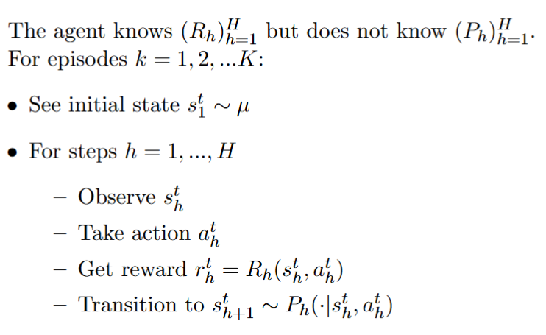
Online Learning MDP Interaction Protocol
The online learning MDP interaction protocol can be defined as -
Notes:
R_h = reward function. P_h = transition probability

Slide 7
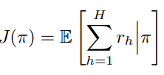
MDP Regret
The expected return on adopting policy is given by -
In MDP, regret measures deviation between the optimal return for all episodes and the actual cumulative return obtained over all episodes by the agent’s policy.
It is given by -
If the initial state is fixed i.e deterministic, regret can be defined as -

Slide 8
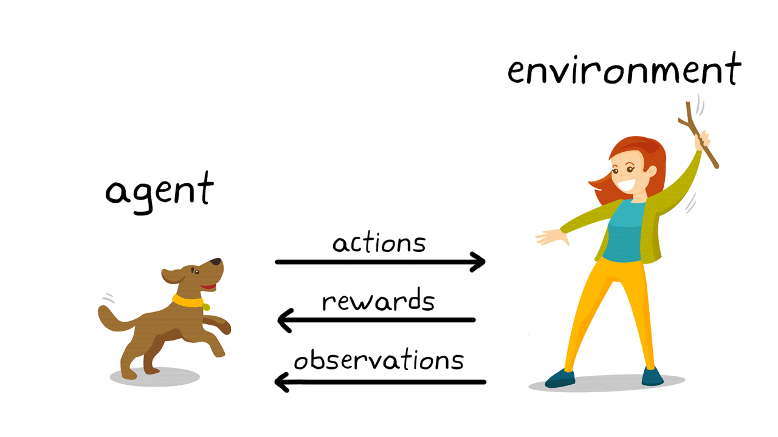
What is Reinforcement Learning ?
Notes:
Agent learns by maximizing its accumulative rewards through sequential decision making in an unknown environment modelled by Markov Decision Process [MDP].
Model-free algorithms are usually more space- and time-efficient compared to model-based algorithms. Example, Q-learning
Model-based algorithms may be able to take the advantage of the learned model and achieve better learning performance in terms of regret. Example, AlphaZero, Monte Carlo Tree Search

Slide 9
Notes:
model-free RL algorithms as algorithms with space complexity sublinear to the space required to store an MDP.

Slide 10
Q-Learning
The algorithm maintains a table of Q-values for each state-action pair.
Q-values represent the expected utility of taking a given action in a given state and following the optimal policy afterward.
Q-value update rule (Bellman equation) -
Notes:
In the beginning, Q-values are initialized with random values. High initial values, can encourage exploration.
Epsilon-greedy approach for exploration i.e with fixed probability perform random action.
t=number of times triple (s,a,h) is visited, alpha_t = (1+H)(H+t)

Slide 11
Problem Definition

Slide 12
Problem setup
Question - Is it possible that model-free algorithms achieve as competitive learning efficiency as model-based algorithms, while still maintaining low time and space complexities?
Solution: UCB-Advantage - A novel model-free algorithm that achieves a regret bound of
with low time complexity of O(T), space complexity of O(SAH)
and switching cost of
Notes:
Model-free algorithms are more space and time efficient. Model-based algorithms achieve better learning performance.
S = states, A = actions, H = episode length, K = number of episodes, T = KH
Regret bound is same order as best model-based algorithms and also matches the information theoretic lower bound up to logarithmic factos.

Slide 13
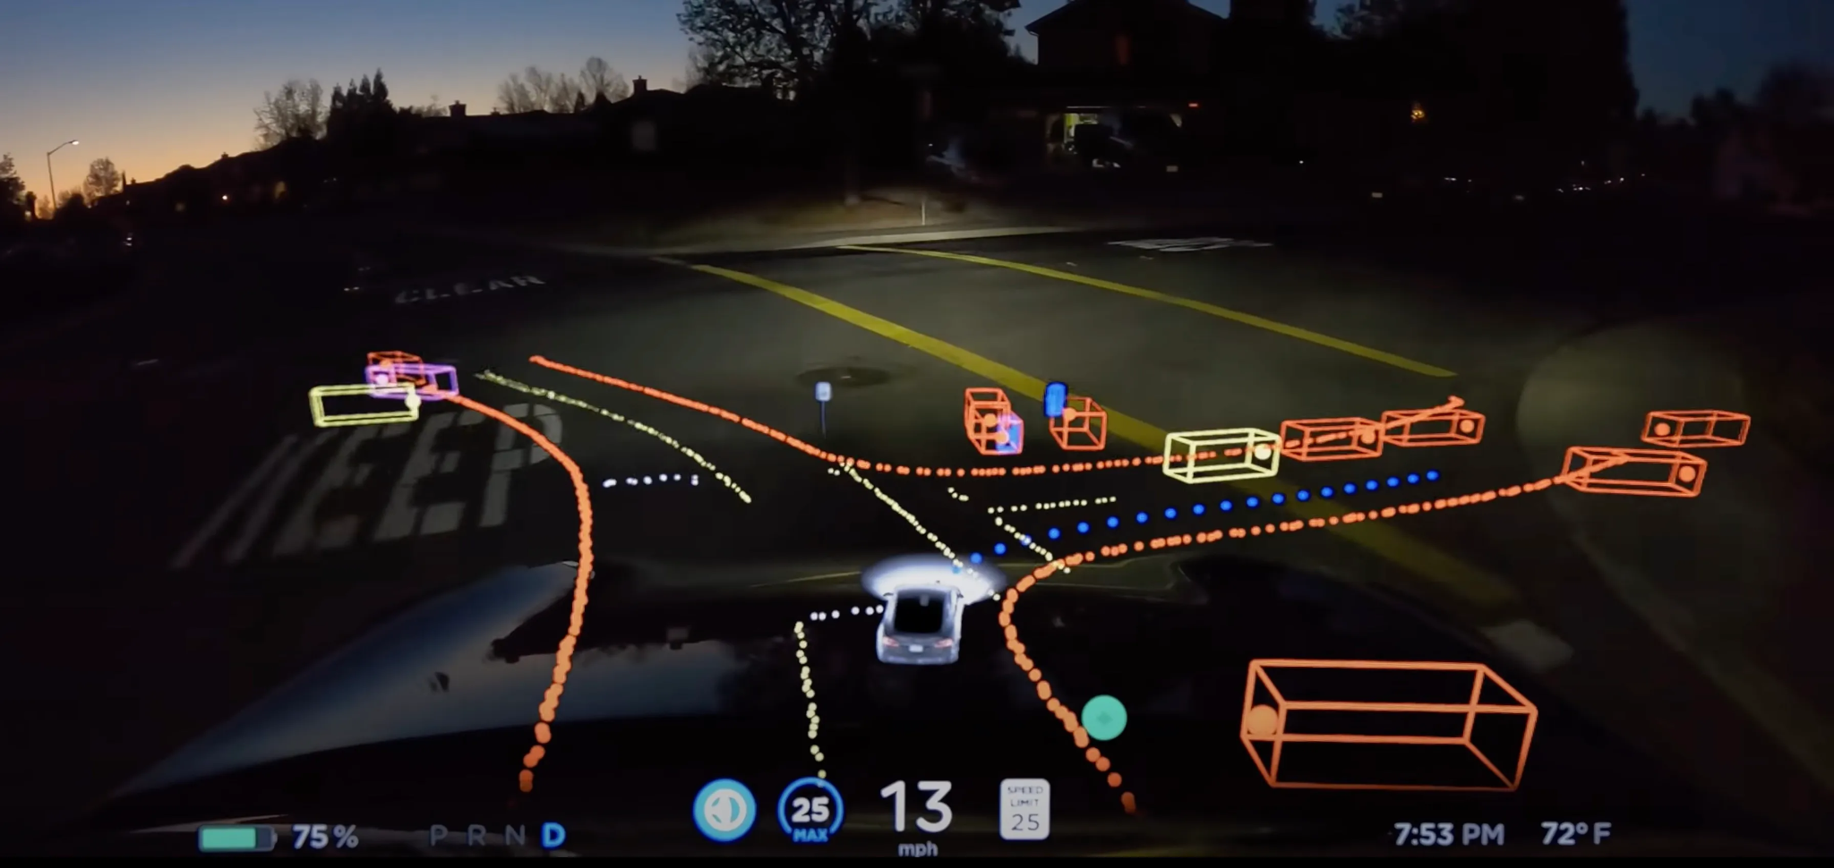
Motivation
Building accurate models for complex, real-world problems is challenging and often infeasible.
Computational and space costs are very high for model-based algorithms as they need to store, update and leverage the environment model.
Notes:
Accuracy of model-based RL depends on accuracy of model.
Computational cost high especially for complex problems.
Model-free algos can be more robust in environments where modeling is difficult or infeasible, such as highly stochastic or complex environments.
Thus, if we were able to solve the problem of poor regret of model-free while maintaining their time and space advantages, we would have a highly powerful RL algo i.e UCB Advantage.

Slide 14
Model-free algorithms preferred for highly stochastic or complex environments.
Due to their simple nature, model-free algorithms often have higher regret bounds than model-based algorithms.

Slide 15
Related Work
Notes:
Paper which had the most influence on the paper being presented

Slide 16
Is Q-learning Provably Efficient? - Jin et. al
Formally defines model-free RL algorithms as algorithms with space complexity sublinear to the space required to store an MDP.
Also proves the information theoretic lower bound for episodic MDP i.e
Proposes algorithm UCB-Hoeffding with regret bound
Improves on UCB-Hoeffding to obtain UCB-Bernstein that has regret bound
Notes:
Information theoretic lower bound - Ω(√ (H^2SAT))

Slide 17
Provably Efficient Q-Learning with Low Switching Cost - Bai et. al
Puts forth the notion of local switching cost (or switching cost).
Defined as the number of state-action pairs by which two policies differ.
Algorithms with low switching cost are useful as deploying new policies in the real-world can be costly.
Uses a lazy-update scheme with UCB-Bernstein to achieve a local switching cost bound of
Notes:
It is typically calculated as the number of state-action pairs where the chosen action differs between two policies being compared. Utilized to lower policy updates.
For eg, in recommendation, need to update policy every time a new product is added to catalog (actions updated).

Slide 18
UCB-Advantage

Slide 19
Summary
A Q-Learning based model-free reinforcement learning algorithm.
Augments Q-Learning with stages and a stage-based framework. Also modifies the standard Q-Learning update rule.
Unique selling propositions -
Better regret bound and space/time complexities than other Q-Learning variants.
Better switching cost than other Q-Learning variants
Simple to implement.
Notes:
Augmentations provide better performance and lower cost than standard or other Q-Learning variants

Slide 20
Preliminaries
Works in the setting of episodic MDPs described by tuple (S,A,H,P,r), such that -
SxA is the state action space
H is length of each episode
P is transition probability matrix
r is deterministic reward function
Environment formulation -
For any episode h, state s and action a,
During each episode, the agent is provided with a starting state
Notes:
Assumptions -
Reward value always between 1 and 0

Slide 21
During each step in an episode, agent takes action and transits to state
based on transition probability
A policy π is used to map from state-episode pairs to action.
The value function gives the expected sum of remaining rewards received from current step onwards under policy π until end of episode
Q function gives the expected sum of remaining rewards under policy π till the end of the episode if a given action is taken in a given state.
Notes:
Policy determines ideal action in a given state for a given episode.
Value function indicates how profitable in long term transitioning to a particular state can be i.e utility/value of a state.
Q function = immediate reward + (prob. Of transitioning into a state)x(value of the state). Thus indicates how profitable taking a particular action in the given state can be).

Slide 22
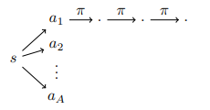
The optimal value function is defined as -
Optimal Q-function is defined as -
Regret at time step T is defined as -
Notes:
The supremum is the smallest value that is greater than or equal to all the values of the function in the specified domain. If the function has a maximum value, the supremum equals the maximum. Otherwise, the supremum is the least value that bounds the function from above.

Slide 23
UCB-Advantage Components
The main components of the UCB-Advantage algorithm are -
Observed samples are divided into stages
Q-values are only updated at the end of a stage
Reference advantage decomposition is used to improve the regret bound
A modified advantage-based update rule is used to update the Q-values

Slide 24
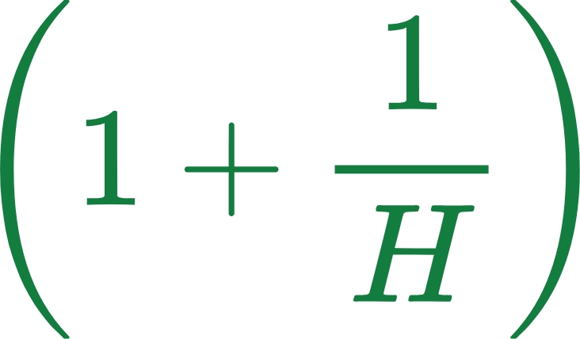
UCB-Advantage Stages
For each state, action, time-step triple (s,a,h), the visits to the triple are divided into stages.
Stages do not have same size. Size of each stage increases exponentially and has growth rate
Length of stage 1 is H and length of ith stage is denoted by -
Based on stage lengths, the indices marking the ends of stages are defined by the set
Notes:
Stages defined on triple level

Slide 25
Stage-based updates
Instead of updating Q value at every step, is updated only when the total number of visits for triple (s,a,h) are equal to the end of its current stage.
Furthermore, only the samples from the latest stage are used for the update.
Use of stage-based updates helps reduce the number of updates to the Q-function. This helps achieve a low switching cost.
Stage-based updates also make the algorithm more amenable to the reference advantage decomposition update rule used by UCB-Advantage.

Slide 26
The standard update rule and its limitations
The standard update rule for Q-Learning is -
Here is the exploration bonus and is empirical estimate of the optimal
However, this update rule cannot be directly used for UCB-Advantage due to the stage-based update framework.
The earlier the samples collected, the more would be the deviation between the value function learned at the moment and the true value.
Notes:
Since we collect samples for the entire stage and update only at end of stage, possibly large deviations.

Slide 27
To mitigate these deviations, we use only the samples from the last stage to determine
This would imply that we will use only (1/H) fraction of the observed data to estimate
This is the cause of the inferior regret bound of in UCB-Bernstein.
To eliminate the additional term, UCB-Advantage uses reference advantage decomposition.
Notes:
Hence, for a better regret bound we need to use a modified update rule to eliminate this issue of deviations from the true estimate due to stages.

Slide 28
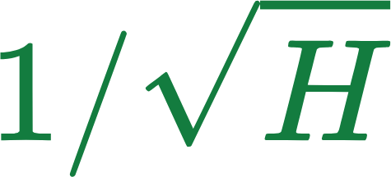
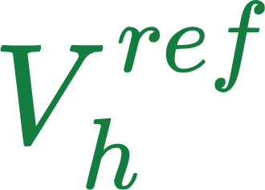
Reference Advantage Decomposition
The reference value function Vref is used to estimate the optimal value function V* with an error factor of such that
is independent of T and K and is set to
The advantage-based update rule for Q-values is then defined by -
Based on this update rule, during the learning process, we learn using
Hence, approximates V* atleast as good as i.e for all samples.
Notes:
In order to resolve the issue with the standard update rule, UCB-Advantage uses reference advantage decomposition and the advantage-based update rule
The use of Vh offsets the weakness of using only (1/H) of the data

Slide 29
This relation between and helps to offset the downsides of considering only (1/H) of the data for estimation.
Reference value vector Vref is learned as part of the learning algorithm.
Notes:
The discussion till now has assumed that the reference value vector V ref is known.

Slide 30
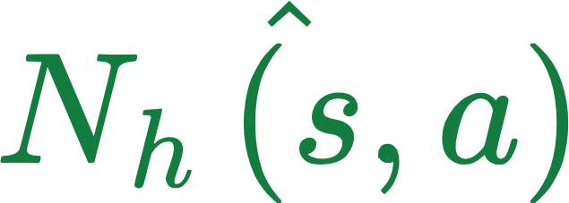
UCB-Advantage Algorithm
Seven types of accumulators are used for updating the Q-function and the value function -
tracks total number of visits to triple (s,a,h)
tracks total number of visits to triple (s,a,h) in the current stage
Three intra-stage accumulators are used, whose values are reset at the beginning of each stage and updated every time step as follows -
Finally, two global accumulators are used for samples in all stages -

Slide 31
Notes:
C1,c2 and c3 are large positive universal constants
The bonuses are set in a way that both expressions can be shown to upper bound Q* in the desired event.

Slide 32
The algorithm initializes
Indicates the number of visits required to each triple in order to learn a
-accurate reference value function. It is set to
The first two expressions in min{..} of the update expression correspond to the standard update rule and the advantage-based update rule respectively.
and are exploration bonuses whose values are updated at the end of every stage.

Slide 33
Analytical Results
Notes:
Since we collect samples for the entire stage and update only at end of stage, possibly large deviations.

Slide 34
Analytical Results
The authors provide a comprehensive proof for this proposition.
The implication of this proposition is that the learned Q-values are always non-increasing.
Q-values depend on the reward function and the value function. The reward function is static while the value function is learnt.
Thus, the learnt value function outputs are also non-increasing.

Slide 35
Analytical Results
The authors use the implication of Proposition 4 regarding the non-increasing nature of the value function learnt by UCB-Advantage to prove this lemma.
This lemma provides an upper bound on the approximation error between the optimal value function and the value function learnt by UCB-Advantage.
This provides insight into the efficacy of the use of the reference value function as proposed by reference advantage decomposition.

Slide 36
Analytical Results
The authors use the implications of Proposition 4 and Lemma 5 regarding the nature of the value function learnt by UCB-Advantage to prove this corollary.
This corollary proves that we need to visit a triple at least times to learn a
-approximate estimation of the optimal value function.
Based on this corollary, as UCB-Advantage learns the reference value function output for a triple after visits, is guaranteed to be a -approximate estimate of V*.

Slide 37
Analytical Results
The authors use the previously discussed analytical results to prove the above regret bound on the performance of UCB-Advantage.
Ignoring the logarithmic factors, gives the regret bound .
This regret bound is better by a factor of from UCB-Bernstein and is of the same order as state-of-the-art model-based algorithms like UCBV1 and vUCQ.

Slide 38
Limitations & Future work
UCB-Advantage is designed for only episodic MDP reinforcement learning problems.
Scope for future work to adapt UCB-Advantage to non-episodic settings.
Notes:
2. Hence, does not work with more complex RL problems, like autonomous vehicles, complex robots, etc.

Slide 39
Conclusion
In conclusion, UCB-Advantage makes smart use of a stage-based update framework and advantage-based update rule to obtain an almost optimal model-free algorithm.
Alongwith a near-optimal regret bound, UCB-Advantage also has low switching cost, making it better suited than other model-free algorithms for complex and stochastic real-world problems.
UCB-Advantage achieves all these performance goals while maintaining low space and time complexities.
However, there is scope for more work in in adapting UCB-Advantage to non-episodic settings

Slide 40
Thank You !

