Slide 1
CSC 696H: Topics in Bandits & Reinforcement Learning Theory
Chicheng Zhang
University of Arizona

Slide 2
Logistics info
Instructor: Chicheng Zhang (chichengz@cs.arizona.edu)
Time & venue: Fridays 1:30-4:10pm (10min break within), Gould-Simpson 701
Lectures will be video-recorded
Class website: https://zcc1307.github.io/courses/csc696fa24/index.html

Slide 3
What is reinforcement learning?
Reinforcement learning (RL) is an area of machine learning concerned with how intelligent agents take sequential actions in an environment in order to maximize the notion of cumulative reward. – adapted from Wikipedia
Example: continuous medical treatment
For time step $t=1,2,..T:$
Receives state $s_{t}$
Takes an action $a_{t}$
Receives reward $r_{t}$
Transitions to state $s_{t+1}$ (that may depend on $s_{t}$)
Goal: maximize $\sum_{t=1}^{T}{r_{t}}$
$$s_{t}$$
$$a_{t}$$
$$r_{t}$$
Patient
$$s_{t+1}$$
Learner
……

Slide 4
Important characteristics of RL
Evaluative feedback (vs. instructive)
Long-term vs. Short-term return
Aka. delayed consequences
temporal credit assignment
https://www.linkedin.com/pulse/demonstration-vs-feedback-shivam-pathak-puadc/

Slide 5
Important special case: online (contextual) bandit learning
The states observed (aka contexts) do not have interdependencies
Example: single-round medical treatment
For time step $t=1,2,..T:$
Receives state (context) $s_{t}$
Takes an action $a_{t}$
Receives reward $r_{t}$
If no state information is given: the multi-armed bandit problem
$$s_{t}$$
$$s_{t+1}$$
$$a_{t}$$
$$a_{t+1}$$
$$r_{t}$$
$$r_{t+1}$$
Patient
Learner
Patient

Slide 6
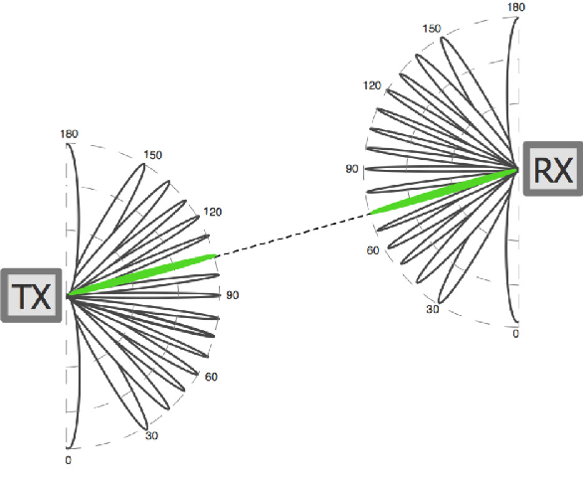
More applications of online bandit learning
Product recommendation
State: user profile
Action: product
Reward: user purchase / clickthrough
Wireless communication
State: none
Action: transmitter & receiver configurations
Reward: received signal strength
https://arxiv.org/pdf/1909.03313.pdf

Slide 7
More applications of reinforcement learning
Can you think of applications that fits into the RL framework, but not the contextual bandits framework?
RL
Contextual bandits
Multi-armed bandits

Slide 8
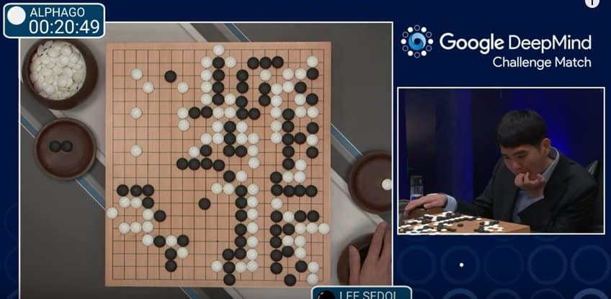
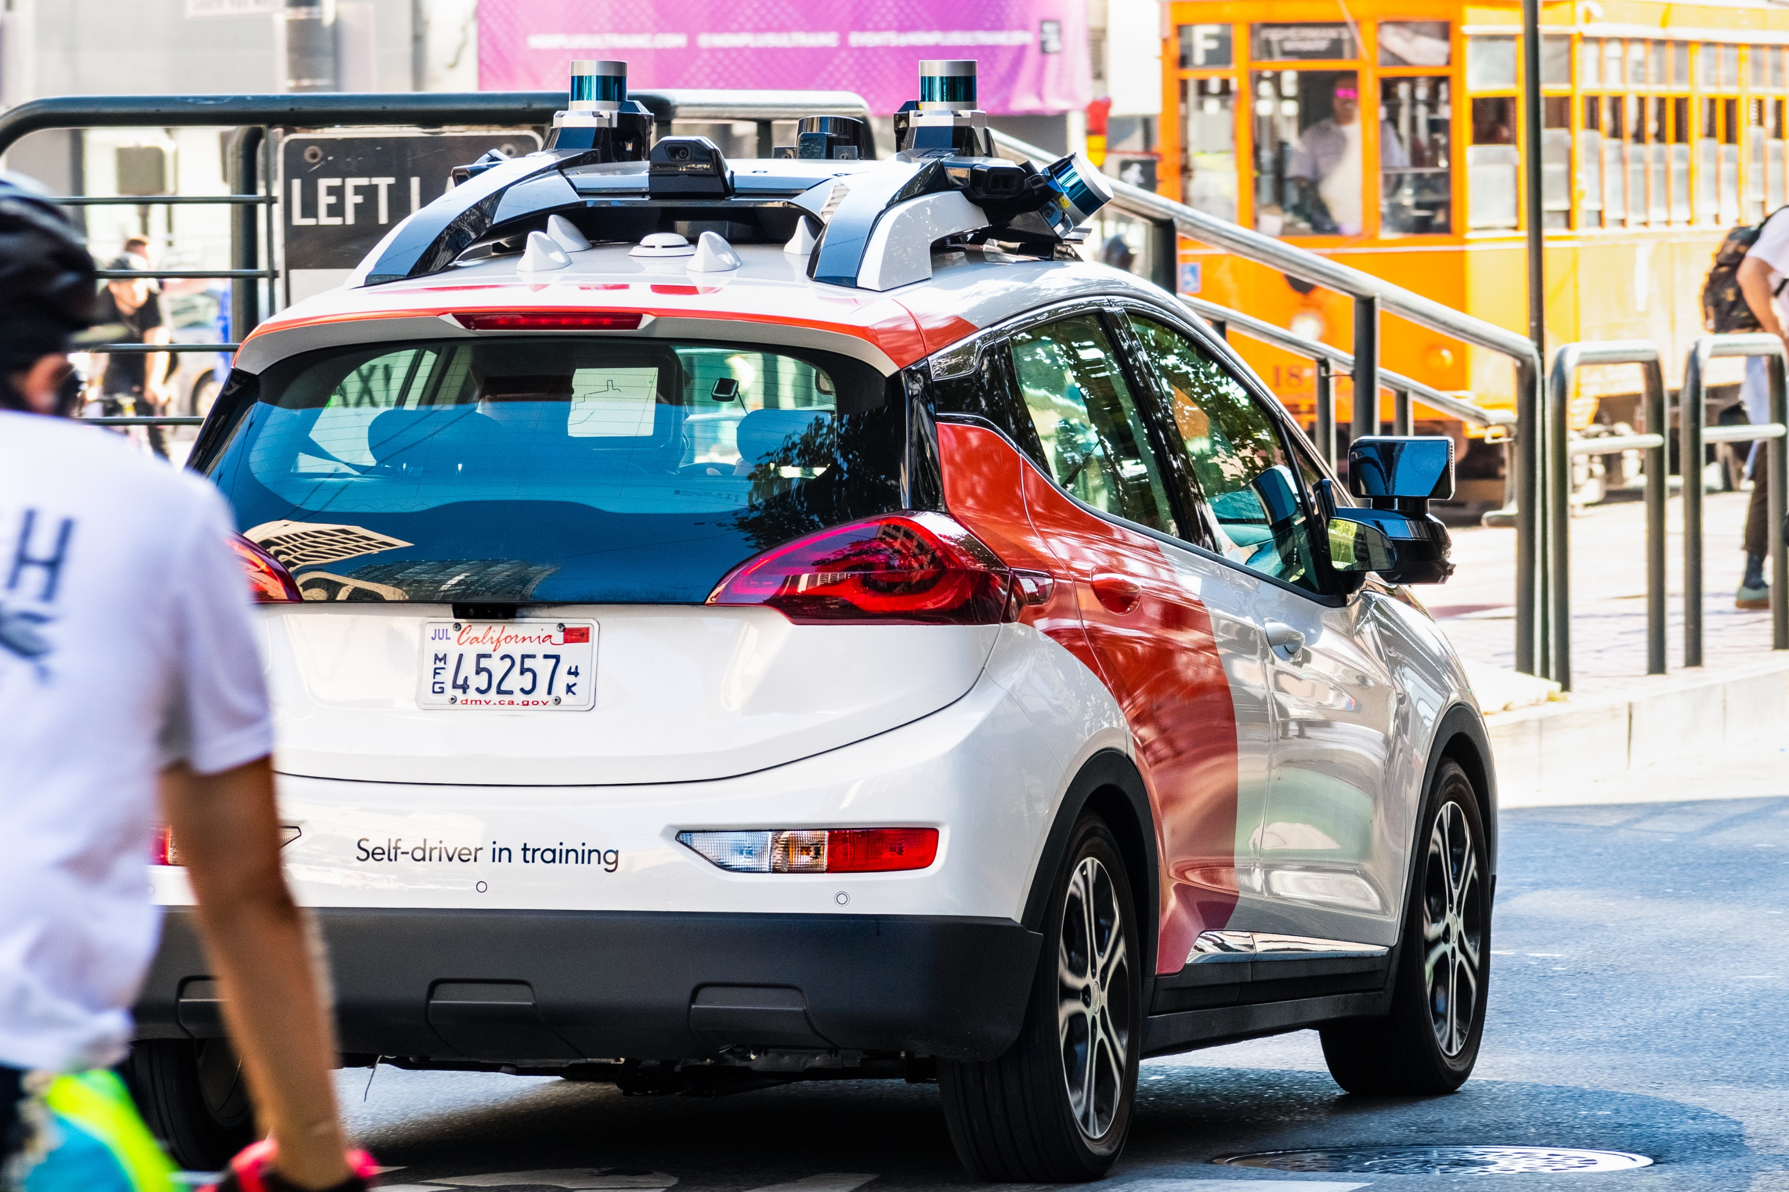
More applications of reinforcement learning
Robot arm manipulation
Game playing
Conversational assistant
(e.g. RL from Human Feedback in training ChatGPT)
Autonomous driving,
…

Slide 9
What this course is about
Study the design and analysis of bandit & RL algorithms with formal performance guarantees, using rigorous mathematical tools
Key performance measures:
Online regret
Sample complexity
Computational complexity
This course will not cover deep reinforcement learning, an important topic on its own
Assignments will mostly be proof-based; no programming assignments

Slide 10
Topics covered
Part 1: lectures
Basic tools: concentration inequalities; full-information online learning
Bandits
Multi-armed bandits
Contextual linear / nonlinear bandits
Advanced algorithms: reduction to online regression; posterior sampling
RL
Markov Decision Processes (MDPs) and planning
RL with a simulator
Online RL: tabular and function approximation settings
(Time permits): policy optimization, offline RL, ..
Part 2: student presentations
(Your choice of bandit / RL theory paper, from the course website, or upon my approval)

Slide 11
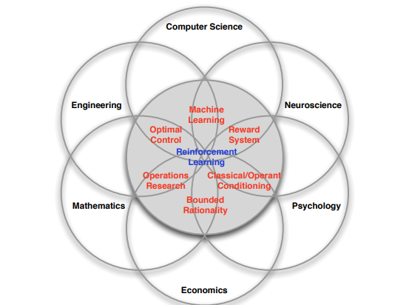
RL: interplay with other fields
[David Silver, 2015]
Prerequisites for this course:
Basic multivariate calculus, Linear algebra, Probability
Basic programming

Slide 12
Evaluation
Homework: 30% (two HWs)
Class participation: 15%
show up in class on time, ask & answer questions
give presentation feedback to your classmates (I will distribute the forms)
Scribe note taking: 10% (in LaTeX, will not be graded but will be given credit)
Paper presentation: 45%
See more details in the syllabus

Slide 13
Paper presentation
You can do a whiteboard presentation or use slides
Required: meet with me >=1 week in advance of your presentation; bring your full draft slides / notes
Your presentation will be evaluated in the following aspects:
Problem setup: What problem does this paper try to solve?
Motivation: Why do people care about the problem?
Related work: Prior to this paper, what other approaches have been proposed for this problem? What are their limitations?
Proposed approach: What’s the new approach in this paper? Does it overcome the limitations in prior work?
Limitations & future work: Do you see any limitations of this paper?
Related: “Heilmeier Catechism”

Slide 14
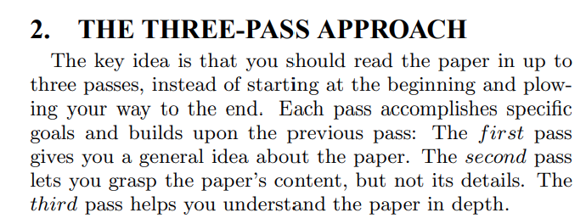
Paper presentation: best practices
Choose a relevant bandit / RL theory paper you like
The course website has some “seed papers”
Use Google Scholar “cited by” to find more & recent advances
Long and technical papers? Try reading it in different passes with different levels of detail
S. Keshav “How to read a paper”
A lot of times you may need to figure out technical details omitted in the paper, to fully understand it
Think about these as “mini-exercises”
I recommend R. O’Donnell “Street Fighting Mathematics”

Slide 15
Paper presentation: best practices
Clarity
Make sure the problem setup is clearly defined
Avoid presenting unnecessary technical details – present core algorithm / analysis
Perhaps surprisingly (?), preparing a short and to-the-point presentation can take much longer time (and deeper understanding) than a long and unfocused one
See https://zcc1307.github.io/courses/csc696fa23/presentation.html for more suggestions on paper reading / presentation preparation

Slide 16
An overview of RL from a machine learning perspective
(largely based on slides of Nan Jiang, Chi Jin, Alekh Agarwal, Akshay Krishnamurthy, John Langford, Wen Sun)

Slide 17
Paradigm: online supervised learning
For time step $t=1,2,…,T:$
Receive example $x_{t}$
Make prediction $\hat{y_{t}}$
Receive label $y_{t}$
Goal: minimize the total number of mistakes
Key challenge: generalization
how to ``transfer’’ the knowledge we learned from previous ${\left(x_{s},y_{s}\right)}_{s=1}^{t−1}$ to predict new & unseen example $x_{t}$?
Typical solution: use a carefully-designed predictor class (function approximation) that encodes inductive bias

Slide 18
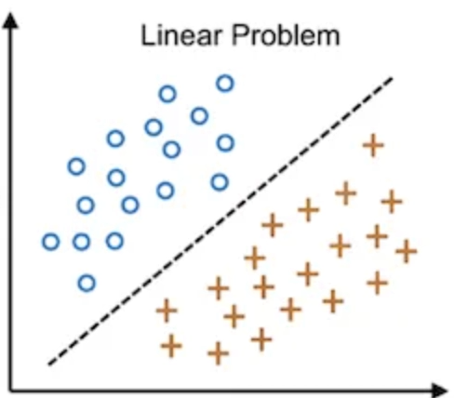
Inductive bias
Loosely speaking: for a learning algorithm, what types of predictors does it prefer
The algorithm’s ``prior beliefs about the world’’
Ex 1: nearest neighbor classifiers
``Examples with similar features likely have the same label”
Ex 2: linear classifiers
``We can draw a line that separates positive and negative examples’’
https://www.naukri.com/code360/library/linear-vs-non-linear-classification

Slide 19
Paradigm: online bandit learning
For time step $t=1,2,..T:$
Receives context $x_{t}$
Takes an action $a_{t}$
Receives reward $r_{t}$
Learner’s goal: maximize cumulative reward $\sum_{t=1}^{T}{r_{t}}$
Additional key challenge: exploration
Taking different actions can yield different rewards – sample selection bias
How to collect good data from which we can learn to take near-optimal actions in the long term?
$$x_{t}$$
$$a_{t}$$
$$r_{t}$$
Patient
Learner
Notes:
In the intro, we’ve already seen the setup of contextual bandit learning. Let’s review it again here.
At each timestep, the learner sees a context, and takes an action based on it. For example, in news recommendation, algorithm sees a user’s profile, for example her location, browsing history, and tries to recommend a category of news that the user likes most. The learner then incurs a cost. In the news example, the cost depends on the user’s reaction to the recommendation, for example if she likes it she would click it. We also assume that each user has an underlying cost vector, which encodes the cost incurred by the learner if other possible actions are taken.
This talk, we assume that the context and cost pair is drawn from a fixed distribution. The goal of the learner is to incur low cumulative cost, or achieve best user satisfaction in the news example.
Usually there is a tradeoff

Slide 20
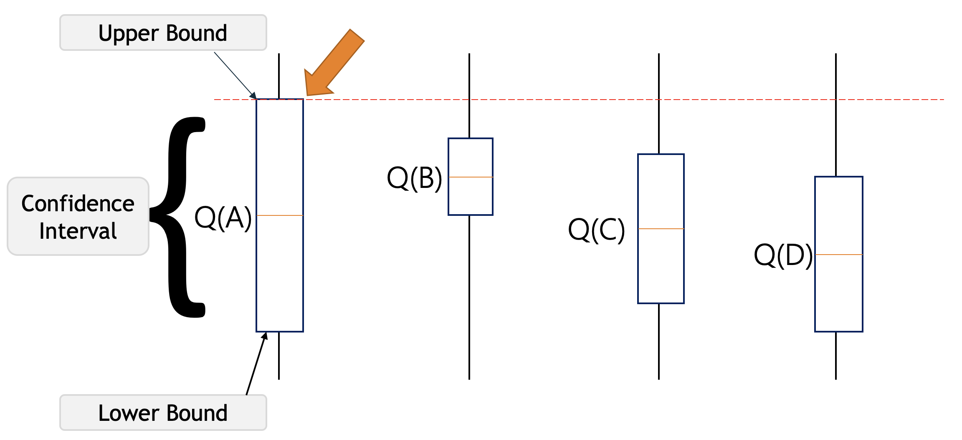
Paradigm: online bandit learning (cont’d)
Multi-armed bandits: a basic model for studying exploration-exploitation tradeoff
Example: where should I go for lunch?
Typical solution: ``optimism in the
face of uncertainty’’ principle
Optimism encourages `healthy exploration’
Can ``pessimism’’ work?
Notes:
confidence bound
based exploration

Slide 21
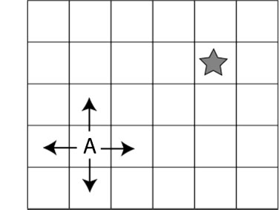
Paradigm: online episodic RL
Initially: learner knows nothing about the environment
For episode $t=1,2,..,T$:
Receives initial state $s_{1}^{t}$
For step $h=1,2,…,H:$
Takes action $a_{h}^{t}$
Receives reward $r_{h}^{t}∼R(⋅ ∣s_{h}^{t}, a_{h}^{t})$
Transitions to next state $s_{h+1}^{t}∼P\left(⋅ ∣ s_{h}^{t}, a_{h}^{t}\right)$
Learner needs to learn the environment parameters $R$ and $P$, as well as taking optimal actions

Slide 22
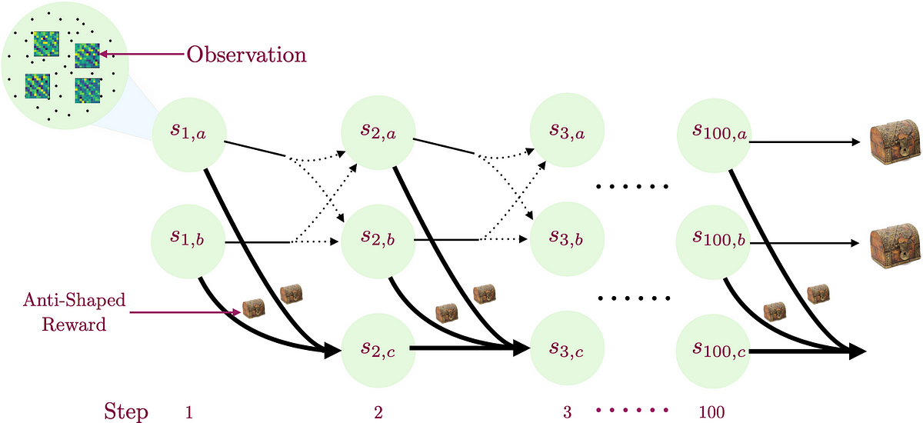
Paradigm: online episodic RL
Additional key challenge: delayed consequences
Different from bandits, instantaneous reward is no longer a good indicator
Some action may reach a more advantageous state, despite having a small instantaneous reward
https://medium.com/@dipendrakumarmisra/homer-provable-exploration-in-reinforcement-learning-6a18378fddb8

Slide 23
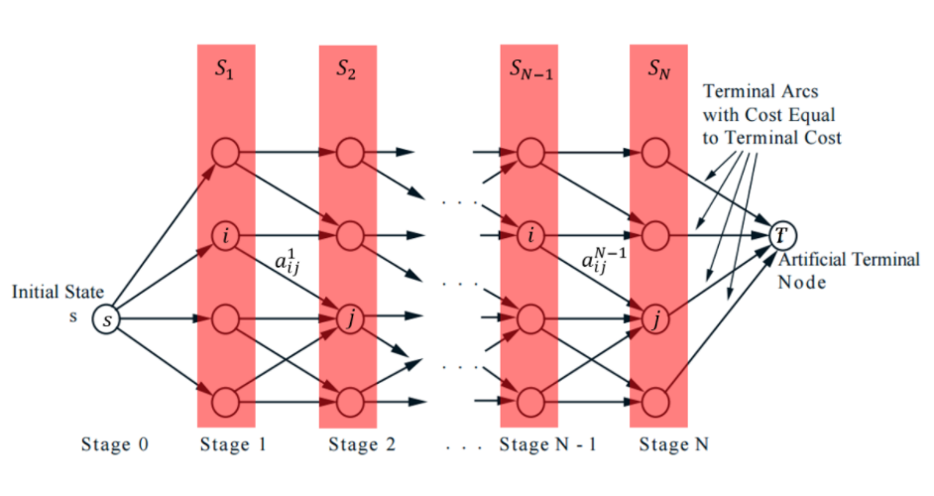
Paradigm: online episodic RL (cont’d)
Typical solution to address the delayed consequence issue:
For each step and (state, action) pair, estimate its optimal value – the best possible expected return one can get starting from it
Estimate optimal values by dynamic programming

Slide 24
Challenges in bandits and RL: summary
Generalization
General RL: tackle all three challenges simultaneously
Other challenges: imperfect information, adversary presence, …
RL with simulators,
Offline RL, imitation learning ..
Contextual bandits; multi-armed bandits
Delayed consequences
Exploration
Discrete state-action
(tabular) RL

Slide 25
Break

Slide 26
What is reinforcement learning?
Reinforcement learning (RL) is an area of machine learning concerned with how intelligent agents ought to take actions in an environment in order to maximize the notion of cumulative reward. –Wikipedia
Example: continuous medical treatment
For time step $t=1,2,..T:$
Receives state $s_{h}$
Takes an action $a_{h}$
Receives reward $r_{h}$
$$s_{t}$$
$$a_{t}$$
$$r_{t}$$
Patient
$$s_{t+1}$$
Learner
……

Slide 27
Prerequisite knowledge
Basic multivariate calculus
Linear algebra
Probability
Basic programming
Additional knowledge that can be useful (not strictly required):
Reinforcement learning
Machine learning theory
Statistics
Algorithm design & analysis
Optimization
Stochastic processes
…

