Slide 1
CSC 696H: Topics in Bandits & Reinforcement Learning Theory
Chicheng Zhang
University of Arizona

Slide 2
Logistics info
Instructor: Chicheng Zhang (chichengz@cs.arizona.edu)
Time & venue: TuTh 3:30pm-4:45pm, Gould-Simpson 701
Lectures will be video-recorded
Class website: https://zcc1307.github.io/courses/csc696fa23/

Slide 3







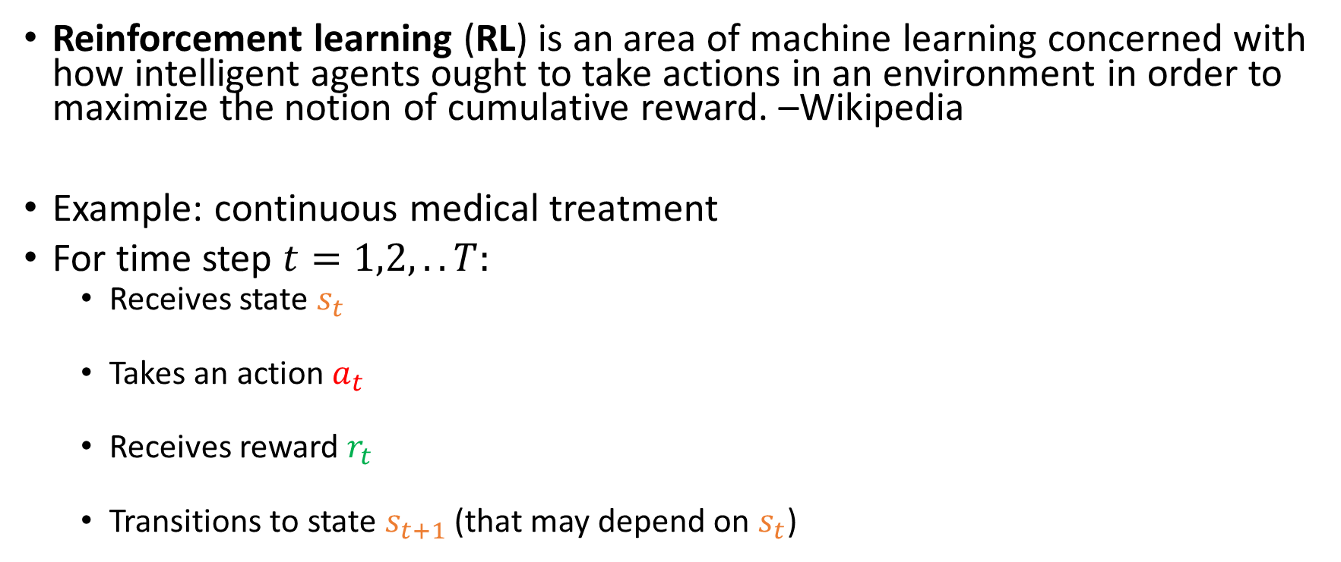


What is reinforcement learning?
Reinforcement learning (RL) is an area of machine learning concerned with how intelligent agents ought to take actions in an environment in order to maximize the notion of cumulative reward. –Wikipedia
Example: continuous medical treatment
For time step $t=1,2,..T:$
  Receives state $s_{t}$
  Takes an action $a_{t}$
  Receives reward $r_{t}$
  Transitions to state $s_{t+1}$ (that may depend on $s_{t}$)
$$s_{t}$$
$$a_{t}$$
$$r_{t}$$
Patient
$$s_{t+1}$$
Learner
……

Slide 4


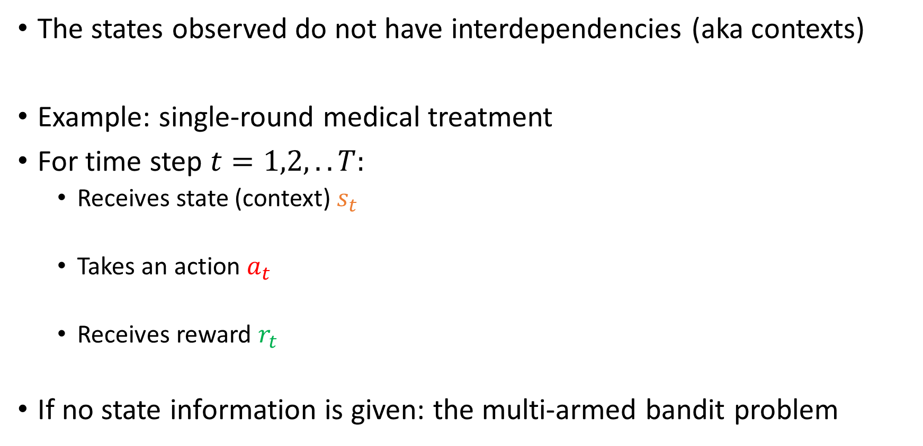


Important special case: online (contextual) bandit learning
The states observed do not have interdependencies (aka contexts)
Example: single-round medical treatment
For time step $t=1,2,..T:$
  Receives state (context) $s_{t}$
  Takes an action $a_{t}$
  Receives reward $r_{t}$
If no state information is given: the multi-armed bandit problem
$$s_{t}$$
$$s_{t+1}$$
$$a_{t}$$
$$a_{t+1}$$
$$r_{t}$$
$$r_{t+1}$$
Patient
Learner
Patient

Slide 5

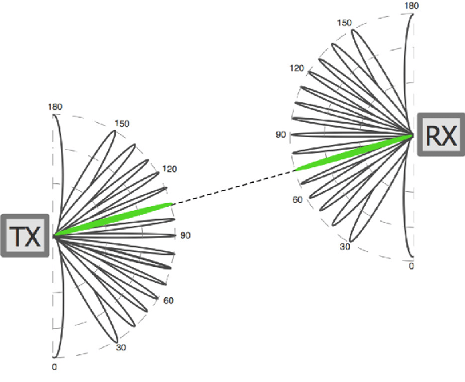
More applications of online bandit learning
Product recommendation
  State: user profile
  Action: product
  Reward: user purchase / clickthrough
Wireless communication
  State: none
  Action: transmitter & receiver configurations
  Reward: received energy
https://arxiv.org/pdf/1909.03313.pdf

Slide 6
More applications of reinforcement learning
Can you think of applications that fits into the RL framework, but not the contextual bandits framework?
RL
Contextual bandits
Multi-armed bandits

Slide 7

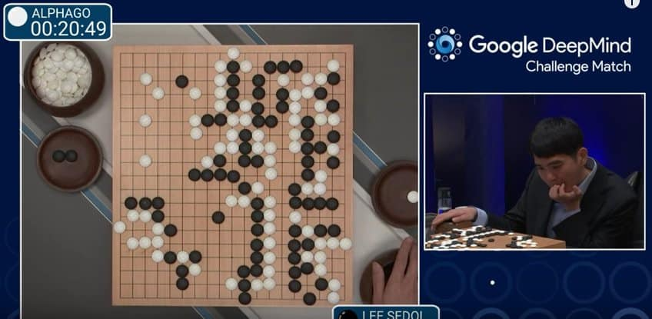

More applications of reinforcement learning
Robot arm manipulation
Game playing
Conversational assistant
  (e.g. RL from Human Feedback in training ChatGPT)
autonomous driving,
…

Slide 8
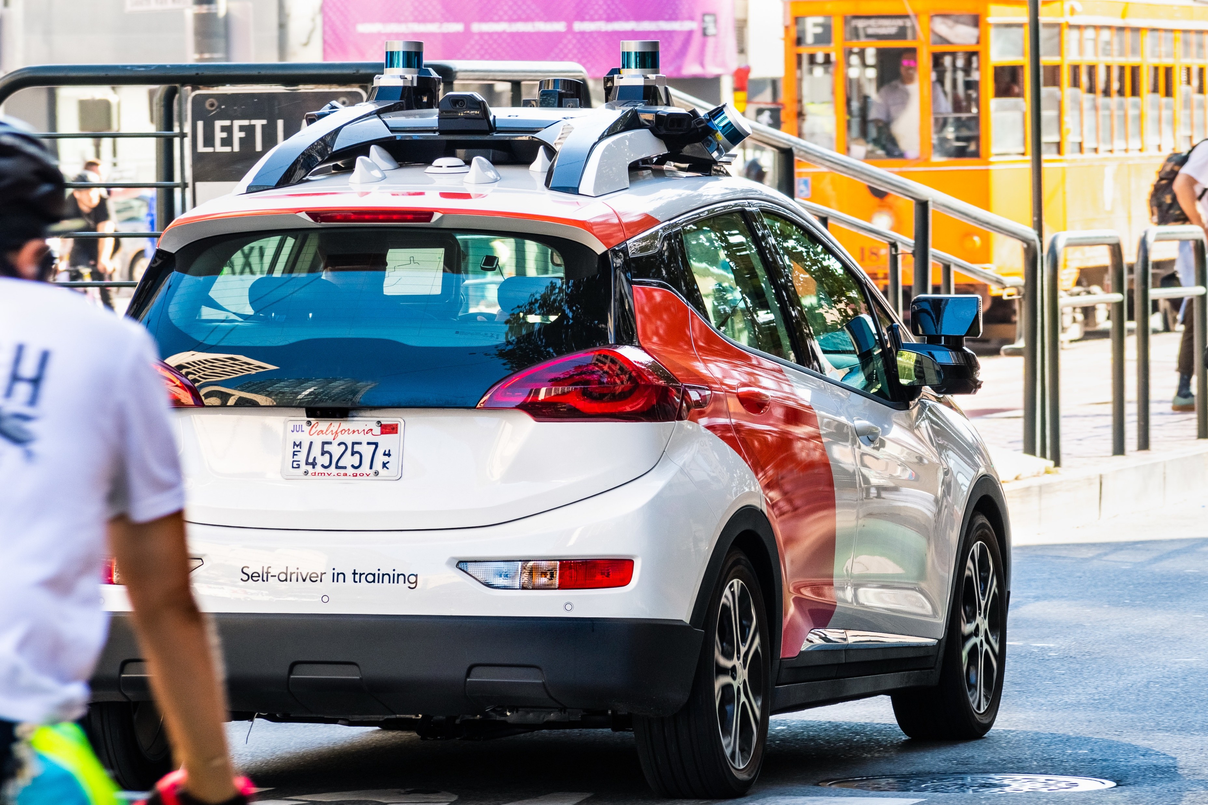
What this course is about
Study the design and analysis of bandit & RL algorithms with formal performance guarantees, using rigorous mathematical tools
Key performance measures:
  Online regret
  Sample complexity
  Computational complexity
This course will not cover deep reinforcement learning, an important topic on its own
Assignments will mostly be proof-based; no programming assignments

Slide 9
Topics covered
Part 1: lectures
  Basic tools: concentration inequalities; full-information online learning
  Bandits
    multi-armed bandits, linear / nonlinear bandits
    advanced algorithms: reduction to online regression; posterior sampling
  RL
    Markov Decision Processes (MDPs) and planning
    RL with a generative model (simulator)
    Online RL: tabular and function approximation settings
    (Time permits): policy optimization, offline RL, ..
Part 2: student presentations
  (Your choice of bandit RL theory paper, from the course website, or upon my approval)

Slide 10
Prerequisite knowledge
Basic multivariate calculus
Linear algebra
Probability
Basic programming
Additional knowledge that can be useful (not strictly required):
  Reinforcement learning
  Machine learning theory
  Statistics
  Algorithm design & analysis
  Optimization
  Stochastic processes
  …

Slide 11
Evaluation
Homework: 30% (two HWs)
Class participation: 15%
  show up in class on time
  give presentation feedback to your classmates (I will distribute the forms)
Scribe note taking: 10% (in LaTeX, will not be graded but will be given credit)
Paper presentation: 45%
See more details in the syllabus

Slide 12
Paper presentation
You can do a whiteboard presentation or use slides
Required: meet with me >=1 week in advance of your presentation; bring your full draft slides / notes
Your presentation (ideally) should cover the following aspects:
  Problem setup: What problem does this paper try to solve?
  Motivation: Why is the problem relevant?
  Related work: Prior to this paper, what other approaches have been proposed for this problem? What are their limitations?
  Proposed approach: What’s the new approach in this paper? Does it overcome the limitations in prior work?
  Limitations & future work: Do you see any limitations of this paper?
Related: “Heilmeier Catechism”

Slide 13
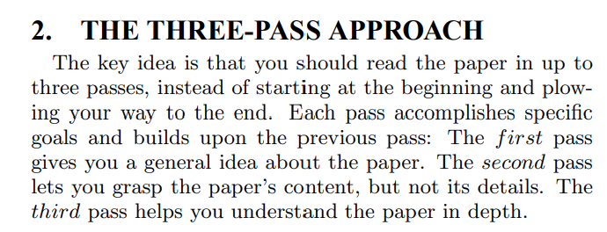
Paper presentation: best practices
Choose a relevant bandit / RL theory paper you like
  Start with the ideas on the course website (under construction)
  Long and technical papers? Try reading it in different passes with different levels of detail
    S. Keshav “How to read a paper”
  A lot of times you may need to figure out technical details omitted in the paper, to fully understand it
    Think about these as “mini-exercises”
    I recommend R. O’Donnell “Street Fighting Mathematics”

Slide 14
Paper presentation: best practices
Clarity
  Make sure your problem setup is clearly defined
  Avoid presenting unnecessary technical details – present core algorithm / analysis
  Perhaps surprisingly (?), preparing a short and to-the-point presentation can take much longer time (and deeper understanding) than preparing a long and unfocused one
See https://zcc1307.github.io/courses/csc696fa23/presentation.html for more suggestions on paper reading / presentation preparation

Slide 15
An overview of RL from a machine learning perspective
(largely based on slides of Nan Jiang, Chi Jin, Alekh Agarwal, Akshay Krishnamurthy, John Langford, Wen Sun)

Slide 16

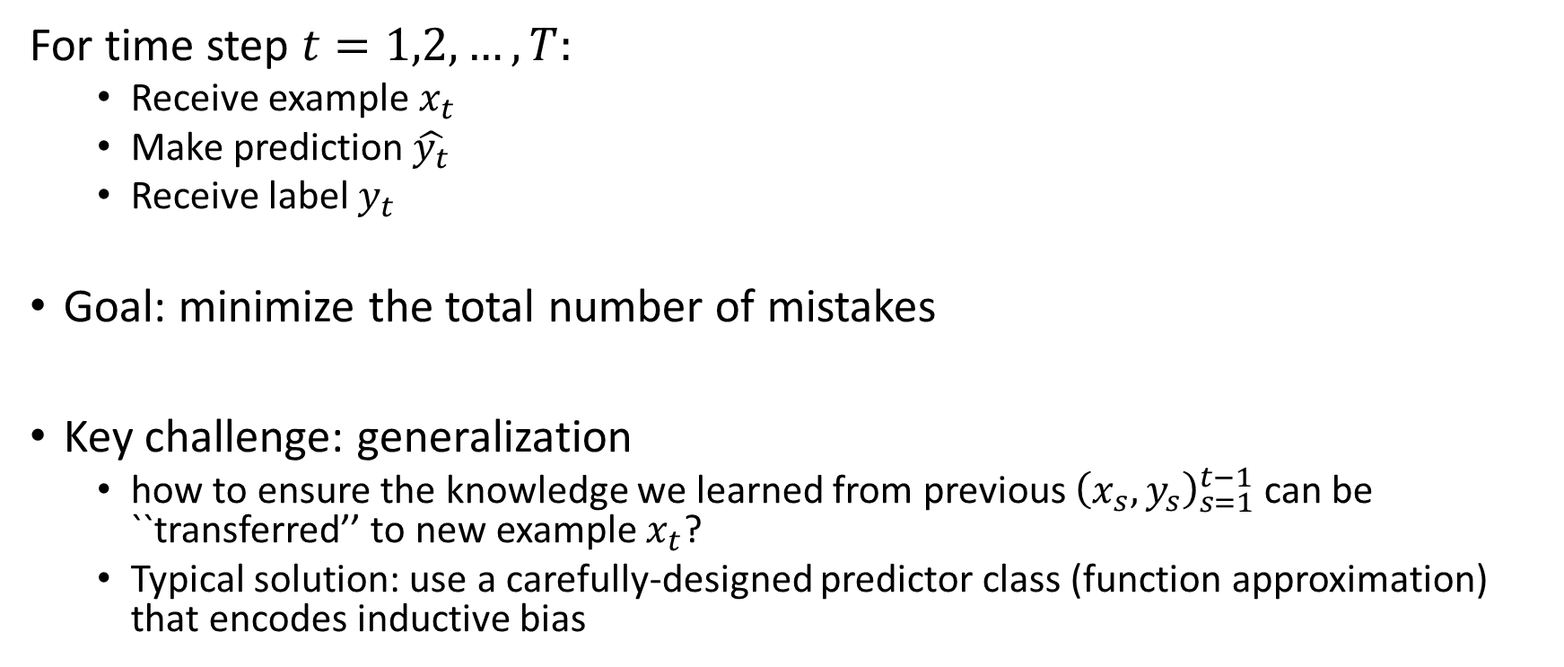
Paradigm: online supervised learning
For time step $t=1,2,…,T:$
  Receive example $x_{t}$
  Make prediction $\hat{y_{t}}$
  Receive label $y_{t}$
Goal: minimize the total number of mistakes
Key challenge: generalization
  how to ensure the knowledge we learned from previous ${\left(x_{s},y_{s}\right)}_{s=1}^{t−1}$ can be ``transferred’’ to new example $x_{t}$?
  Typical solution: use a carefully-designed predictor class (function approximation) that encodes inductive bias

Slide 17


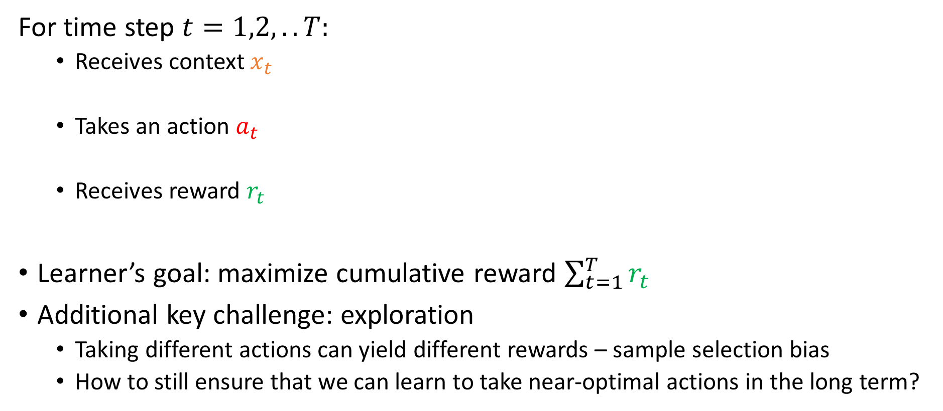


Paradigm: online bandit learning
For time step $t=1,2,..T:$
  Receives context $x_{t}$
  Takes an action $a_{t}$
  Receives reward $r_{t}$
Learner’s goal: maximize cumulative reward $\sum_{t=1}^{T}{r_{t}}$
Additional key challenge: exploration
  Taking different actions can yield different rewards – sample selection bias
  How to still ensure that we can learn to take near-optimal actions in the long term?
$$x_{t}$$
$$a_{t}$$
$$r_{t}$$
Patient
Learner
Notes:
In the intro, we’ve already seen the setup of contextual bandit learning. Let’s review it again here.
At each timestep, the learner sees a context, and takes an action based on it. For example, in news recommendation, algorithm sees a user’s profile, for example her location, browsing history, and tries to recommend a category of news that the user likes most. The learner then incurs a cost. In the news example, the cost depends on the user’s reaction to the recommendation, for example if she likes it she would click it. We also assume that each user has an underlying cost vector, which encodes the cost incurred by the learner if other possible actions are taken.
This talk, we assume that the context and cost pair is drawn from a fixed distribution. The goal of the learner is to incur low cumulative cost, or achieve best user satisfaction in the news example.
Usually there is a tradeoff

Slide 18




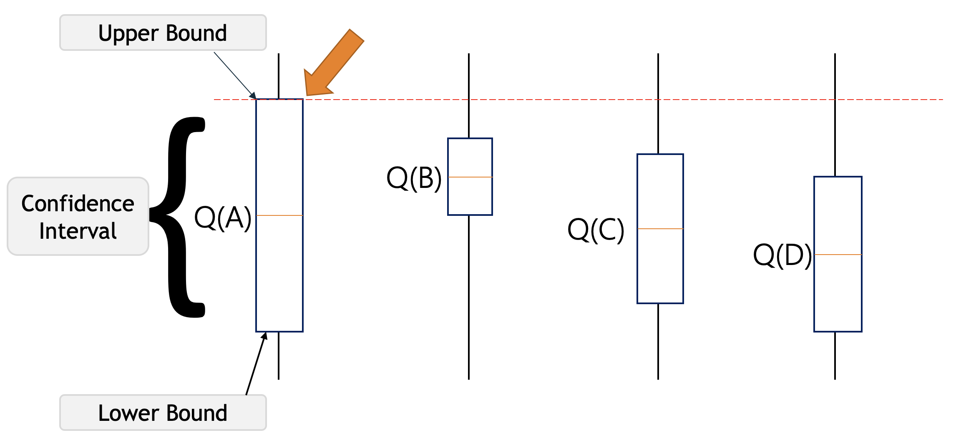
Paradigm: online bandit learning (cont’d)
Multi-armed bandits: a basic model for studying exploration-exploitation tradeoff
Example: where should I go for lunch?
Typical solution: confidence bound
based exploration

Slide 19
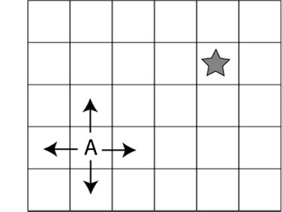
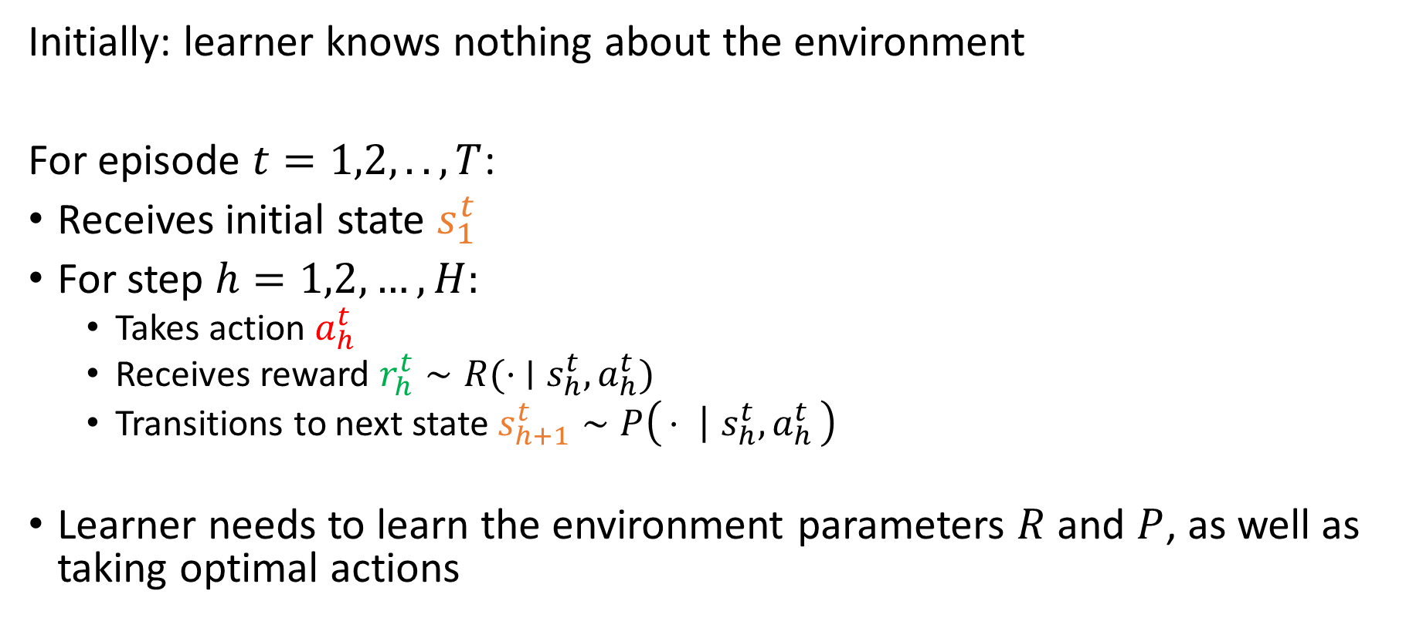
Paradigm: online episodic RL
Initially: learner knows nothing about the environment
For episode $t=1,2,..,T$:
Receives initial state $s_{1}^{t}$
For step $h=1,2,…,H:$
  Takes action $a_{h}^{t}$
  Receives reward $r_{h}^{t}∼R(⋅ ∣s_{h}^{t}, a_{h}^{t})$
  Transitions to next state $s_{h+1}^{t}∼P\left(⋅ ∣ s_{h}^{t}, a_{h}^{t}\right)$
Learner needs to learn the environment parameters $R$ and $P$, as well as taking optimal actions

Slide 20
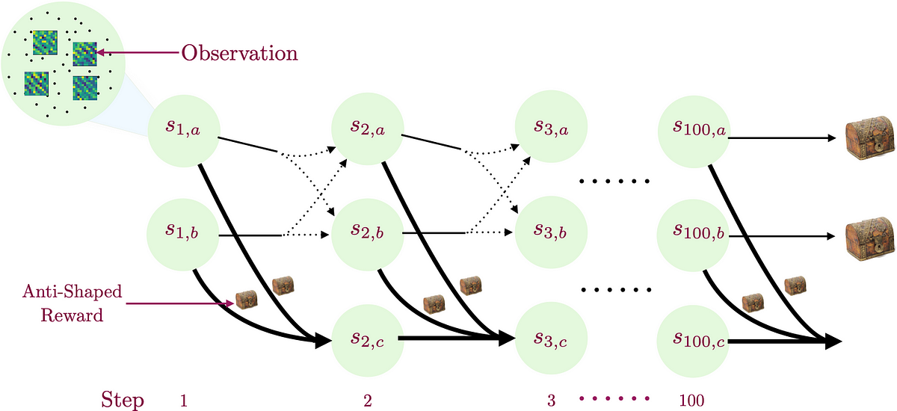

Paradigm: online episodic RL
Additional key challenge: delayed consequences
  Which action was the key reason that the agent performed badly in episode $t$?
  Immediate reward is no longer a good indicator
https://medium.com/@dipendrakumarmisra/homer-provable-exploration-in-reinforcement-learning-6a18378fddb8

Slide 21
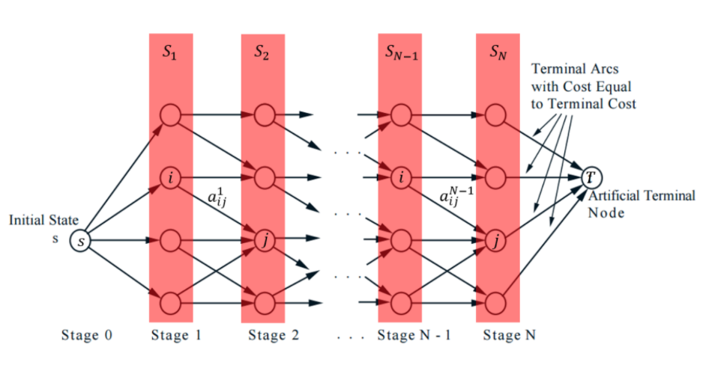
Paradigm: online episodic RL (cont’d)
Typical solution to address the delayed consequence issue:
  For each step and (state, action) pair, estimate its optimal value – the best possible expected reward one can get starting from it
  Estimate optimal values by (variants of) dynamic programming

Slide 22
Challenges in bandits and RL: summary
Generalization
General RL: tackle all three challenges simultaneously
Other challenges: imperfect information, adversary presence, …
RL with simulators,
Offline RL, ..
Contextual bandits; multi-armed bandits
Delayed consequences
Exploration
Discrete state-action
(tabular) RL

Slide 23
Thank you!

Slide 24
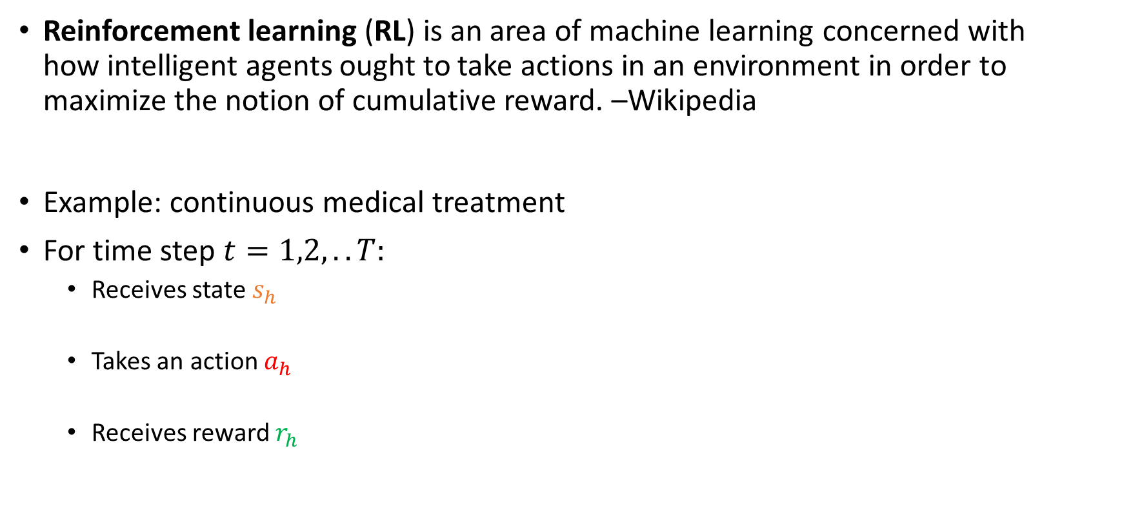
What is reinforcement learning?
Reinforcement learning (RL) is an area of machine learning concerned with how intelligent agents ought to take actions in an environment in order to maximize the notion of cumulative reward. –Wikipedia
Example: continuous medical treatment
For time step $t=1,2,..T:$
  Receives state $s_{h}$
  Takes an action $a_{h}$
  Receives reward $r_{h}$
$$s_{t}$$
$$a_{t}$$
$$r_{t}$$
Patient
$$s_{t+1}$$
Learner
……

