Slide 1
Online Learning in Unknown Markov Games
Authors:
Presenter: Zhiwu Guo

Slide 2
Motivation
Sequential decision making in a multi-player environment
Start with two play for simplicity: we & an opponent
Why is the problem difficult?
The environment is unknown to us
The opponent is potentially adversarial against us
The opponent’s actions are unknown to us

Slide 3
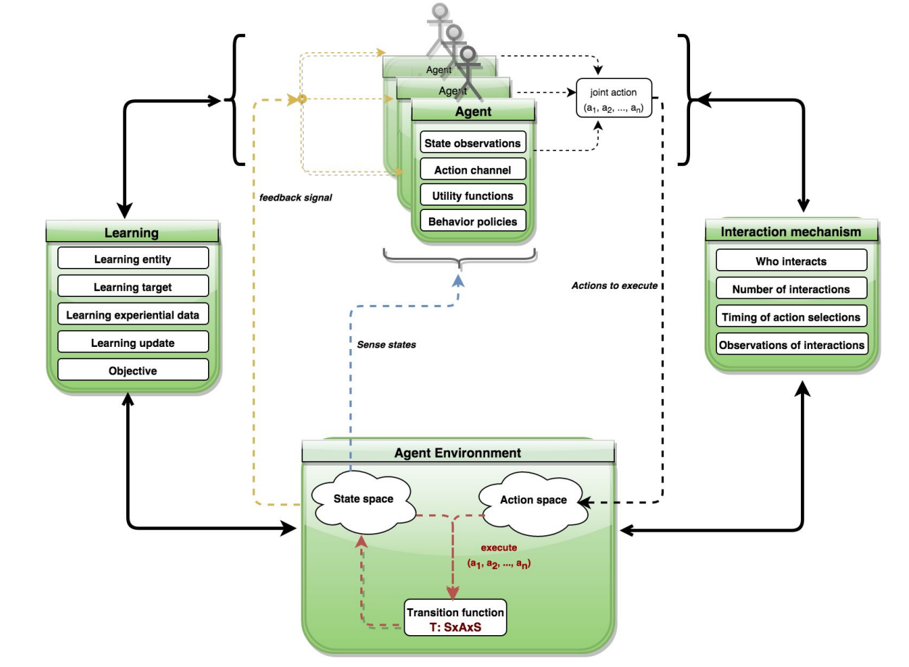
Multi-Agent Learning
General setup

Slide 4
Recap: Markov Models
 | No Agents | Single Agent | Multiple Agents
State Known | Markov Chain | Markov Decision Process (MDP) | Markov Game (a.k.a. Stochastic Game)
State Unknown | Hidden Markov Model (HMM) | Partially-Observable Markov Decision Process (POMDP) | Partially-Observable Stochastic Game (POSG)

Slide 5
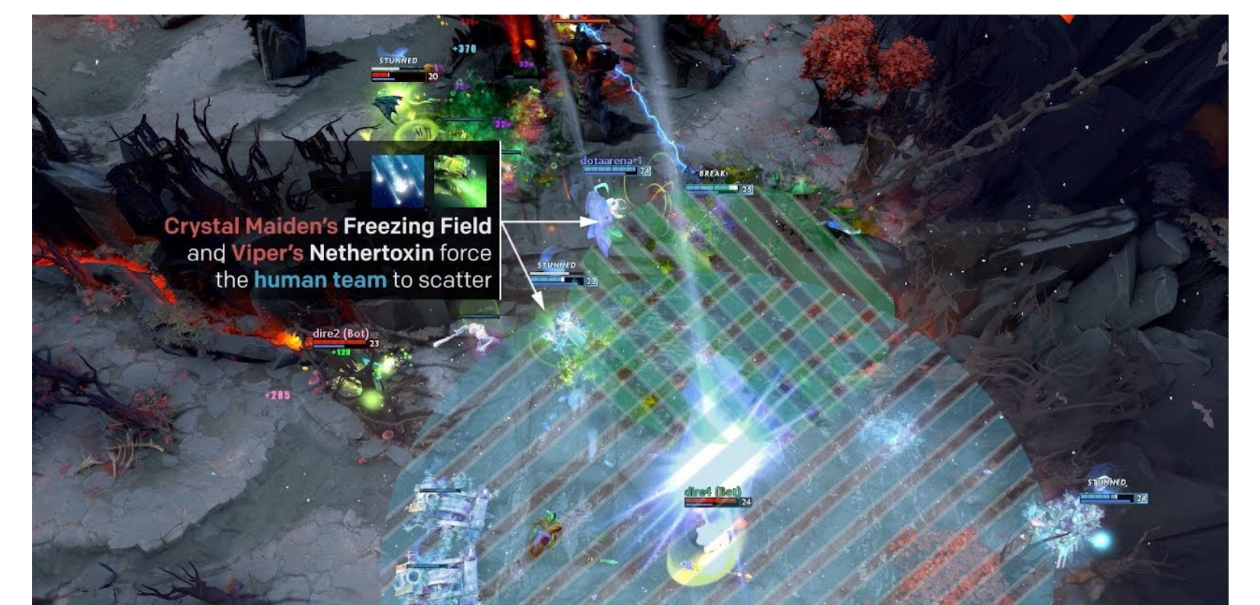
Multi-Agent RL Application: Dota 2
Dota 2 AI agents are trained to coordinate with each other to compete against humans

Slide 6
Problem Setup
Episodic Markov decision process (MDP)
($H,𝒮,𝒜,ℙ,r$) # steps in an episode, state space, action space, transition, reward
Episodic two-player zero-sum MG
($H,𝒮,𝒜,ℬ,ℙ,r$) # $𝒜,ℬ$: action spaces for max-player and min-player,
$ℙ{=\{ℙ_{h}:𝒮_{h}×𝒜_{h}×ℬ_{h}→Δ(𝒮_{h+1})\}}_{h∈[H]}$
${r=\{r_{h}:𝒮_{h}×𝒜_{h}×ℬ_{h}→[0,1]\}}_{h∈[H]}$
Max-player’s policy ${μ=\{μ_{h}:𝒮_{h}→Δ(𝒜_{h})\}}_{h=1}^{H}$
Min-player’s policy $ν$ defined similarly

Slide 7
Interaction Protocol

Slide 8
Value Functions
V-func. and Q-value func.
Two operators
Bellman equations

Slide 9
Offline and Online Learning in MGs
Offline learning (self-play)
Control both players to approximate Nash equilibrium (NE)
NE/Minimax thm.: $\max_{μ}\min_{ν}V_{h}^{μ,ν}(s)=\min_{ν}$ $\max_{μ}$ $V_{h}^{μ,ν}(s)$ $=V_{h}^{∗}(s)$
Online learning
Control only max-player; min-player changes policy arbitrarily
Informed v.s. unknown: observe min-player’s actions or not
This paper

Slide 10
Two Questions for Unknown MGs
Regret: often used as a performance measure in online learning
How much we miss compared with “best” response
Question 1: Is sublinear (in the #episodes) regret achievable?
Question 2: Can regret be independent of #opponent’s actions?

Slide 11
Related Work
Self-play
Goal: To find $ε$-approximate Nash equilibrium within $K$ episodes
Q-SP(Bai et al., 2020) achieves
V-SP (Bai et al., 2020) achieves the best existing result
Online MGs
Informed setting
Xie at al., (2020) achieves
Q-OL (adopted from Q-SP) achieves (Appendix C in this paper)
Unknown setting
No regret analysis yet
Dependence on $B$

Slide 12
“Strong” v.s. “Weak” Regret
“Strong” regret: compete against best fixed policy in hindsight
“Weak” regret: compete against NE value
The first result in this paper(lower bound for “strong regret”):
There exists an MG for which the “strong” regret is at least linear in #episodes.

Slide 13
Regret Independent of #Opponent’s Actions
The second result in this paper (upper bound for “weak regret”):
With proper choice of hyperparameters, Nash V-learning achieves
$S≔\left|𝒮\right|$ $A≔\left|𝒜\right|$
Nash V-learning
Originally proposed in (Bai, Jin, Yu, NeurIPS’20) for self-play
Incremental learning of V-func. (similar with Q-func. in Q-learning)
Online: learn much more aggressively (via hyperparameters.)

Slide 14
Contributions Recap
There exists an MG for which the “strong” regret is at least linear in #episodes.
First sublinear regret for unknown MGs
First regret independent of #opponent’s actions for online MGs
Extended to multi-player MGs

Slide 15
Technical Details

Slide 16
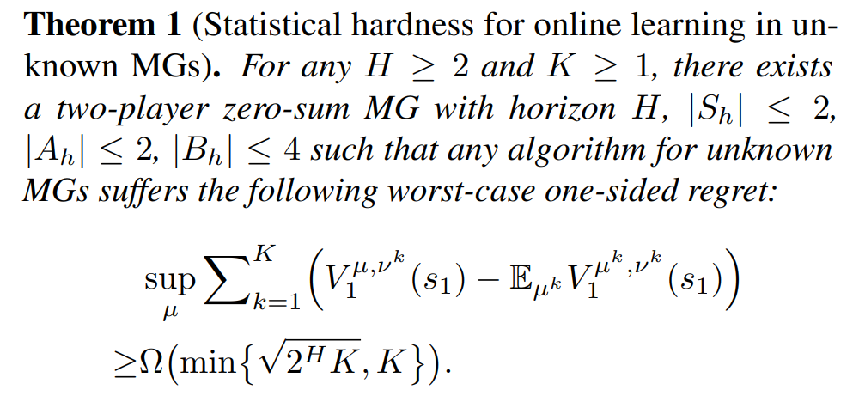
Statistical Hardness
Competing against the best policy in hindsight is statistically intractable
the regret has to be either linear in $K$ or exponential in $H$
Any algorithm has to suffer linear regret unless $K≥Ω(2^{H})$

Slide 17
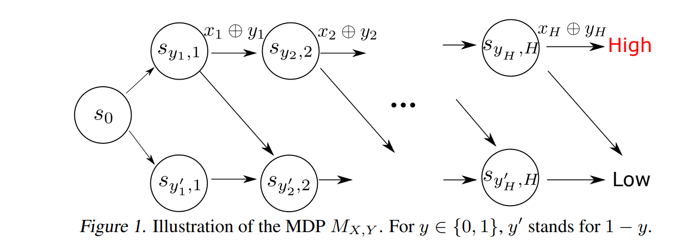
Proof Sketch of Statistical Hardness
Inspired by “combination lock”
Achieve high reward requires guessing every bit of $X$ correctly
The problem as hard as multi-armed bandit problem with $2^{H}$ arms.

Slide 18
Proof Sketch of Statistical Hardness (Cont.)
Reduce adversarial MDP problem to online learning in unknown MG
The state and action space for the max-player the same as MDP
Min-player controls transitions and reward such that the induced MDP for the max-player is the same as $M_{X,Y}$
Min-player reproduces all the possible transitions in original MDP

Slide 19
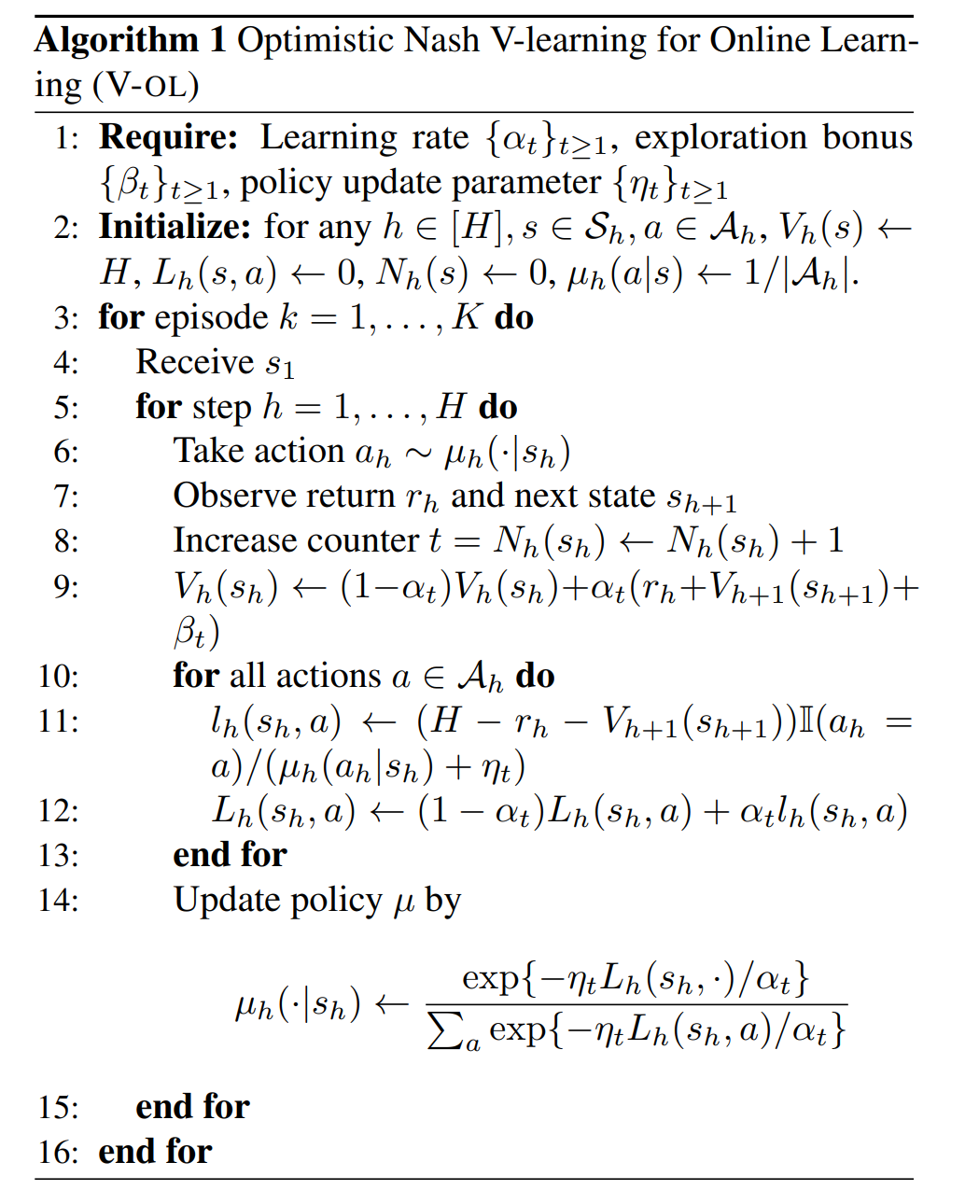
Nash V-learning
Remarks
Avoids learning Q-table
Based on this, authors derived the
first regret that does not depend
on opponents’ action space
Hyperp.
V-func.
Loss
Policy

Slide 20
Intuition of V-learning
Favoring more recent samples
$ι$ is log factor
$G≥1$, learn more aggressively
V-learning for self-play (V-SP) | Online V-learning for unknow MGs(V-OL)

Slide 21
Comparison between V-OL and V-SP
Hyperparameters choices
V-SP may suffer linear regret in #episodes
Subprocedure for resampling in V-SP
V-OL only needs $O\left(HSA\right)$ space instead of $O(HSAK)$
Proof structure in V-SP does not hold in V-OL
V-OL also works in multi-player general-sum MGs

Slide 22
Regret Bound for V-OL
If $G=1$, the regret in (4.2) will be useless
Sublinear regret is achievable

Slide 23
Proof Procedures of Theorem 2
Upper confidence bound (UCB) property is satisfied.
Ensure $V_{h}^{k}$ is an entrywise UCB on $V_{h}^{∗}$
Regret bounds analysis

Slide 24
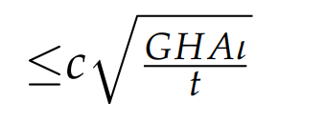
V-learning Lemma
Where
Proof sketch
Azuma-Hoeffding inequality and properties about $α_{t}^{i}$
Term(1):Sum of weighted${ V}_{h}^{μ^{∗},ν}$
Term(2):$V_{h}^{k}(s)−\sum_{i=1}^{t}{α_{t}^{i}β_{i}}$
$$k^{1}$$
$$k^{2}$$
…
$$k^{t}$$
1
2
3
4
5
6
…
$k$ (episode ind.)
Term(3)
Upper bound term (1) –term(3)
,with

Slide 25
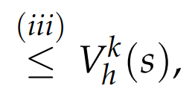
Upper Confidence Bound Lemma
Proof sketch
Backward induction: $V_{h+1}^{∗}≤V_{h+1}^{k}⇒V_{h}^{∗}≤V_{h}^{k}$
induction assumption
V-learning lemma

Slide 26
Regret Bound for V-OL
Sublinear regret is achievable

Slide 27
Proof of Regret Bound
By definition of $V_{h}^{k},V_{h}^{μ^{k},ν^{k}}$
$V_{h}^{k}\left(s\right)=$
Subtract and add same term
Azuma-Hoeffding inequality:

Slide 28
Proof of Regret Bound (Cont.)
By the same regrouping technique as that in (Jin et al., 2018)
To bound
Sum over $[K]$

Slide 29
Proof of Regret Bound (Cont.)
With technique in (Jin et al., 2018)

Slide 30
Proof of Regret Bound (Cont.)
If we take $G=1$ as in V-SP, the regret is linear in $K$ and therefore useless. That is the reason why V-OL introduces a tunable parameter $G≥1$
Two choices of $G$ to balance $\sqrt{K}$and $K$, both of G choices $≥1$

Slide 31
Multi-player General-sum Games
$m$-player general-sum MG : ${MG}_{m}(𝒮,{\left\{𝒜_{i}\right\}}_{i=1}^{m},ℙ,{\left\{r_{i}\right\}}_{i=1}^{m},H)$
${ 𝒜}_{i}=∪_{h∈[H]}𝒜_{i,h}$ # action space of player $i$
$r_{i}{=\{r_{i,h}:𝒮_{h}×⊗_{i=1}^{m}𝒜_{i,h}→[0,1]\}}_{i=1}^{m}$ # return func. of player $i$
$ℙ={\{ℙ_{h}:𝒮_{h}×⊗_{i=1}^{m}𝒜_{i,h}→Δ(𝒮_{h+1})\}}_{h∈[H]}$ # transition
Suppose we are player 1
$${MG}_{m}$$
Indistinguishable
($H,𝒮,𝒜_{1},ℬ,ℙ,r_{1}$),$ℬ=⊗_{i=2}^{m}𝒜_{i}$

Slide 32
Summary
There exists an MG for which the “strong” regret is at least linear in #episodes.
First sublinear regret for unknown MGs
First regret independent of #opponent’s actions for online MGs
Extended to multi-player MGs (see paper for more details)

Slide 33
Thank You!

